Slide 1
Time and Effort Statements
aka
Monthly Personnel Activity Reports
Teresa Scott, Sr. Director-Grant Management & Legislative Projects

Slide 2
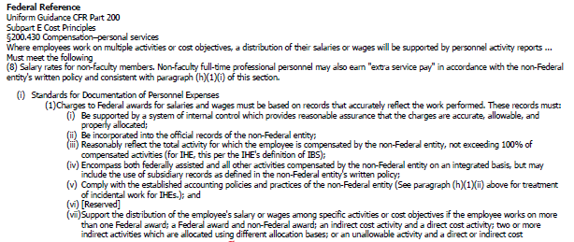
Why do we have to do this?
IT IS THE LAW!

Slide 3
Comments on the current method
Forms are confusing!
Takes too much time away from our work to complete!
What a waste of paper!
My duties won’t fit in the space!
Why can’t it be electronic?
You spoke! We listened!

Slide 4
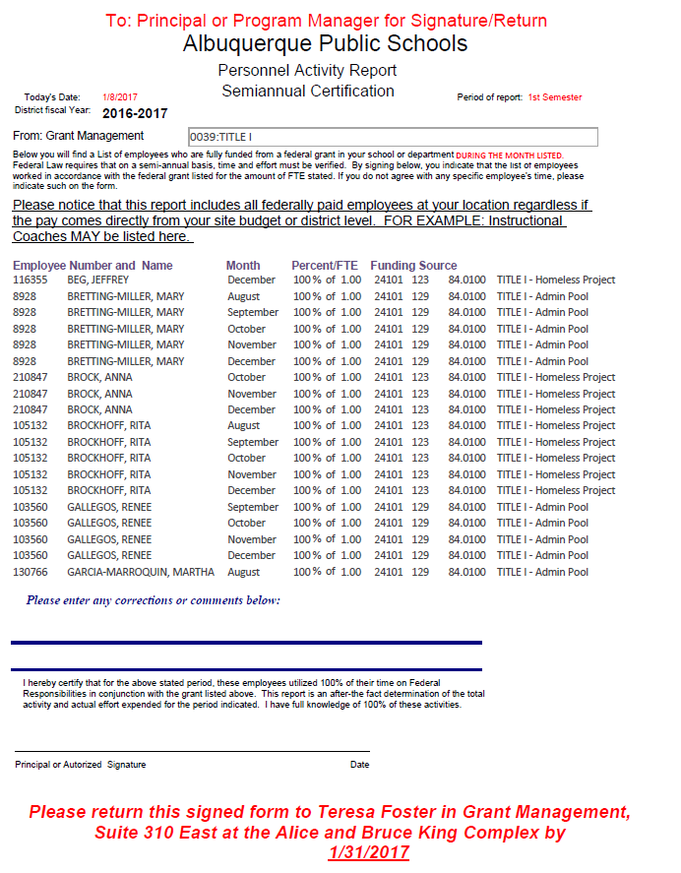
Old forms
Split funded employees
Fully funded employees
Sent out over 300 per month
Directly to employee
Sent out over 300 pages twice per year to supervisors

Slide 5
4,200 PIECES OF PAPER PER YEAR HOW MANY TREES IS THAT?

Slide 6
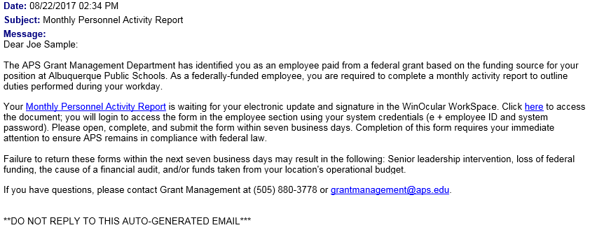
New Forms-Electronic WinOcular Workflow
Click either link to start

Slide 7
Login Screen

Slide 8
After Login
Click here to begin

Slide 9
Click here to open report

Slide 10
Top Section of Form
EXAMPLE 1
This example shows an employee paid partially with Federal Funds and partially with Operational Funds with an extended contract.
Notice the percentage adds up to 100% not 120%
.7 FTE = 58.33 (58% rounded) of 1.2 Total FTE
.5 FTE = 41.67 (42% rounded) of 1.2 Total FTE

Slide 11
Federal duties section
NOTICE:
The amounts here are for the work actually performed, they MAY NOT match the totals from the previous slide. It is still accurate because this section is for what was done, NOT what was budgeted for.
Employee fills in BLUE sections only. Most are dropdown choices

Slide 12
Non-Federal Section and Totals
Anything NOT allowed in the Federal Fund should be entered here.
This field must total 100% to submit the form

Slide 13
Signature and Submit Section

Slide 14
Click here to submit to Supervisor

Slide 15
Supervisor Section

Slide 16
Example 2: Split employee between two Federal Grants

Slide 17
Example 3: Part-time employee paid fully from Federal Grant
Notice employee was able to enter in the “other” field when duty was not available in dropdown
Notice even though the employee is only .75 FTE, the total work is 100% of that .75

Slide 18
How do you determine who gets them?
Who will get these?
Anyone paid from a Federal Grant will receive this monthly EVEN if they are fully funded—this is new from the past practice.
All employees are coded to a payment source (fund) in Infor (Lawson) determined by the supervisor of that employee.
All forms are generated from actual payments to employees each month according to where the paycheck was coded.
Any payments that post to a cost account that begins with 2401, 2406, 2499 and/or 2599 will be included.

Slide 19
How much time do we have to respond? What if I don’t think I should get the form?
Seven Days
Fill in the form and submit it anyway, because your paycheck DOES reflect Federal Funding.
Talk to your supervisor to find out why you are coded to this fund
If there is an error, the supervisor should note it in the comments during their review of the form and send in a current ERF (Employee Request for Change form)
You are always welcome to email us with your concerns at GrantManagement@aps.edu be sure to add your name and employee # in emails.

Slide 20
When will this start?
The data starting point is July 1, 2017.
Form distribution for July paychecks – Early September
Form distribution for August paychecks – Late September
Each month by the 10th for the preceding month’s paychecks.
For example: by October 10th for September paychecks.

Slide 21
Questions?
All Grant Management staff can be reached at:
505-880-3778 (message line only)
GrantManagement@aps.edu
Individual staff contact information at:
http://www.aps.edu/finance/grant-management-and-legislative-projects/staff-listing
Thank you!

