Slide 1



FY 2027
Budget Approval
May 6, 2026
Rennette Apodaca, Chief Financial Officer
David Vigil, Executive Director Budget and Strategic Planning

Slide 2
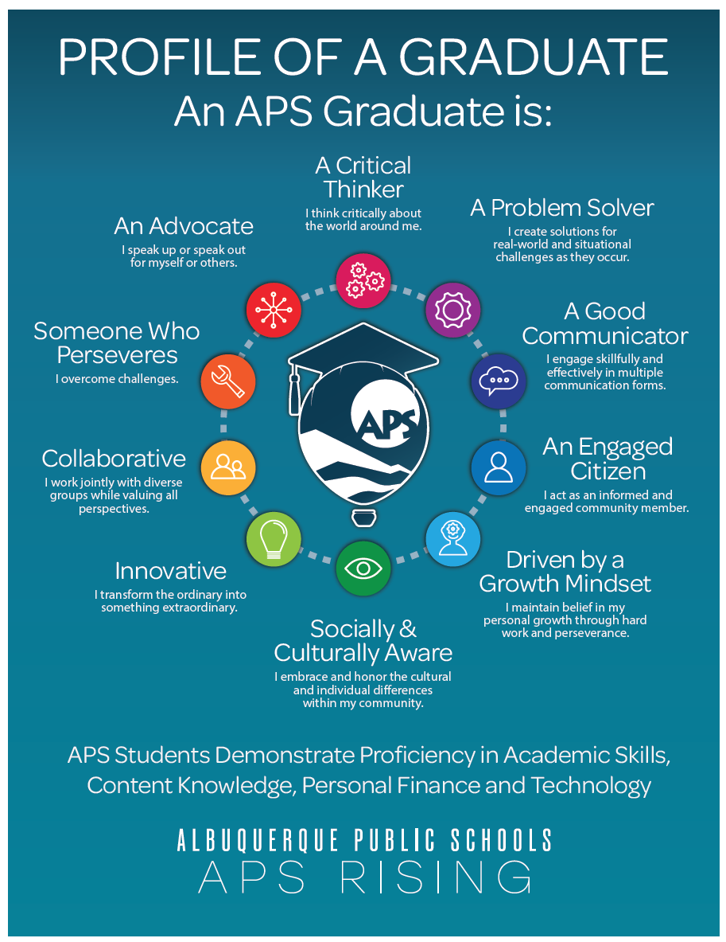
Our APS Commitment
“We commit to ensuring that these traits serve as the foundation for student success in our Elementary Commitment, Middle School Redesign, and the Academies of Albuquerque, by creating a coherent throughline of skills, habits, and mindsets from Pre-K through High School.”
2

Slide 3
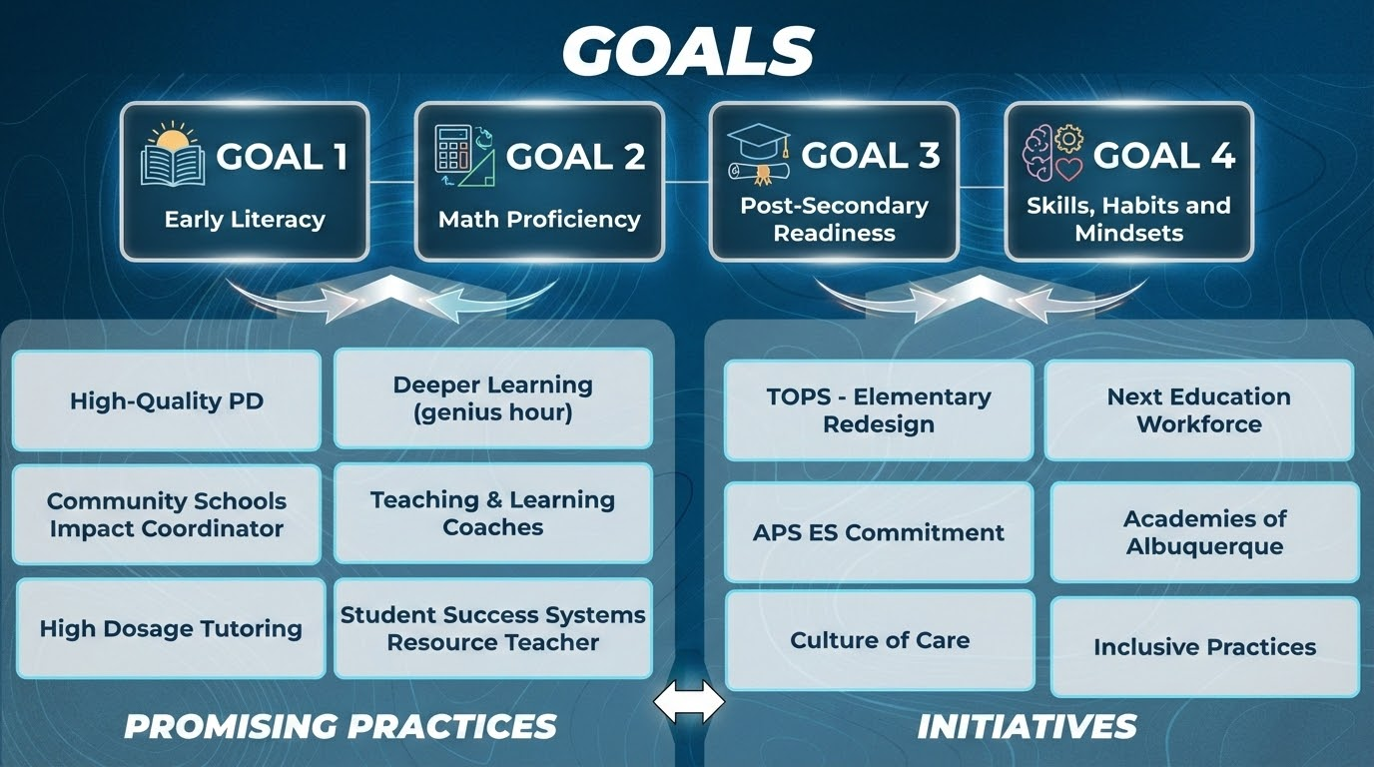
3

Slide 4
The Role of the Board of Education in Budget Governance
The Albuquerque Public Schools budget represents the culmination of months of planning, engagement, and alignment to district priorities. It is both a financial plan and a reflection of our shared commitment to student success.
The Board of Education’s role is one of governance and stewardship. While the Board does not manage day-to-day financial decisions, it ensures that the superintendent’s proposed budget reflects the community’s vision and the Board’s adopted goals and guardrails. The Board approves the budget only when it is confident that resources are aligned to support improved outcomes for all students, as part of the process for submission to the New Mexico Public Education Department for final review and approval.
The Board reviews the budget through a strategic lens:
Does this budget clearly prioritize our goals?
Is there clear evidence that the guardrails are being honored?
What is the logic from outcomes to outputs to inputs?
What is being added, continued, increased, decreased, or eliminated?
How much is being invested toward each goal, and how is that changing over time?
To maintain its governance role, the Board does not engage in line-item management or rewrite the budget. If alignment is not clear, it sends the proposal back for revision, preserving its ability to hold the superintendent accountable for results.
Once approved, the Board delegates authority to the superintendent to implement the budget, then monitors progress and evaluates outcomes to ensure investments lead to meaningful gains in student achievement and well-being.
In this way, the budget becomes more than a plan; it becomes a commitment to results, guided by the community and overseen by the Board.
4

Slide 5
Guiding Principles
Student Outcomes
Increase Student Outcomes
Goals and Guardrails
Alignment to Board of Education Goals
Honoring Board of Education Guardrails
Voice of the Community
Board of Education Community Meetings – 10/20/25 & 10/27/25
Meet Student Needs
Community and Staff Budget Survey – 5,300 Responses
Be a Leader Student Budget Presentation – October 2025
School Instructional Councils – Budget Process
5

Slide 6
Budget Timeline
Activity | Date
FY 2027 Budget Calendar Presented to the Board (action) | Sept 3, 2025 (BOE Meeting)
Begin Preparation of Budget Presentation Template | September 2025
Community Survey | Sept 30 - Oct 12, 2025
Community Meetings | October 20 and 27, 2025
Begin Preparation of Financial Assumptions for FY27 | October 2025
Fixed Cost and Insurance Estimate to PED | November 2025
Review of LEFC and LFC Outlook Data | December 2025
Receive Student Enrollment Projections for FY27 | December 2026
Begin Building Budget Call Templates | December 2025
Legislative Session Begins | January 20, 2026
Budget Development for Schools and Departments | Feb – April 2026
End of Legislative Session | February 19, 2026
Legislative Update | March 4, 2026
Program Area Presentations: Food Nutrition, Transportation, Capital | March 4, 2026
Program Presentations: Special Education | March 18, 2026
PED Spring Budget Workshop | March 18 – 20, 2026
Program Presentation: Fed/State Programs, Operational | April 15, 2026
FY 2027 SEG Revenue Projections Presented to the Board | April 15, 2026
FY 2027 Final Budget Presented to the Board (action) | May 6, 2026
Budget Submission to PED | May 20, 2026
6

Slide 7
FY 27 Budget Highlights: HB-2 and Operational Fund
2026 Regular Legislative Session Updates – Funding included in SEG (State Equalization Guarantee)
SB 151 – 1% Salary increase for school district employees
HB47 – 80% of insurance premiums to be paid by employer, 20% by employee, requires APS to participate in the NM Public School Insurance Authority beginning in July 2027
HB 2 – provides the following, all in SEG Funding: Funding for teacher mentorship, ed. plans, literacy, CTE, & community school framework Instructional Materials, including dual credit materials and educational technology Sufficient funding to provide a minimum hourly wage of $15 Sufficient funding for free menstrual products in schools
District Highlights
1% Salary increase for school district employees is estimated to cost $6.2M
80% of insurance premiums to be paid by APS is estimated to cost $35M, $29M of which is attributable to SEG – Operational Fund
Declining Enrollment – The district declined by 2560 students from School Year 2024-2025 to 2025-2026. The result is a decrease of approximately $40M in SEG Operational Funding.
FY26 SEG: $1.015B FY27 SEG: $1.019B
7

Slide 8
2026-2027 Operational Fund Budget Summary
Revenues | Amount
SEG | $ 1,019.5
Other Revenue | $ 15.0
Impact aid | $ 0.3
Ad Valorem | $ 6.5
Total Revenues | $ 1,041.3
Expenditures | Amount
Schools | $ 780.1
Departments | $ 165.2
District Wide | $ 112.1
Total Expenditures | $ 1,057.4
Surplus (Deficit) | $ (16.1)
FY26 EOY Projected Fund Balance | $ 73.9
FY27 Projected Fund Balance (Reserve Requirement Met) | $ 57.8
Reserve Requirement | $ 52.9
Current as of April 2026; subject to change
8

Slide 9
Budget for Albuquerque Public Schools
All Funding Sources Including Reserve
$2,348,869,726
9

Slide 10
Operating Budget by Account
Account Group | FY2026 | FY2027
Compensation and Employee Benefits | 1,004,228,314 | 1,065,870,004
Professional and Technical Services | 66,010,454.09 | 77,675,925.51
Property Services | 632,776,652.39 | 694,275,606.00
Other Purchased Services | 93,021,867.42 | 61,873,088.04
Supplies | 143,286,296.61 | 112,433,688.12
Property | 29,942,156.24 | 37,719,038.76
Debt Service | 203,183,081.00 | 215,485,137.00
Restricted Expenditures | 78,500,000.00 | 83,537,239.00
Total | $ 2,250,948,822.00 | $ 2,348,869,726.34
10

Slide 11
Operating Budget by Function
Function Name | FY2026 | FY2027
Instruction | 786,714,624.85 | 799,809,231.86
Support Services - Students | 157,847,096.64 | 200,840,765.89
Support Services - Instruction | 42,886,055.60 | 44,338,624.29
Support Services - General Administration | 15,346,422.12 | 15,233,257.00
Support Services - School Administration | 68,292,717.67 | 66,979,831.44
Central Services | 62,290,918.76 | 54,487,264.87
Operation & Maintenance of Plant | 123,274,016.78 | 113,744,889.00
Student Transportation | 32,208,935.78 | 28,425,588.00
Other Support Services | 187,662.00 | 140,201.00
Food Services Operations | 93,196,958.99 | 90,536,764.00
Capital Outlay | 665,814,033.81 | 728,541,194.00
Debt Service | 202,889,379.00 | 205,792,115.00
Total | $ 2,250,948,822.00 | $ 2,348,869,726.34
11

Slide 12
APS Full Time Equivalent Totals
12

Slide 13
Operational Fund Cash Reserves ($M)
13

Slide 14
2026-2027 Budget Resolution Comparison
Fund | 2025-26 Amount | 2026-27 Amount
Operational | 1,081,700,000 | 1,153,432,113
Impact Aid | 490,943 | 983,892
Forest Reserve/Ad Valorem | 9,669,917 | 11,203,417
Student Transportation | 24,558,813 | 23,962,400
Food and Nutrition Services | 79,269,796 | 77,648,356
Universal Free Lunch (State Funded) | 15,392,967 | 15,392,967
Athletics | 1,504,094 | 1,410,694
Activities | 19,004,359 | 19,553,019
Federal Grants | 114,478,835 | 75,801,492
State and Local Grants | 30,821,606 | 22,958,258
General Obligation Bonds | 209,933,164 | 267,695,522
Special Capital Outlay-Federal | 14,363,035 | 2,572,946
Special Capital Outlay-State | 22,633,234 | 24,345,516
Special Capital Outlay-Local | 34,941,445 | 44,247,461
Special Capital Outlay | 7,422,113 | 11,867,472
House Bill 33 | 235,962,065 | 251,980,580
Senate Bill 9 | 108,214,977 | 98,556,977
Educational Technology Equipment | 26,462,975 | 27,801,923
General Obligation Bonds Debt Service | 204,958,371 | 207,861,107
Enterprise Fund - KANW Radio Station | 1,615,658 | 1,733,964
Enterprise Fund - Graphics Enterprise Services | 1,701,777 | 1,744,282
Enterprise Fund - Charter School Business Services | 128,386 | 123,672
Enterprise Fund - Transportation Enterprise Fund | 3,812,557 | 4,427,288
Enterprise Fund - Facilities Enterprise Fund | 1,846,058 | 1,512,465
Enterprise Fund - Technology Professional Development | 61,677 | 51,943
Total All Funds | $ 2,250,948,822 | $ 2,348,869,726
14

Slide 15
2026-2027 Budget Resolution
BE IT RESOLVED by the Board of Education of Albuquerque Schools, subject to any technical adjustments by APS and the Public Education Department and approval by the Public Education Department of the State of New Mexico, that the amounts shown in the following schedule be appropriated to each fund as specified for the ensuing fiscal year beginning July 1, 2026, and ending June 30, 2027.
Fund | 2026-27 Amount
Operational | 1,153,432,113
Impact Aid | 983,892
Forest Reserve/Ad Valorem | 11,203,417
Student Transportation | 23,962,400
Food and Nutrition Services | 77,648,356
Universal Free Lunch (State Funded) | 15,392,967
Athletics | 1,410,694
Activities | 19,553,019
Federal Grants | 75,801,492
State and Local Grants | 22,958,258
General Obligation Bonds | 267,695,522
Special Capital Outlay - Federal | 2,572,946
Special Capital Outlay - State | 24,345,516
Special Capital Outlay - Local | 44,247,461
Special Capital Outlay | 11,867,472
House Bill 33 | 251,980,580
Senate Bill 9 | 98,556,977
Educational Technology Equipment | 27,801,923
General Obligation Bonds Debt Service | 207,861,107
Enterprise Fund - KANW Radio Station | 1,733,964
Enterprise Fund - Graphics Enterprise Services | 1,744,282
Enterprise Fund - Charter School Business Services | 123,672
Enterprise Fund - Transportation Enterprise Fund | 4,427,288
Enterprise Fund - Facilities Enterprise Fund | 1,512,465
Enterprise Fund - Technology Professional Development | 51,943
Total All Funds | $ 2,348,869,726
15

Slide 16
Albuquerque Public Schools Authorized Charter Schools – FY 27 Budget Projections
Name of Charter School | Student Enrollment: Budget has been based on the average of the MEM on 80 and 120 reporting dates 2025-26 | Operational Budget: Ensure that the Charter school's operating budget is within the allotted resources | 2% Administrative Fee | Parental Notification: Ensure that parental involvement in the budget process was solicited in preparation of the budget
ABQ Charter Academy | 377 | $5,943,867.84 | $118,877.36 | Yes
ACE Leadership | 280.5 | $4,052,111.20 | $81,042.22 | Yes
Albuquerque Institute for Mathematics & Science | 319.5 | $4,096,400.92 | $81,928.02 | Yes
Albuquerque Talent Development | 151.5 | $2,919,579.00 | $58,391.58 | Yes
Alice King Community School | 344.5 | $5,667,716.00 | $113,354.32 | Yes
Christine Duncan's Heritage Academy | 524.5 | $10,375,838.00 | $207,516.76 | Yes
Cien Aguas International School | 420.5 | $6,555,024.04 | $131,100.48 | Yes
Coral Community Charter | 189.5 | $3,319,273.10 | $66,385.46 | Yes
Corrales International School | 210.5 | $3,365,543.93 | $67,310.88 | Yes
Digital Arts and Technology Academy | 305 | $3,889,424.98 | $77,788.50 | Yes
East Mountain High School | 436 | $7,441,250.74 | $148,825.01 | Yes
El Camino Real Academy | 329 | $5,502,996.00 | $110,059.92 | Yes
Gilbert L. Sena Charter | 172.5 | $3,104,220.67 | $62,084.41 | Yes
Gordon Bernell Charter | 188 | $3,444,686.51 | $68,893.73 | Yes
Health Leadership High School | 246.5 | $3,343,273.53 | $66,865.47 | Yes
La Academia De Esperanza | 224 | $3,564,289.65 | $71,285.79 | Yes
Los Puentes Charter School | 148.5 | $2,727,569.00 | $54,551.38 | Yes
Mark Armijo Academy | 223 | $3,475,808.00 | $69,516.16 | Yes
Montessori of the Rio Grande | 216 | $2,975,187.64 | $59,503.75 | Yes
Mountain Mahogany Community School | 218.5 | $3,653,162.00 | $73,063.24 | Yes
Native American Community Academy | 446.5 | $7,091,222.51 | $141,824.45 | Yes
New America School- NM | 113 | $1,656,756.00 | $33,135.12 | Yes
New Mexico International School | 429.5 | $6,345,643.32 | $126,912.87 | Yes
Public Academy for Performing Arts | 429 | $5,289,904.20 | $105,798.08 | Yes
Robert F. Kennedy Charter School | 296 | $4,454,101.38 | $89,082.03 | Yes
Siembra Leadership High School | 598.5 | $10,210,069.25 | $204,201.39 | Yes
South Valley Academy | 603.5 | $10,073,209.00 | $201,464.18 | Yes
Technology Leadership High School | 315.5 | $4,080,666.00 | $81,613.32 | Yes
The International School at Mesa del Sol | 258.5 | $4,320,032.59 | $86,400.65 | Yes
Note: The top of this spreadsheet shows the corresponding statutory responsibility from the APS Board in approving the charter schools’ budgets. The information presented is based on school projections and not PED-issued 910B5s.
16

Slide 17
New Mexico State Statute 22-8-6.1 Charter School Budget Submission
B. Each locally chartered charter school shall submit to the local school board a school-based operating budget for approval or amendment. The approval or amendment authority of the local school board relative to the charter school operating budget is limited to ensuring that sound fiscal practices are followed in the development of the operating budget and that the charter school operating budget is within the allotted resources. The local school board shall have no veto authority over individual line items within the charter school's proposed financial budget or over any item in the educational plan but shall approve or disapprove the operating budget in its entirety. Upon final approval of the charter school operating budget by the local school board, the individual charter school operating budget shall be included separately in the budget submission to the department required pursuant to the Public School Finance Act and the Charter Schools Act.
17

Slide 18
Thank You

