Slide 1
EveryDay Math and CCSS
Excel Unit Planner
By Alex Johnson-Jimenez
Jimenez_al@aps.edu

Slide 2
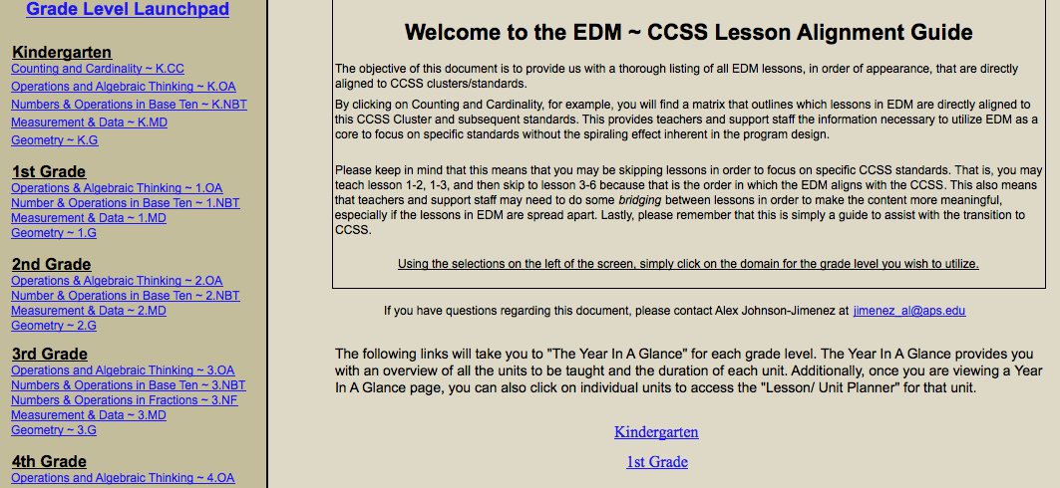
The Launchpad

Slide 3
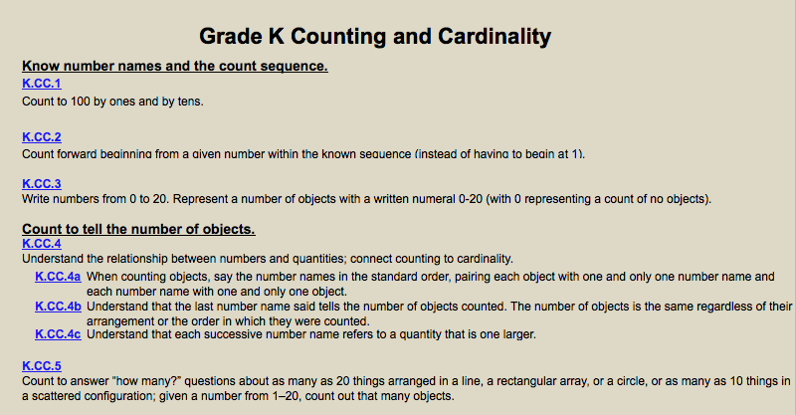
CCSS Standards

Slide 4
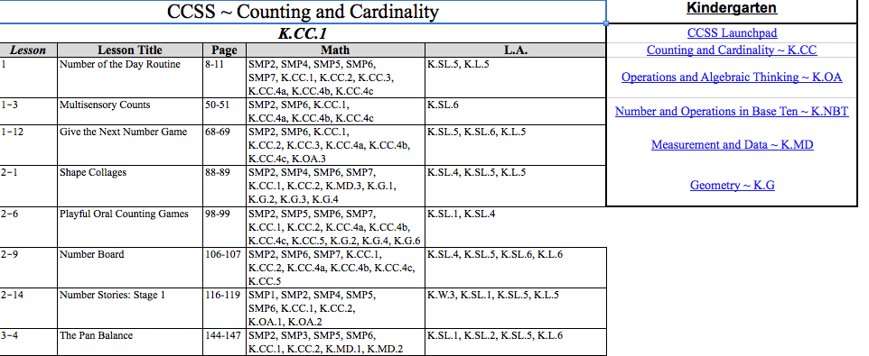
The EDM Crosswalk

Slide 5
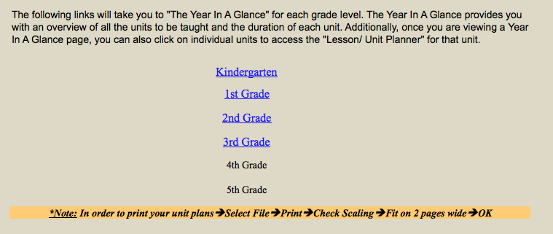
The APS Year-In-A-Glance

Slide 6
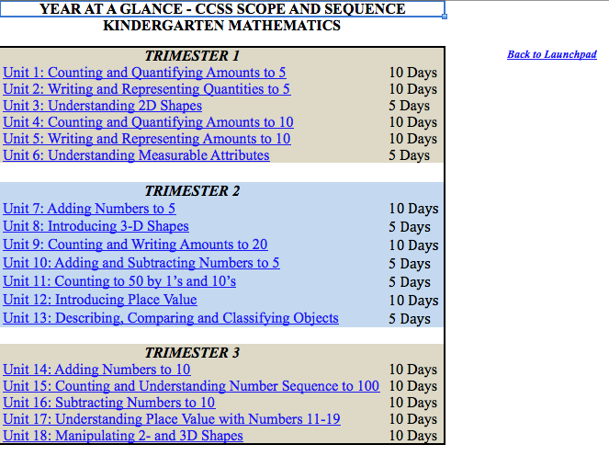
Year-In-A-Glance

Slide 7
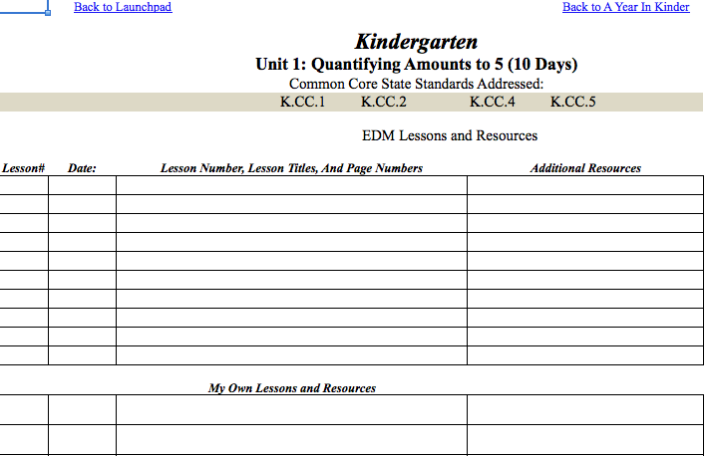
The Unit Planner-Left Side

Slide 8
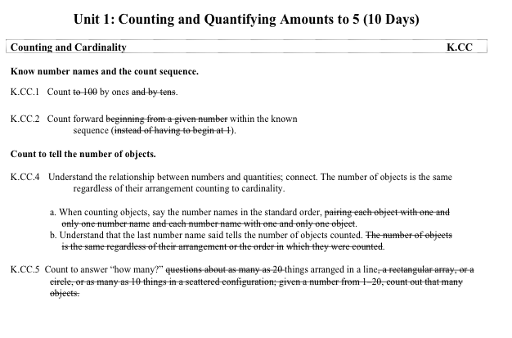
The Unit Planner-Right Side

Slide 9
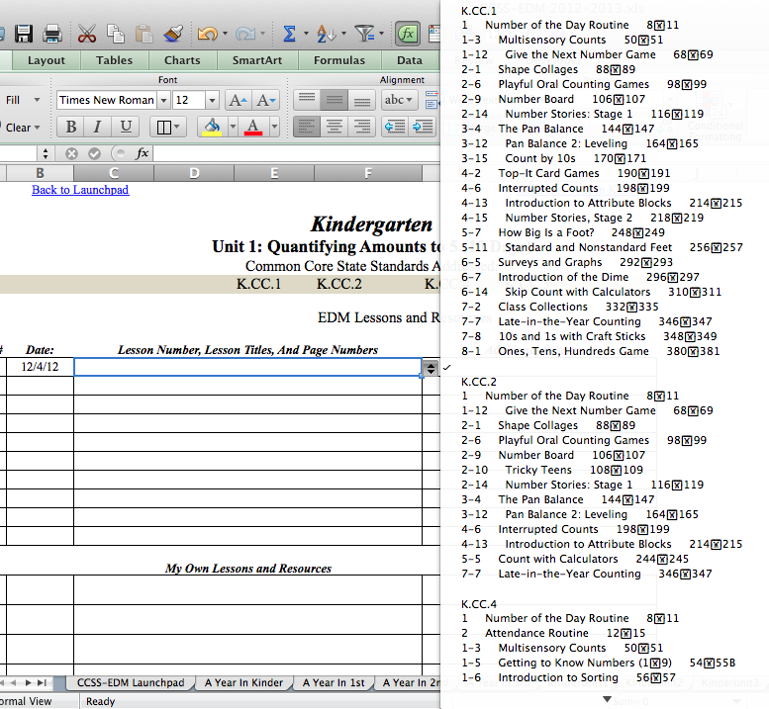
Unit Planning

Slide 10
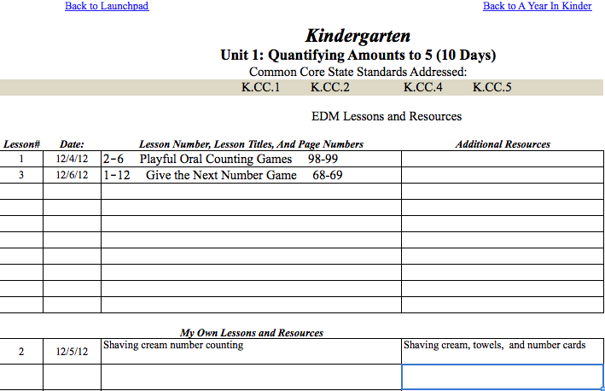
Sample Lessons

Slide 11
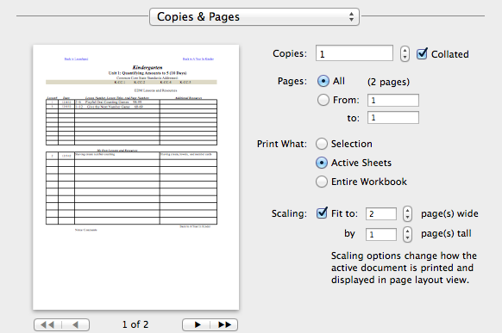
Printing the Lessons

Slide 12
Alex Johnson-Jimenez
East San Jose Elementary School
Jimenez_al@aps.edu
505-764-2005

