Slide 1
Culture of Web 2.0
Mark Langner
Instructional Coach
Madison Middle School

Slide 2
“Instead of streaming a video, I can post it in the students’ public folder and they can drag, drop and view it. Then they can open a new doc in Word and save their response to the class folder on the server. Is that right?”
paraphrase of a question by P. Perry

Slide 3
Who are the people in your neighborhood?
Marcie Johnson
Amy Phipps
Cibola Cluster Coaches
Gary Baudino
Tom Ryan and the office previously known as Online Learning Technologies (now Instructional Learning Technology)
Cristina Padilla, Drucie Turner, Adam Herrera
Brittny Meis, Teresa Stoddard, Mike Gallegos
Wayne Bennett

Slide 4
Madison Middle School 2009-2010
New Principal (third in five years)
New Instructional Coach
New Technology Coordinator
Professional development focus was on Differentiated Instruction, Curriculum Mapping and Non-fiction Writing and rubric

Slide 5
School-wide Initiatives
Performance assessment, PDSA, RACE, pre-mid-post-testing, Blackboard, I-grade, yourhomework.com
Where to begin..?
“It’s on Blackboard.”

Slide 6
2009 – 2010
(previous year: Thinking Maps)
Communication via E-mail: RACE
Informational Blackboard site
Technological infrastructure
I –grade and I-parent
2 Day course: shells
Blackboard training (10 week)
RACE data by assignment
PLC’s
(summer: Thinking Maps)

Slide 7
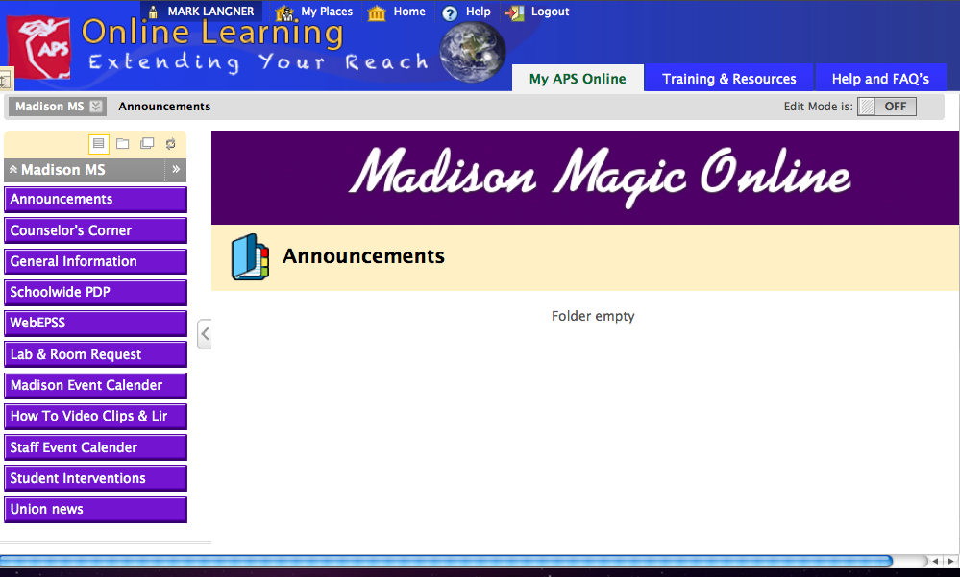

Slide 8
Table of Contents
AIP Information -- General Information
Behavior Referral -- General Information
Budget 2010-2011 -- General Information
C.L.A.S.S -- General Information
Classroom Walk-through -- General Information
Computer Lab Sign-Up -- General Information
Data Director Overview -- General Information
Discipline and Management -- General Information
Duty Stations -- General Information
EPSS (Educational Plan for Student Success) -- General Information
Magic Memos -- Announcements
PLC (Professional Learning Community) Information -- PLC information
PDP (Professional Development Plan) blank forms -- General Information
PDP schoolwide -- General Information
Safety Information (Lockdown, etc.) -- General Information
Staff Roster -- General Information
Student Behavior Referral -- General Information
Student-led IEP's -- Special Education
Teacher Competencies -- General Information
Team Roster -- General Information
Test Security -- General Information

Slide 9
2010 – 2011
F2F PLC’s until Union snag
More Blackboard training
Blackboard announcements/PLC discussion boards
RACE data on Wiki; prompts on Blog
Google Docs (generic log on)
Conference and keynote
Qwest grant
Alternate Governance Plan & Education 360
Promethean Boards

Slide 10
The Blackboard Sites of
Madison Middle School

Slide 11
Introduction to Marcie’s keynote
OMG RU KIDDING ME? WHEN I WAS APPROACHED TO DELIVER THIS SPEECH I TRULY THOUGHT IT WAS A JOKE. WHEN I FINISHED LAUGHING AND REALIZED THIS WAS NOT A JOKE BUT AN OPPORTUNITY TO TALK ABOUT TEACHING, LEARNING AND LEADERSHIP I WAS EXCITED. THEN I PANICKED…WHAT COULD I SHARE THAT WOULD BE OF INTEREST AND VALUE? I WILL START OUT BY TELLING YOU WITH GREAT CERTAINITY THAT I AM NOT A TECHNO GURU. I AM A DEDICATED SCHOOL ADMINISTRATOR WHO IS PASSIONATE ABOUT CREATING LEARNING ENVIRONMENTS THAT WILL PROVIDE THE FOUNDATION FOR TEACHING AND LEARNING IN THE 21ST CENTURY.

Slide 12
“Transform the education environment by removing limits to when, where and how learning can occur…”

Slide 13
2011 – 2012
eLibrary
Madison 10 week course
  Formative and summative assessment
  Project-based learning
  LMS (Blackboard)
Google Docs (domain log on)
School Messenger
Discovery Education
Online courses
  9th grade social studies
  9th grade health
Qwest grant for Thinking Maps

Slide 14
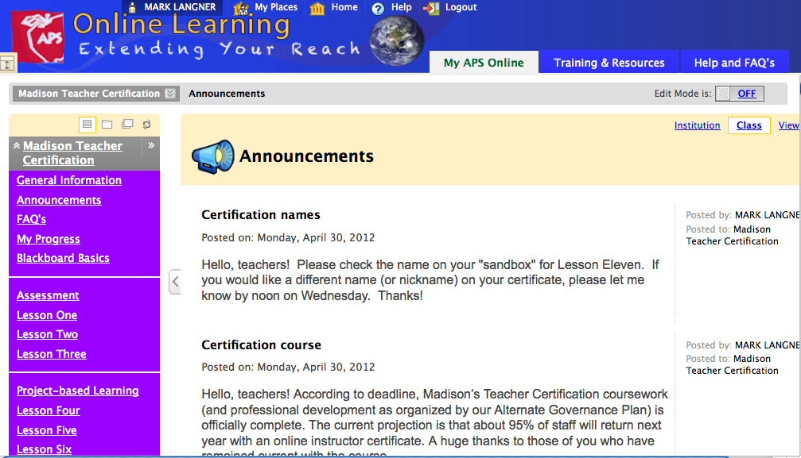

Slide 15
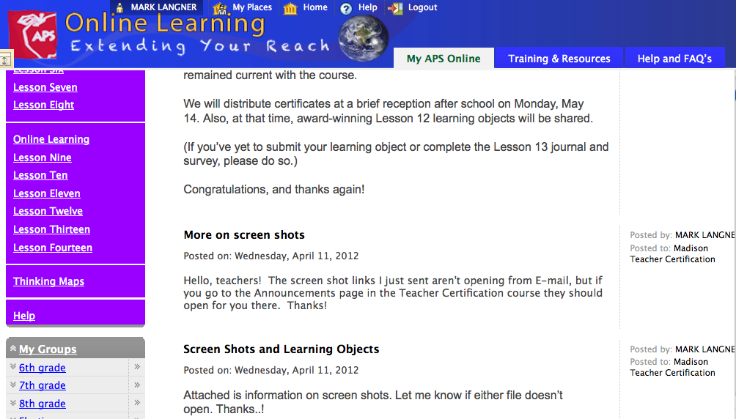

Slide 16


Slide 17
2012 – 2013
August PD:
  Thinking Maps software
  CCSS F2F sessions
eLibrary
Discovery Education
  Digital
  Techbooks
School Loop
Classroom Messenger
CCSS on Blackboard

Slide 18
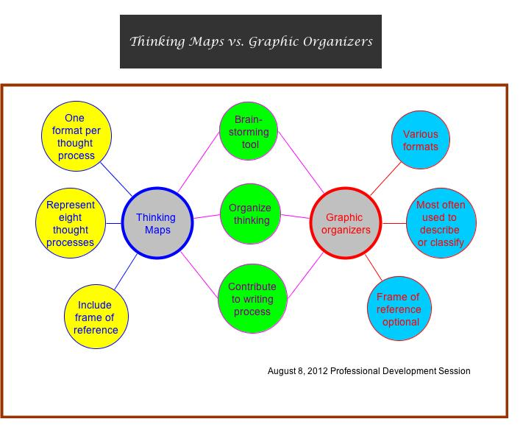

Slide 19
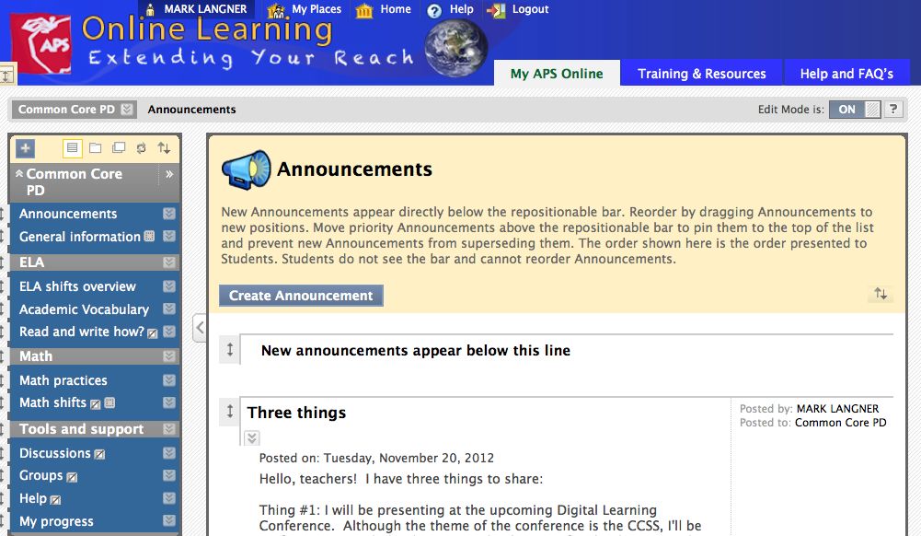

Slide 20
What’s next..?
eBooks
..?

Slide 21
(Live demo of sites)
Any questions..?

Slide 22
Thank you!

