Slide 1


C³
Collaboration
& the Common Core
Jamai Blivin
CEO, Innovate+Educate

Slide 2
Today’s Discussion = c³
Collaboration and
Common Core
I+E and NM STEM recognize the importance of collaboration of teachers, the technology empowering the collaboration, expanding access as well as advancing PD by using the technologies that exist to empower teachers and learners

Slide 3

Innovate+Educate is an industry led national 501c3 non-profit that promotes innovative solutions in education and workforce.
Innovate+Educate oversees the NM STEM Network, led by Director Terri Nikole Baca. A primary goal of the NM STEM Network is to focus on the “T” in STEM and advocate for technology in teaching and learning. We work closely with Education 360, NM Public Education Department and NMSU MC² in New Mexico.

Slide 4
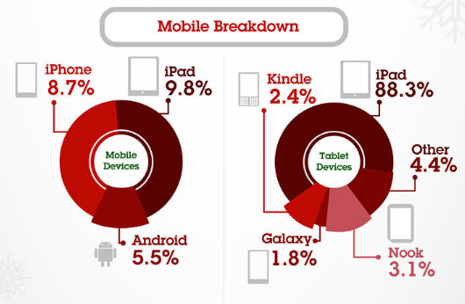
Technology transforms when we least expect it
Black Friday 2012 – 24% of shopping was done on mobile device
Up for 15% in 2011.. The IPAD accounted for 88.3% of mobile shopping

Slide 5


Personalized Learning
Personalized Learning is the tailoring of pedagogy, curriculum, and learning environments to meet the needs and aspirations of individual learners, often with extensive use of technology in the process.
Notes:
Research shows that 1-1 tutoring is the most effective way to improve learning outcomes for students.
Through the use of technology we are working toward a model of 1-1 tutoring for all students
Some people believe that if the student has control of time and pace that they have created a personalized learning environment. As this definition states - it is much more than some control. Personalize learning tailors or prescribes or designs, teaching and learning to meet the unique needs of the learner. Blended learning provides wrap- around support for each student.

Slide 6

The Future of Education
Trends NOW
Forcing transformation
Individualization
(Personalized
Learning)
A NEW LEARNER
Digital Textbooks
Online Assessments
mandated
Increase in need for 2 year
and industry recognized credentials
(career ready)

Slide 7
Opportunity and a Sense of Urgency
OPPORTUNITY
We have for the first time in history an opportunity to have a nationally recognized seamless transferability system of learning across States
Imagine the value of a transferable, transparent system that allows teachers and states to collaborate
URGENCY
It is here today!
NM has online course requirements (online, dual credit or AP) for all graduating NM students
Online assessments required by 2015
Digital textbooks and data systems are transforming the funding and direction of education

Slide 8

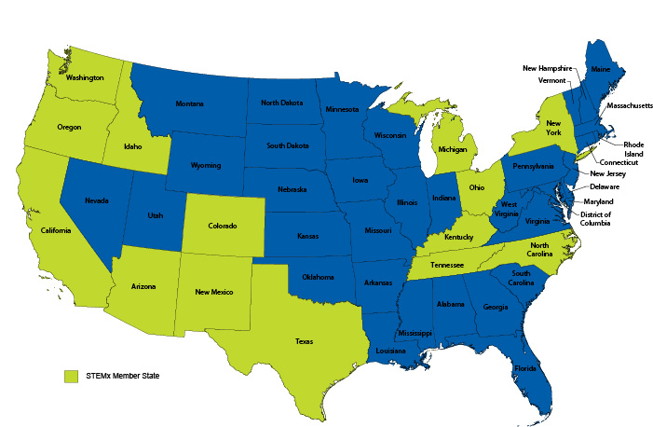


Slide 10

College and Career Ready Students
Use technology and tools strategically in learning and communicating
Use argument and reasoning to do research, construct arguments, and critique the reasoning of others
Communicate and collaborate effectively with a variety of audiences
Solve problems, construct explanations and design solutions
*
11

Slide 11

What the Standards do NOT define:
How teachers should teach
All that can or should be taught
The nature of advanced work beyond the core
The interventions needed for students well below grade level
The full range of support for English language learners and students with special needs
Everything needed to be college and career ready

Slide 12
So what do we do for the 37% or more or our students in NM?
NM 2011 Graduation Rate
63% All
Students
Lower in minority
Groups

Slide 13
Teacher
Student
Expanded Access
The Ecosystem

Slide 14
The Data
Over 30% of NM Juniors (11th graders) must have remediation in core cognitive competencies including reading, mathematics (at a 6th grade level) and do not graduate with critical thinking skills necessary to advance
It is critical to expand access to students to gain the competencies necessary for their success.
A need for a common sharing platform of professional development around common core
A need for a common sharing platform for student learning
A need for services for remediation that are easy to navigate….who’s responsibility is this?

Slide 15
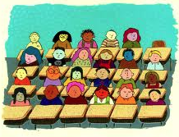
Good ole’ Algebra
Require course to graduate
100%
Notes:
Let’s start with the problem. What’s the academic need that demands transformation?
An example might be 9th grade Algebra which is required of all students in order to graduate.

Slide 16
9th Grade Algebra
Solutions Needed!
Over 40% of students fail
State spends $3,000,000 in teacher salary alone for students that fail
State will spend another $3,000,000 for these students to take it again
It is
Likely that students will take the same class they failed the year prior!?!?!
-40%

Slide 17
How can we do it different?
TODAY….
TRANSFORMING
Many students are missing important foundational concepts
Student remains in course for the semester for operational reasons
Teacher integrates technology into curriculum to teach all learners.
Teacher and learners use technology to access content, collaborate and publish within the school.
Learners use technology to create, collaborate and publish and have support from community and guides 24/7

Slide 18
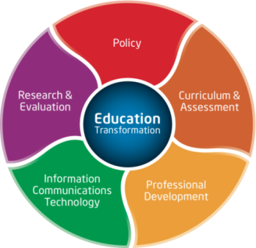
Improved Efficiency
29% reduction in budget
Reduced operating costs
  Textbook independent courses
  Cut non-certified staff by 40%
  75% reduction in General Supply budget - paper, copier costs and paper related supplies
More efficient scheduling of teachers
Cost per student dropped 17% over the past year.
Cost per student instead of course

Slide 19
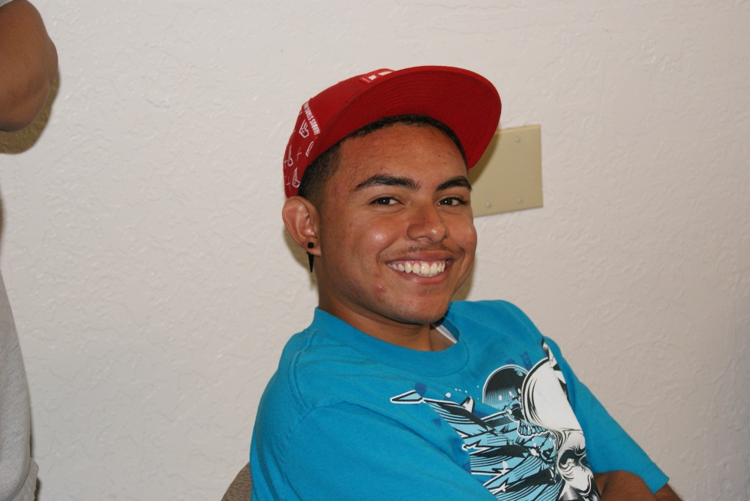
Success for the Student
20% increase in the passing rate of students over F2F program
1000+ seniors able to graduate on time
1,100 students took courses summer 2012
Significant increase in parental contact
88% - 93% Summer school pass rate

Slide 20


Slide 21

Questions? Comments/
THANK YOU
http://www.surveymonkey.com/s/J57NTKZ

