Slide 1

New Mexico PBS LearningMedia
And Other
Educational Media Resources
December 4, 2012

Slide 2
20,000 +FREE Resources
By Subject
Notes:
2
2

Slide 3















AWARD-WINNING CONTENT

Slide 4
Content by Media Type

Slide 5
Content by Grade Level
Notes:
A very quick recap on body of resources in LM.
-- Important to note the value and use by teachers of interactive media. A recent snap shot of traffic statistics reveal that 25% of the media teachers use on LM is interactive media.

Slide 6

http://www.pbslearningmedia.org/election
Notes:
I am thrilled to debut the PBS LearningMedia Election 2012 Collection. This Collection is an aggregation of contextualized election related resources for the K-12 classroom. While the content spans grade levels, the primary focus are on grades in middle and high school.

Slide 7





Featuring Related Content From…
& MORE!
Notes:
A selection of contributors to LearningMedia election collection
Spans grade levels
All media types : video, interactive, audio, documents, images
Here are the resource currently available in PBS LearningMedia: http://www.pbslearningmedia.org/content/#q=election&go

Slide 8
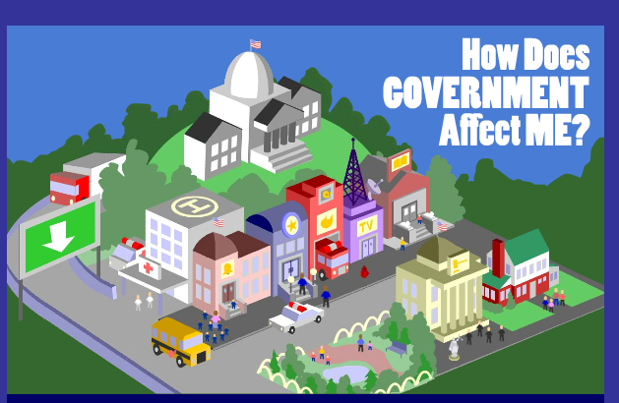
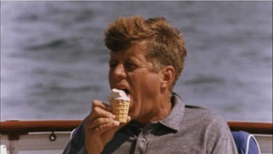
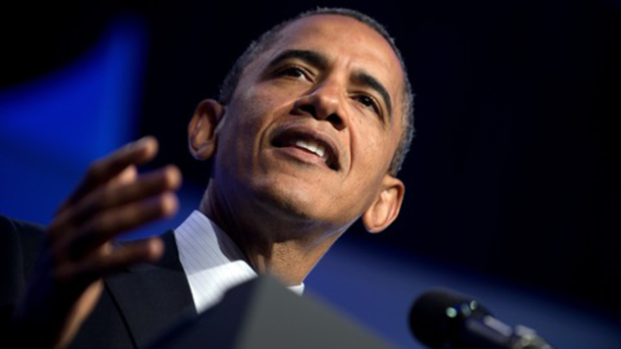
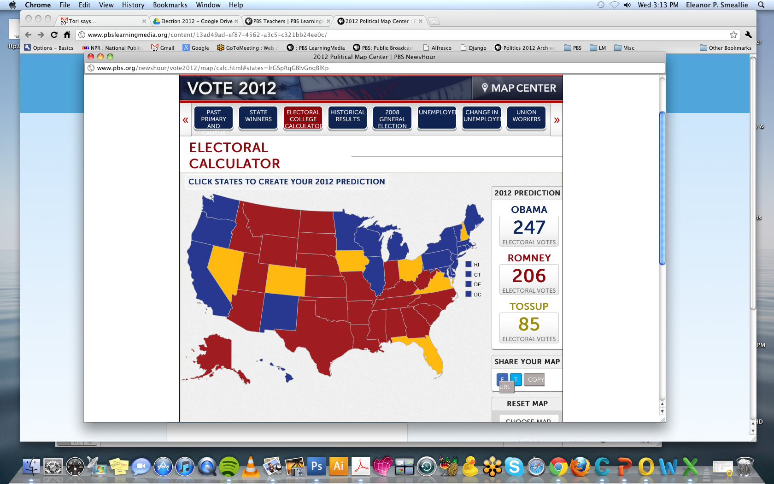
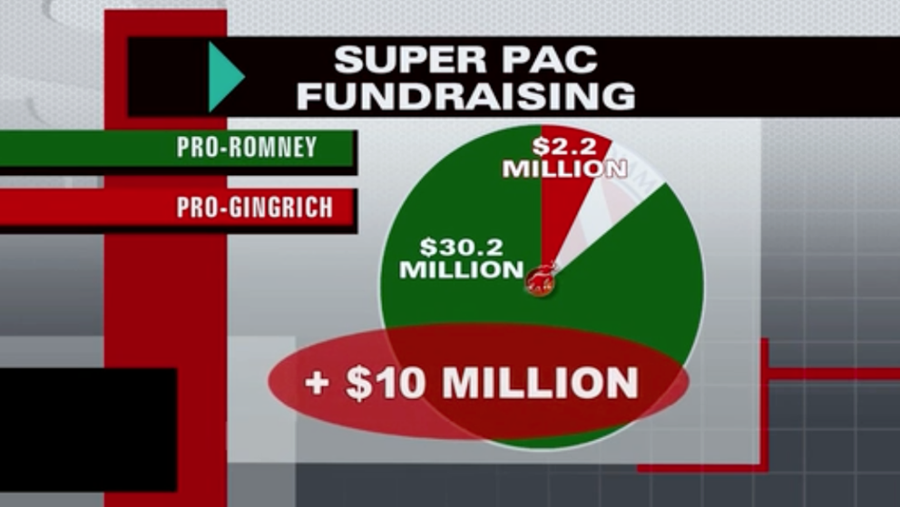
Multimedia Content
Notes:
The Multi-media glossary has a text definition and real world examples of key terms and concepts. The idea is that the more connections students have to these terms, the more memorable the terms will be for them.
One of the great resources we have that helps identify the concept of battleground or swing states is the 2012 Political Map Center. It has a fantastic Electoral College calculator teachers could use to have students predict the outcome of the Presidential election.
“How does Government Affect Me?” is an interesting interactive for younger students especially, highlighting the idea of Civic Participation.
We also have some really great videos on Super PACs.
To go along with these terms and concepts, we have a variety of Lesson plans: for classroom use, just about all of them incorporate a multi-media piece, designed for different age groups (grades 3-6, middle school, and 9-12)
Overview:
Glossary of terms and concepts relating to the presidential election in the united states
Components: Vocabulary words & definitions; Videos/animations/audio files; Real world and historical examples
Examples include: Rights, 1st Amendment, Constitutional Democracy, Campaign Strategy: PAC, Super PAC, FEC, Political Messaging, Grassroots Organizing, Get out the Vote, Opinion Polls, Primary, Caucus, Delegates, Superdelegates, Conventions, Party Platform, electoral college, battleground states
Lesson plans with a multi-media component
Contributors include POV, NewsHour, Frontline, WGBH and more.
For use in grades 3-12
Topics include:
Citizens United v. FEC
Duties of the President
The Electoral College
Voting Rights
Presidential Debates

Slide 9
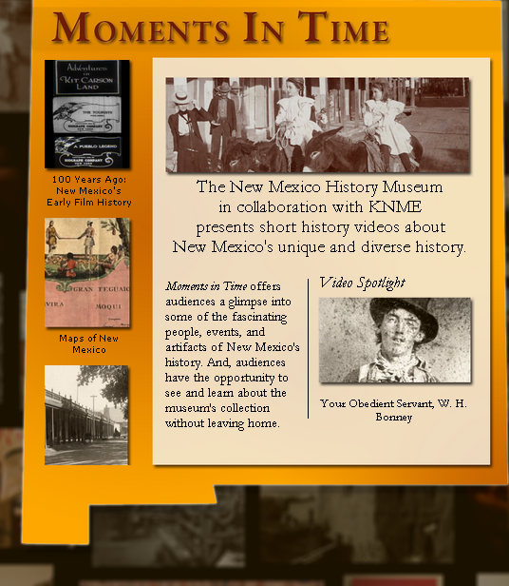
Moments in Time
New Mexico History
Fifteen Videos
With Lesson Plans
Activities
Assessments
Extensions
State Standards!
http://www.newmexicopbs.org

Slide 10
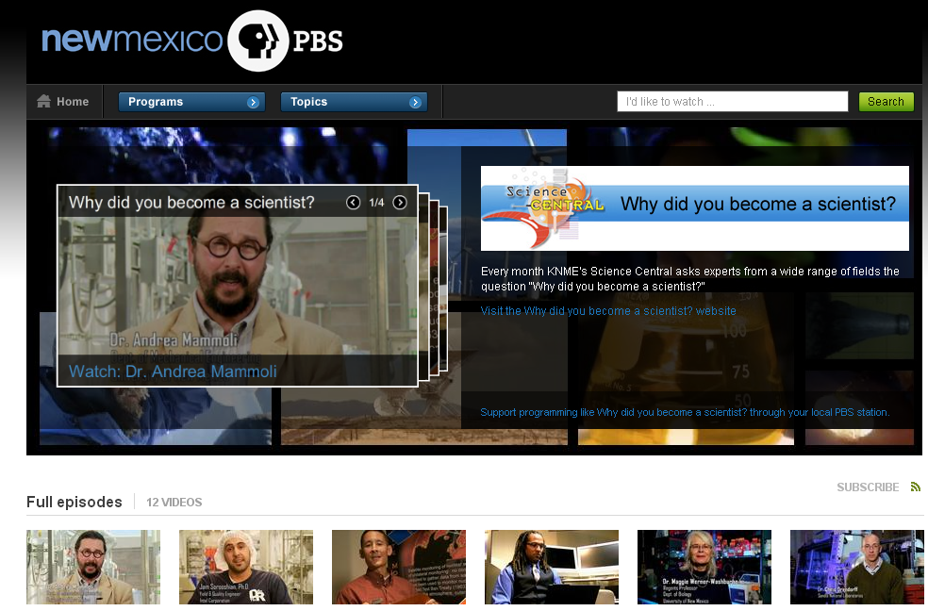
http://www.science-central.org/

Slide 11
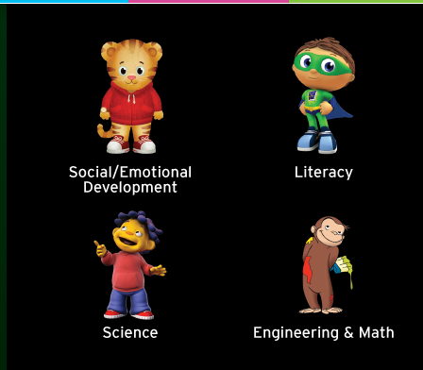
Whole Child Curriculum for ages 2-8
Social-emotional, Math & Engineering, Literacy,
Natural Science & Nature, Science, Music & Language
America’s Largest Classroom

Slide 12
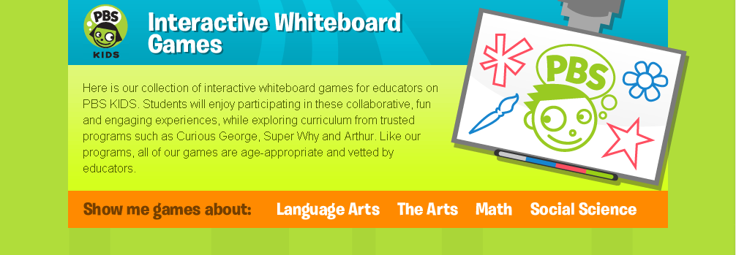
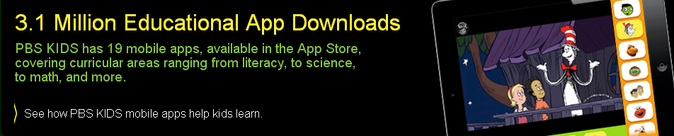
Interactive Games and Apps PK-3

Slide 13
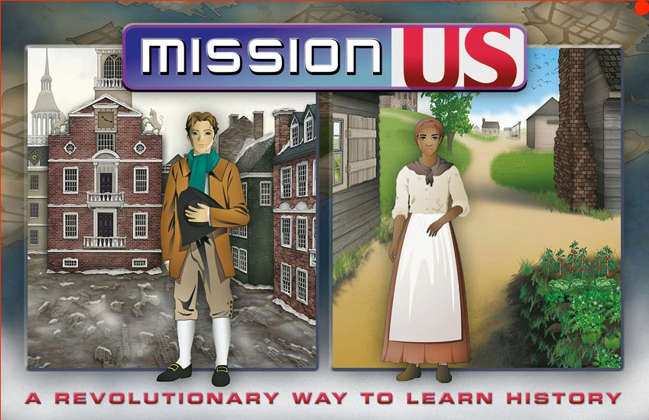
Interactive Games 5th – 8th Grades

Slide 14

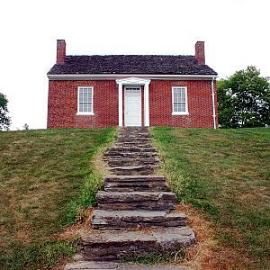
Notes:
14

Slide 15
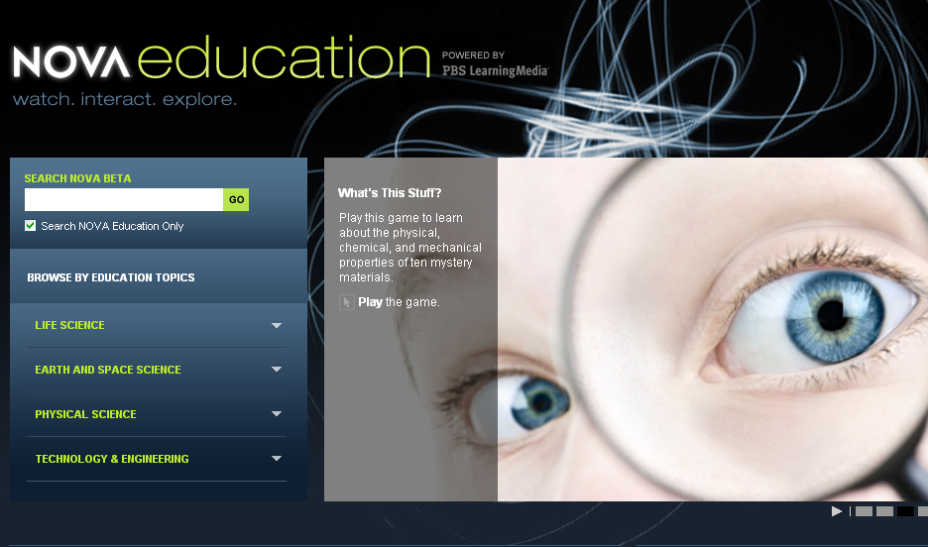
Video and Interactives High School Level

Slide 16
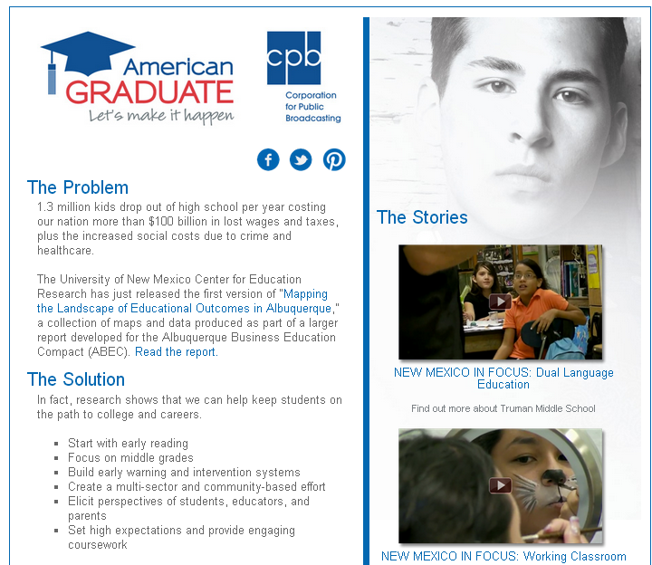

Slide 17
Register Now
www.nm.pbs.learningmedia.org
Rose Poston, Teacher Professional Development, Technology Training, TeacherLine
277-2396 rposton@knme.org
Laurel Wyckoff, PBS LearningMedia, Community Engagement, American Graduate
277-8296 lwyckoff@knme.org
www.newmexicopbs.org

