Slide 1


Slide 2
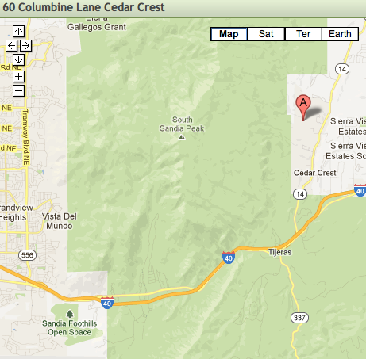
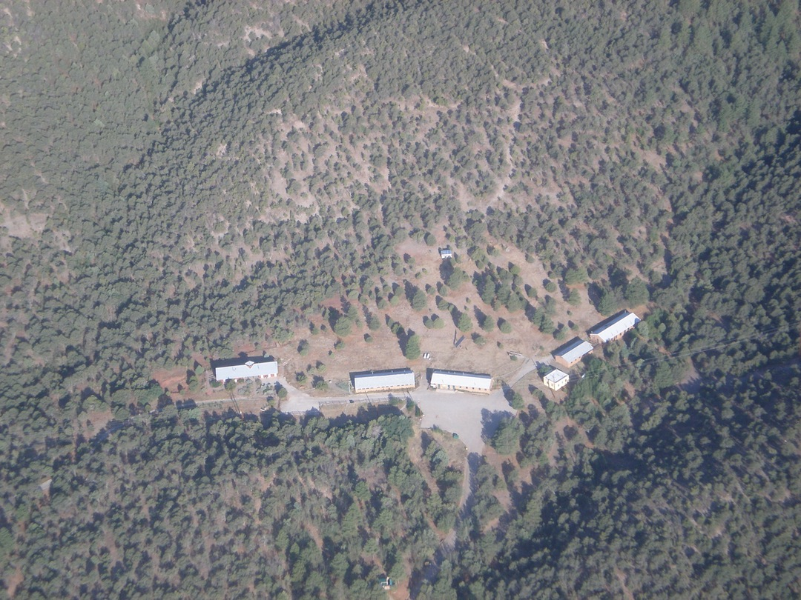
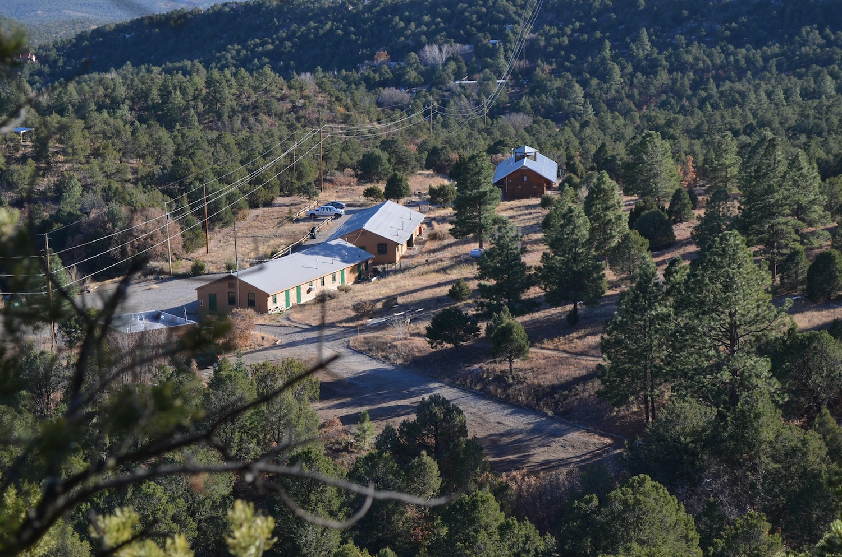
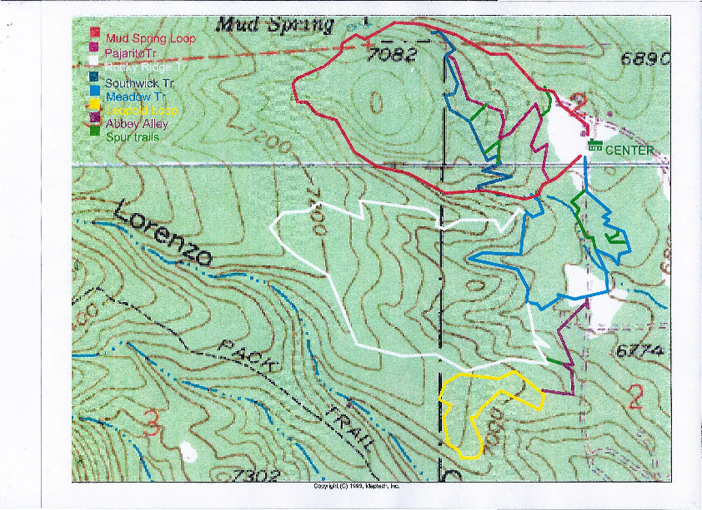
Background and History
Notes:
Center Established in 1967 (out of Physical Education)
128 acres against Cibola National Forest
Owned & operated by APS until…
1989-90 – almost closed
Joint Powers Agreement with NMMNHS (1993)
6 miles of trails
7 outdoor classrooms
7 seating areas on trails
Staff – 6.5 paid employees (1 APS, 2.5 NMMNHS, 3 grant funded)
2 student teachers, 10+ volunteers

Slide 3
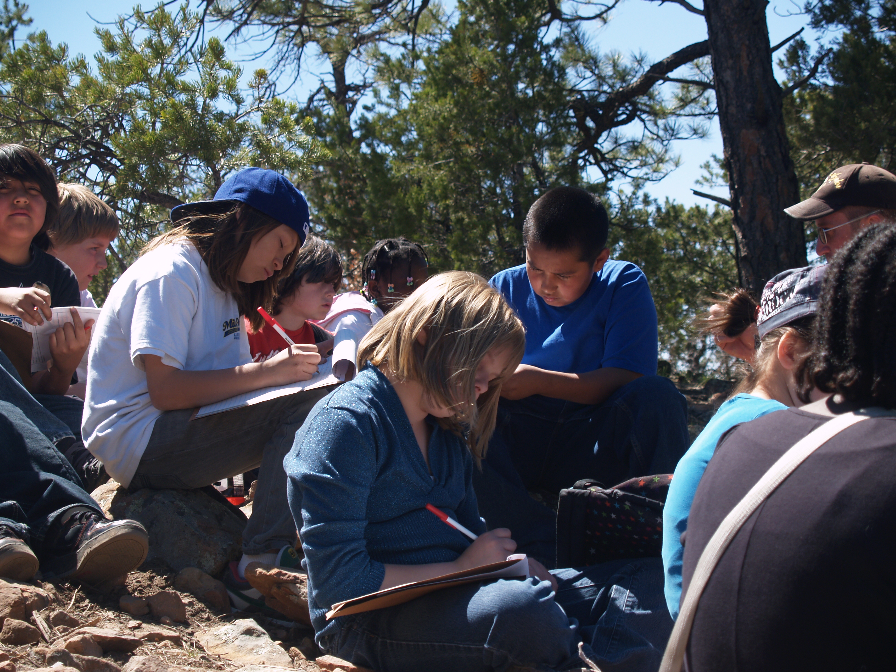
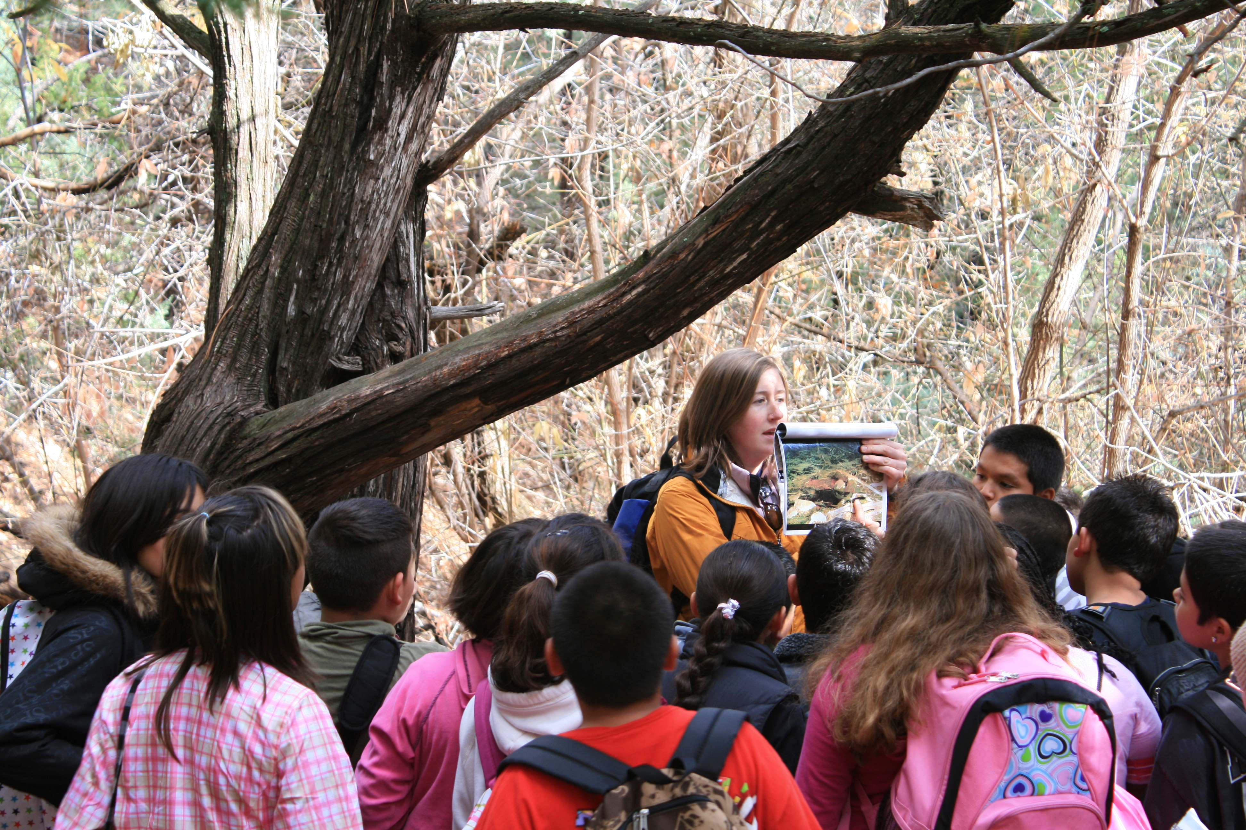
5th Grade Ecology Field Program
The most valuable lesson my students learned was “the hands-on application of life science knowledge taught in class. My students are inner city students who rarely get the opportunity to experience the mountains.” - Dwayne Norris – Whittier ES
The program “creates passion and care in the children, something often missing from today's data focused classrooms. One of my boys said, "I thought this was going to be boring, but it is not!”” – Elaine Carrillo, Painted Sky ES
“The students learned a lot of information and they returned to the school excited about the experience. I have been…on this trip for about 15 years and I was impressed with…the changes that were made.” – Jack Vermillion, SY Jackson Principal
Notes:
Serve between 10-17,000 students per year
4.5 hour standards-based program – life science standards
Intro, hike, lunch, activity, wrap up

Slide 4
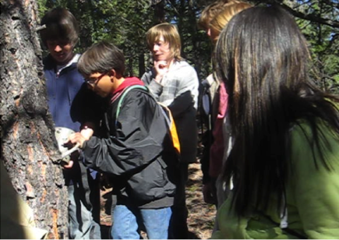
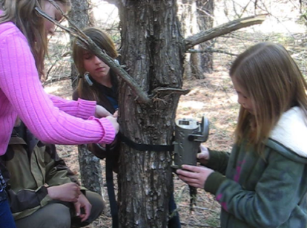
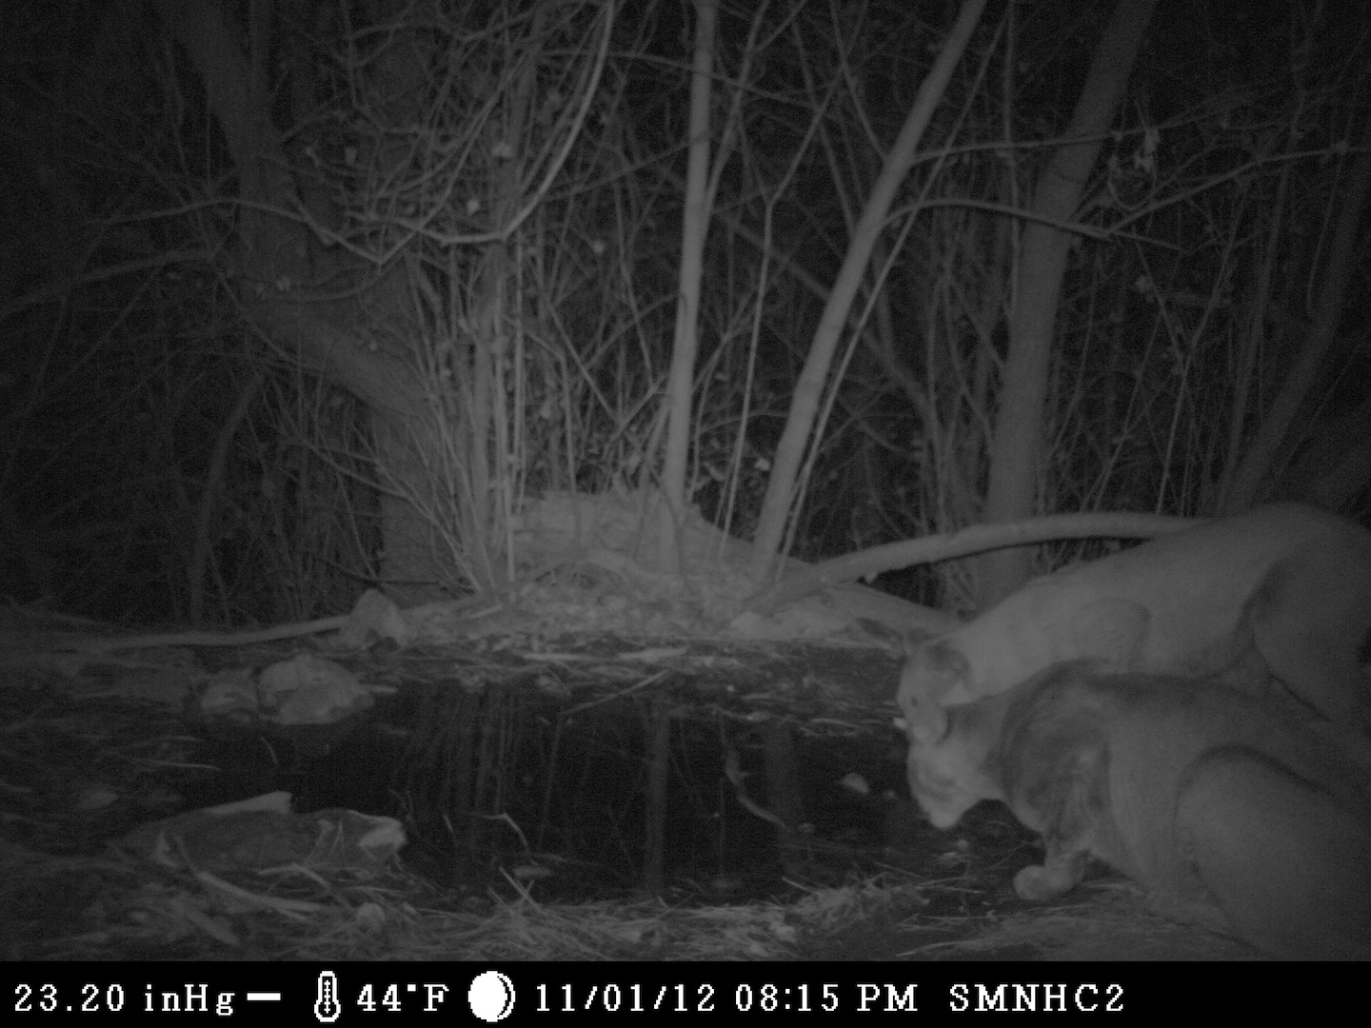
Qwest-APS Teacher Education & Technology Grant – Spring 2011
Notes:
Grant funded 5 new wildlife cameras, student transportation, batteries solar panels for cams
RMS students installed cameras…Students received data from Chris
Analyzed, categorized, graphed and drew conclusions from the data
Narrowed data by time of day, time of year, temperature and species

Slide 5
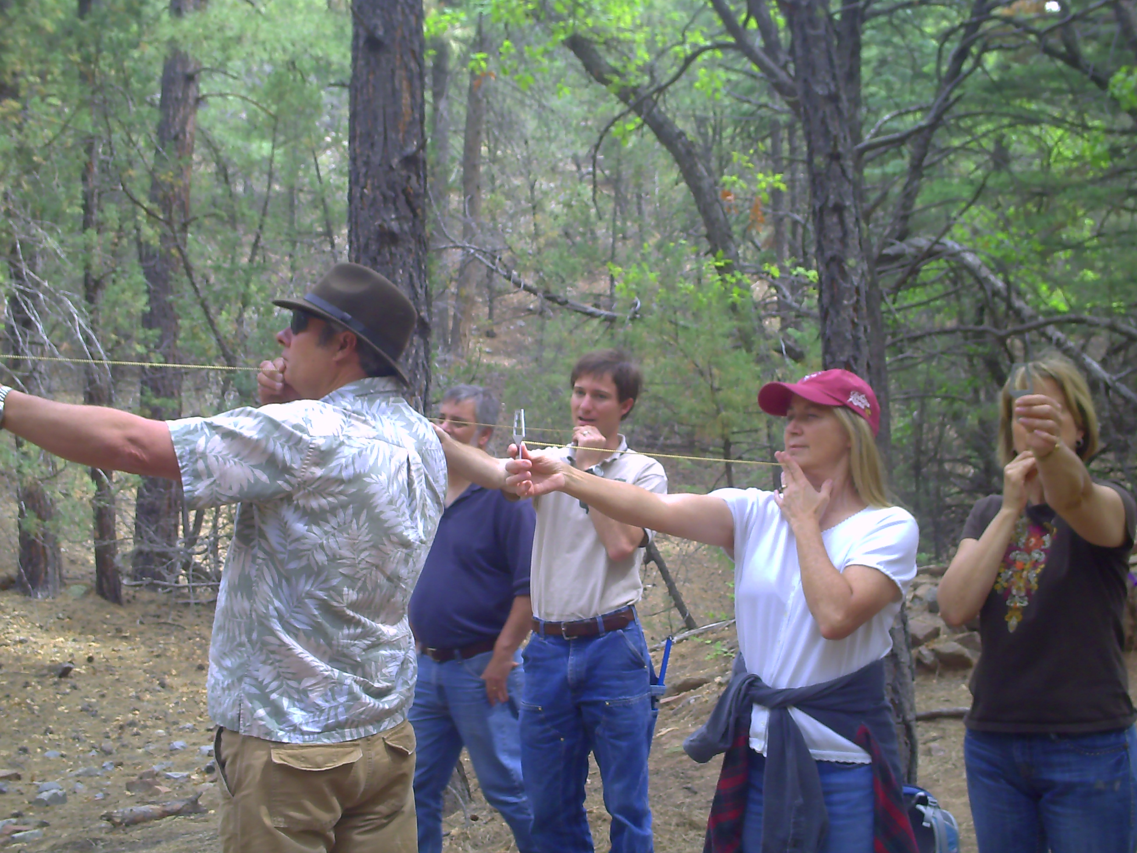
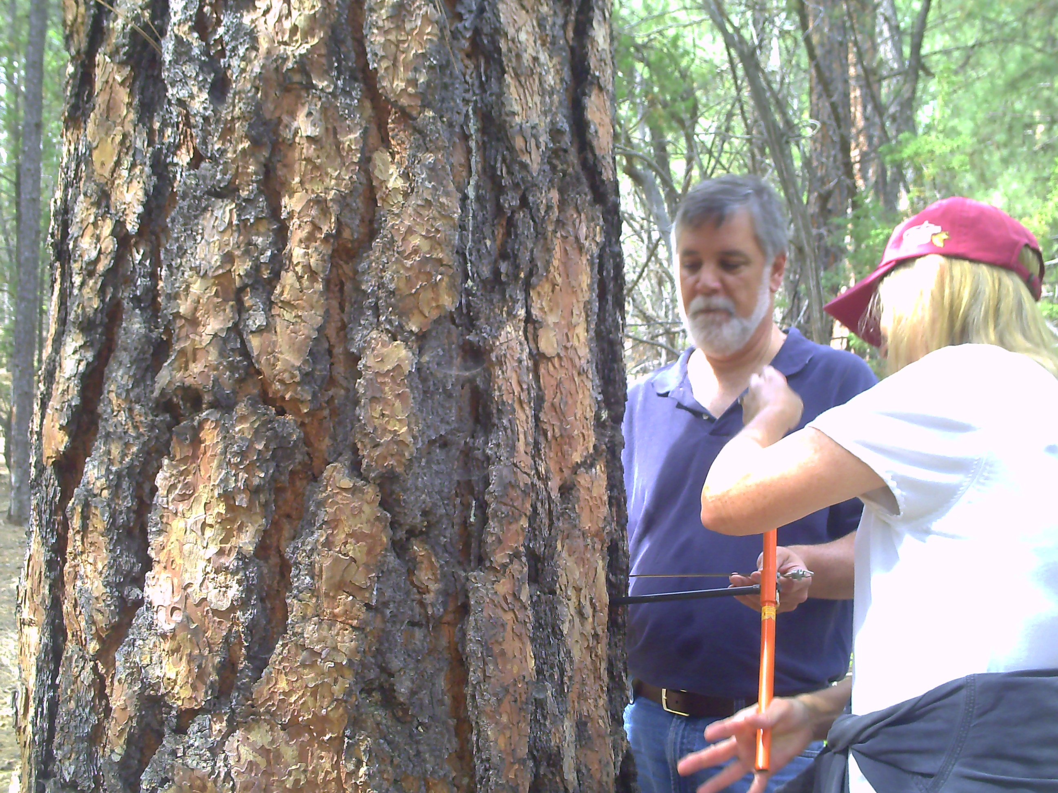
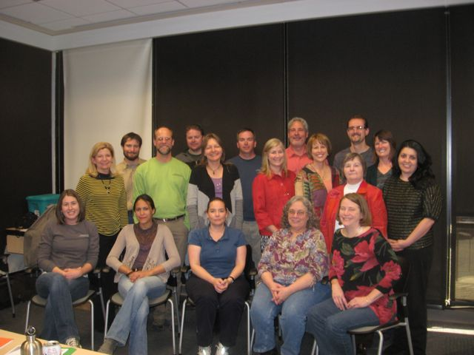
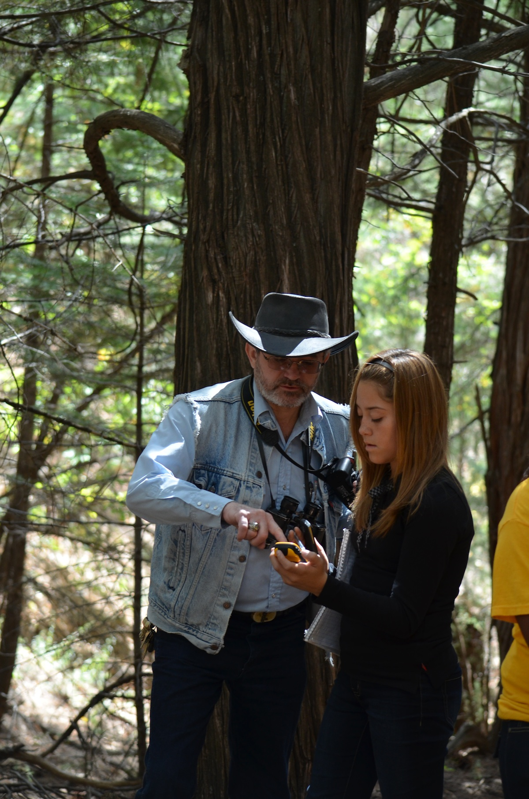
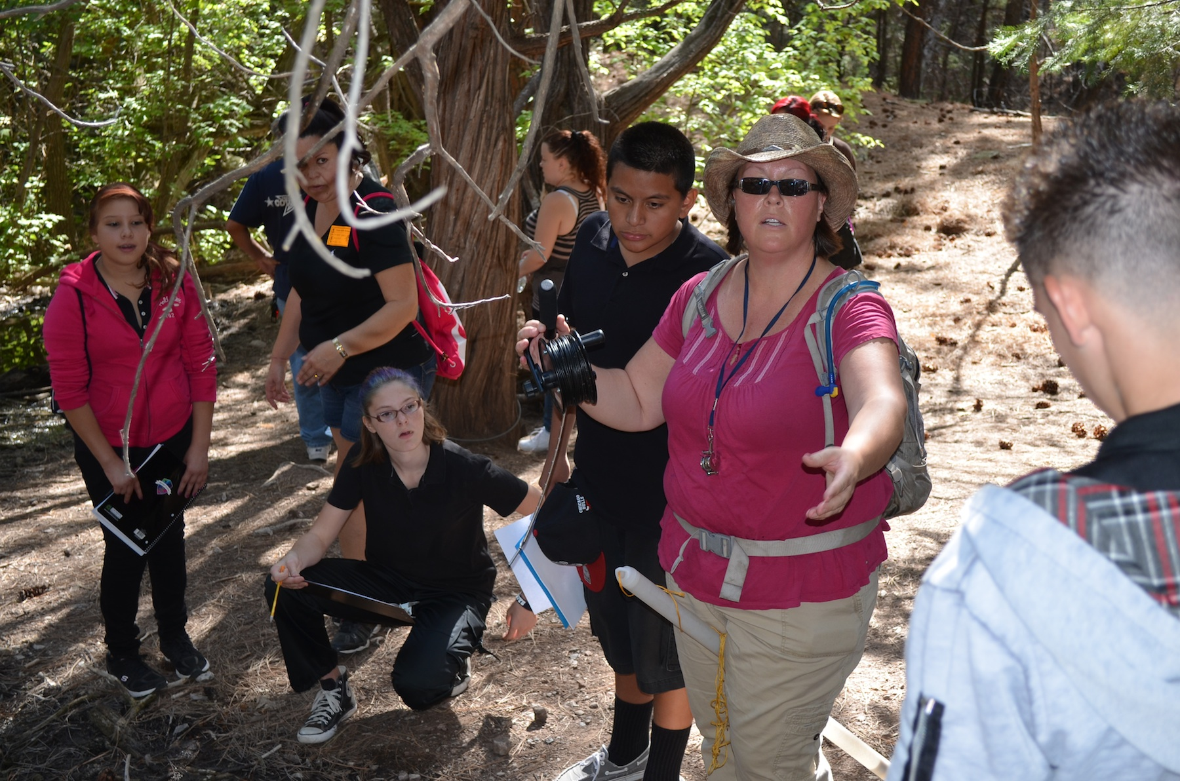
Middle School Project Based Learning Ecological Monitoring Program
Clara & Keith - VBMS
Notes:
Some quotes, from teachers, on here too!

Slide 6
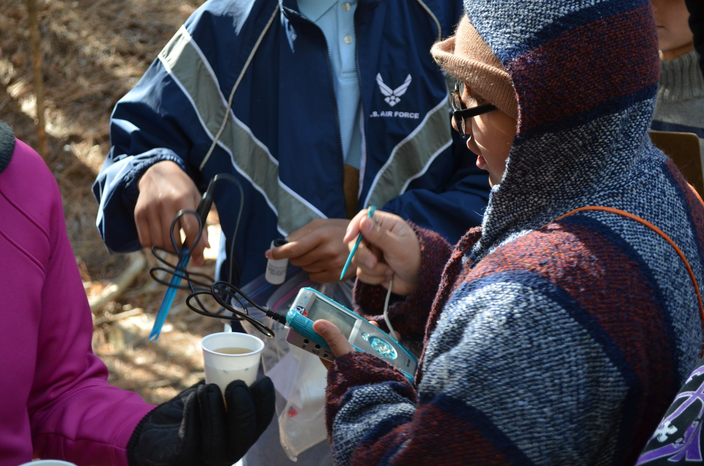
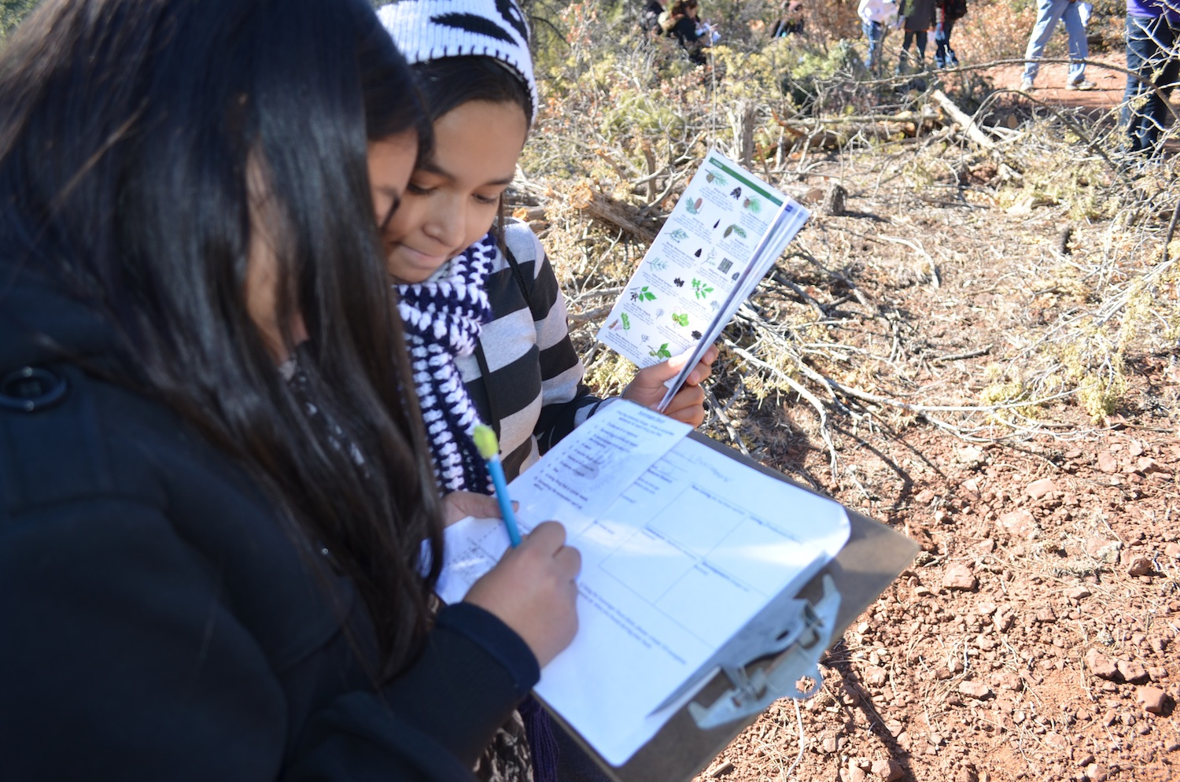
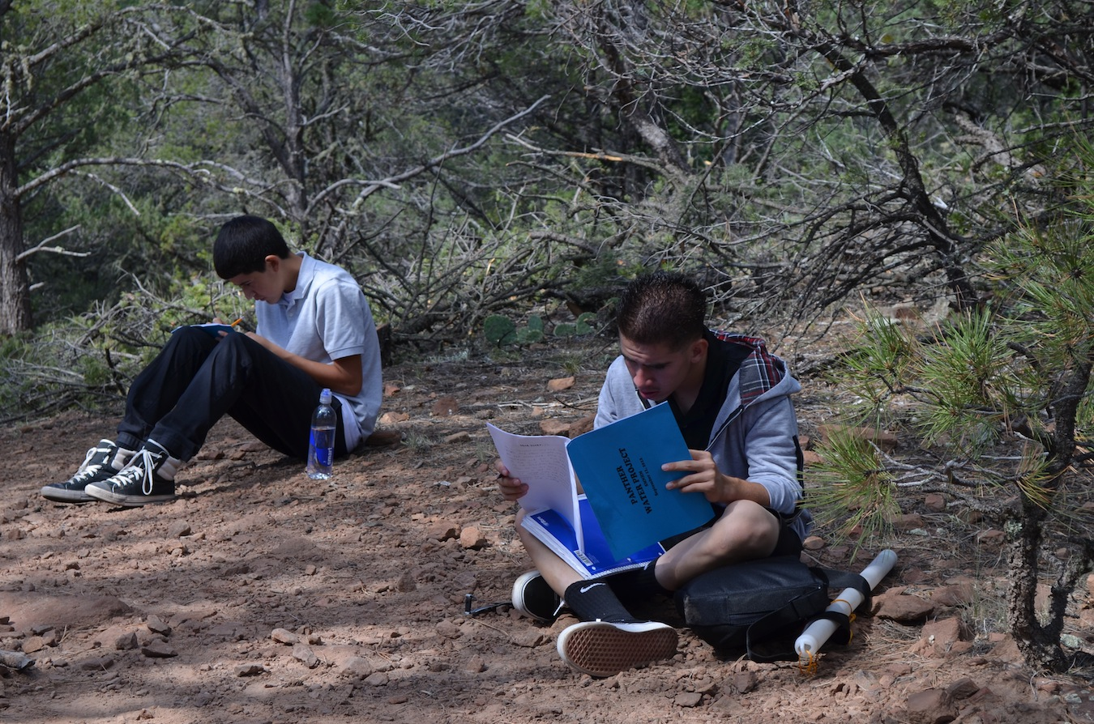
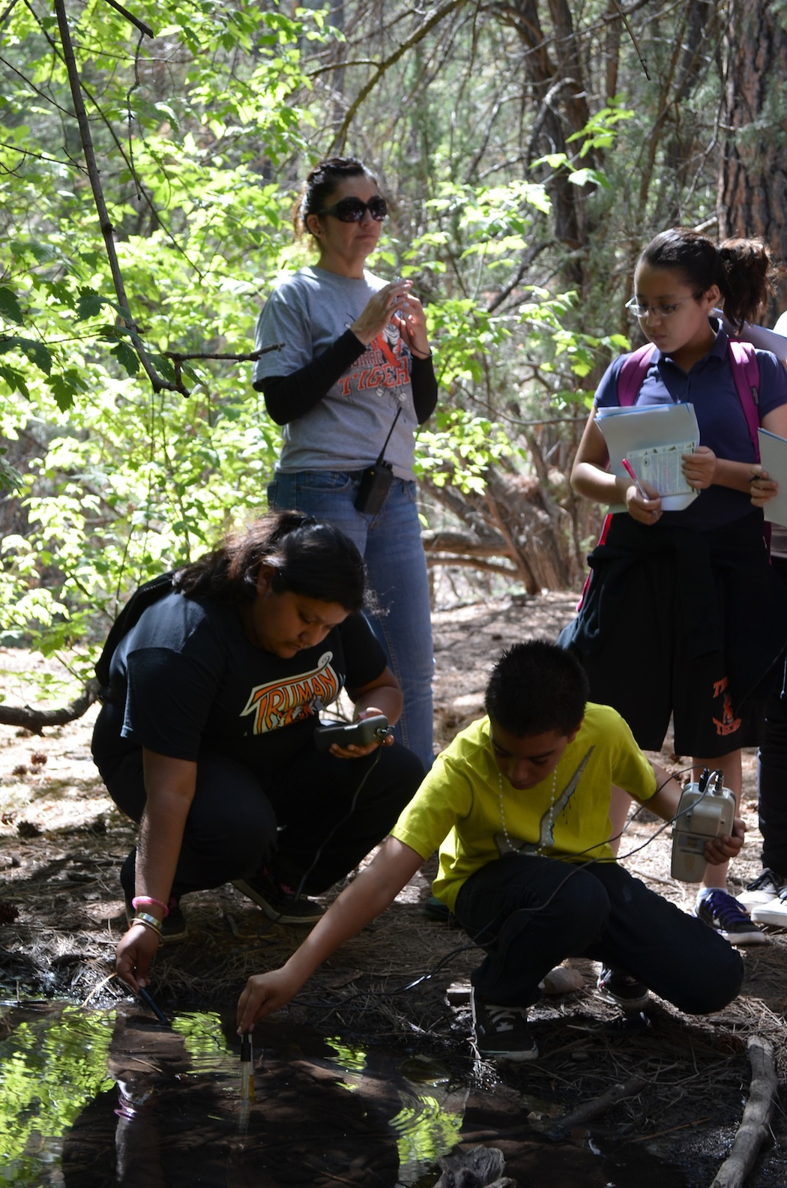
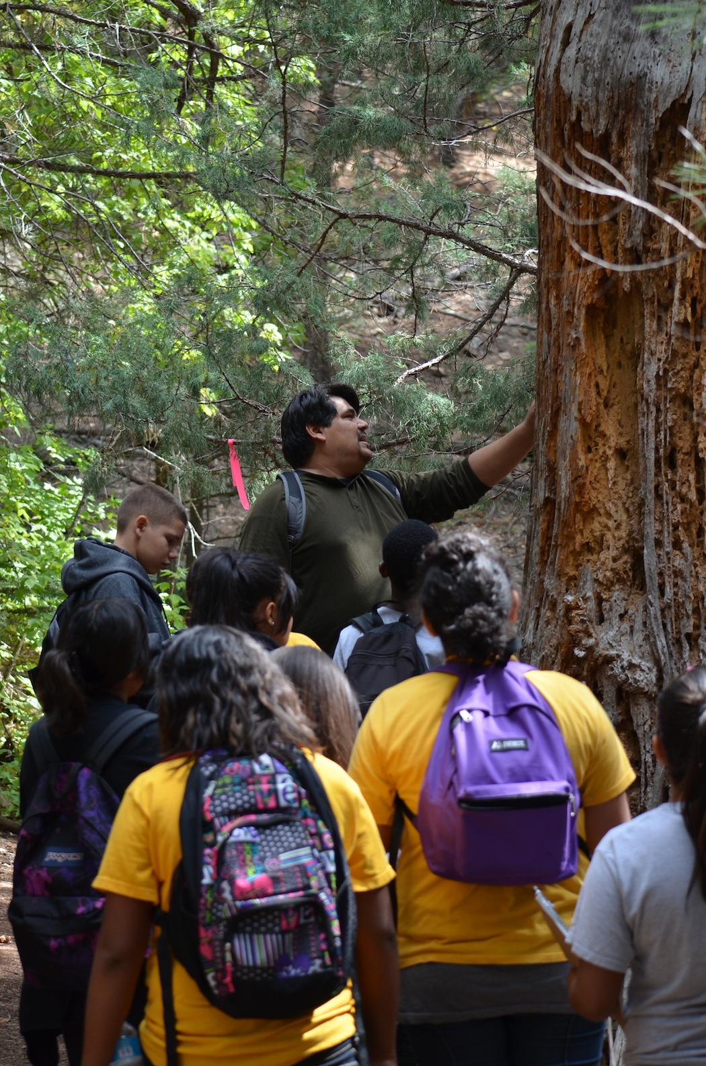
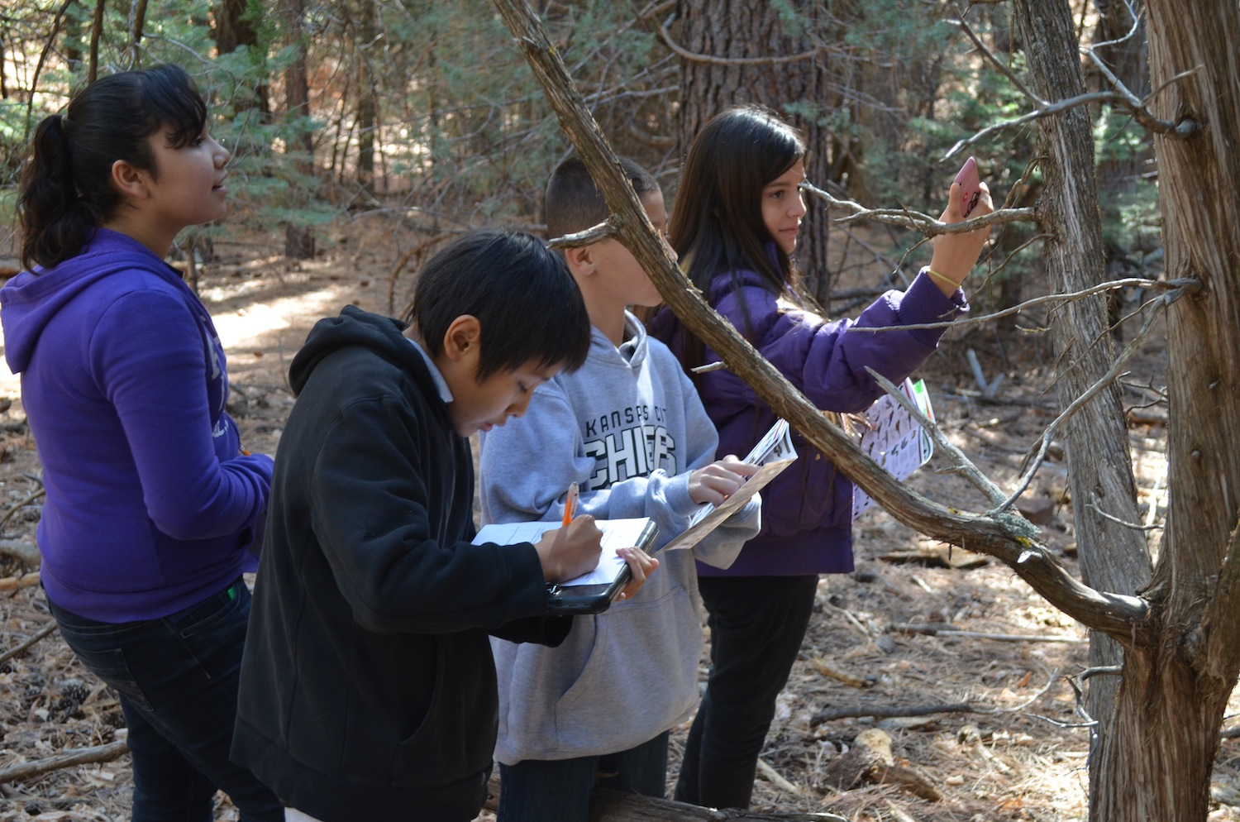
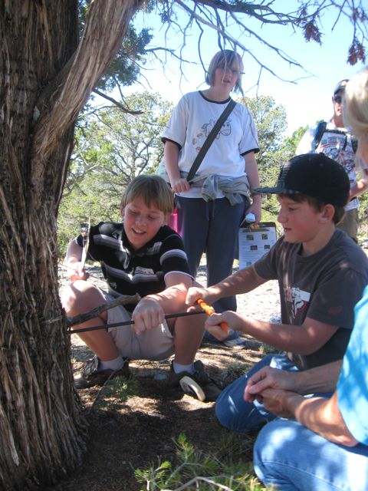
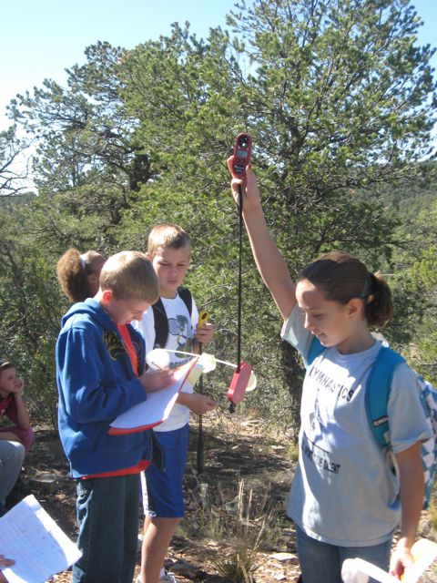
Middle School Project Based Learning Ecological Monitoring Program
Notes:
RMS – wildlife camera installation
MMS – dendrochronolgy & forest health
TMS – water & weather
VBMS – wildlife evidence
DRMS – air quality
JCMS – interactions between bears & human beings

Slide 7
Future Possibilities…
…a video conversation with Paul Mauermann, SMNHC museum manager…
Shane - VBMS
Notes:
Paul – for each item, show the equipment…and discuss the research that is happening at the center…
Camera Trap Data
Bear Collar Data – Nature Mapping
Dendrochronology data
Ozone monitoring data
Weather stations
Water Quality
Adopt a Pixel
Non-science research potential…archaeological site, history of land use, art classes, creative writing

Slide 8








Our Appreciation

