Slide 1
Ronda Davis
Member of the NM PARCC Educator Leader Cadre
Member of PARCC Consortium Math Operational Working Group
Math Coach at Highland High School, Albuquerque Public Schools
PARCC Mathematics
PARCC: Partnership for Assessment of Readiness for College and Career
14 Facts Every Math Educator Should Know – Q & A
9/12/14

Slide 2
Objective
I will get all my current questions about PARCC answered
Notes:
Write down any questions that come up during the presentation
At least an hour will remain to answer any questions that aren’t covered in the presentation
I understand there is the part about I don’t know what I don’t know - I’ve tried to address the most common questions RDA & I get from teachers

Slide 3
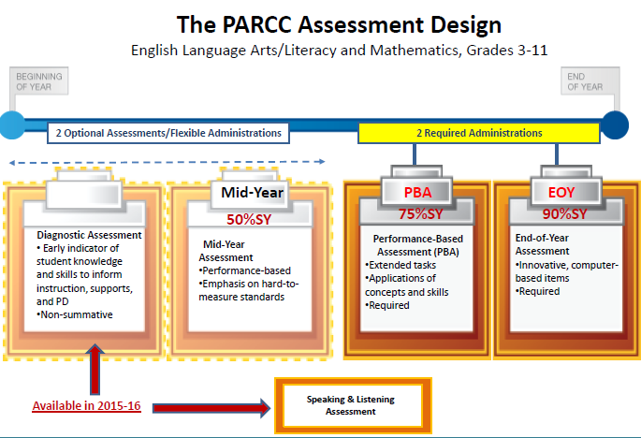
#1 PARCC replaces the SBA this Year
Notes:
CCSS were adopted in 2010 by most states
APS piloted in 2011-12 & 2012-13 in school grade levels
Each school taught CCSS in 2013-2014
Timed – yes, but generally speaking SBA was timed as well.
--about 50-55 minutes per session/unit
All work done & submitted on the computer WITHOUT any answer booklets
The design of the PARCC assessment is driven by the following priorities:
Determine whether students are college and career ready or on track
Assess the full range of the CCSS, including stds that are difficult to measure
Measure the full range of S performance, including the performance of high & low performing S’s
Provide data during the academic year to inform instruction, interventions & PD
Provide data for accountability, including measures of growth
Incorporate innovative approaches throughout the assessment system.

Slide 4
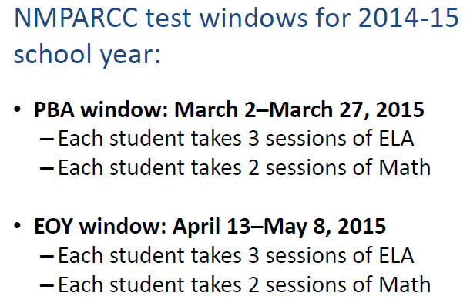

Slide 5
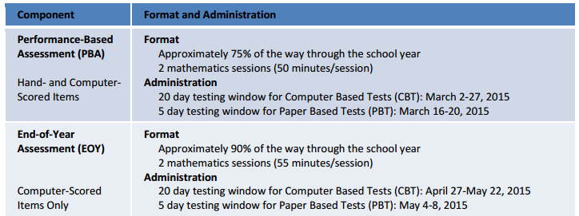
April 13 – May 8
For this year’s testing, results will not be available until Fall, 2015
Notes:
While it is anticipated that most students will complete the test sessions within these estimated times, all
participating students will have a set amount of additional time for each session to provide them with ample
time to demonstrate their knowledge. Students with disabilities who have a documented (e.g., IEP) extended
time accommodation will be given time beyond the set additional tim

Slide 6
#2: Students Test By Content –
Not Necessarily Grade Level
Grades 3 – 8: Take the Test Based on their Enrolled Grade
Grades 6 – 12: Take the Test Based on their Enrolled Class
  Algebra 1
  Geometry
  Algebra 2

Slide 7
#3: Scoring
Scoring Will Be Based on Student Work for Hand Scored Items (PBA)
Scoring Will Be Based on Correct Work for Machine Scored Items
(EOY & PBA)
Notes:
EOY – 100% machine scored
PBA – machine & hand scored – any dependent scoring will need to be handscored

Slide 8
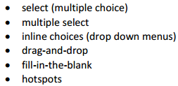
Samples of Scoring
& Technology Enhancements
Both PBA & EOY will have:
All constructed response will
appear on PBA
  Free Response on EOY & PBA
  (machine-scored)
equation editor
Notes:
Address Good Test Taking Skills:
Crossed Out Answers will not be graded
USE Multiple Select opportunities as often as possible in class!!!

Slide 9
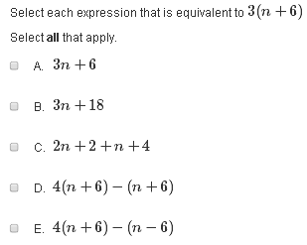
Multiple Select: 6th Grade Example

Slide 10
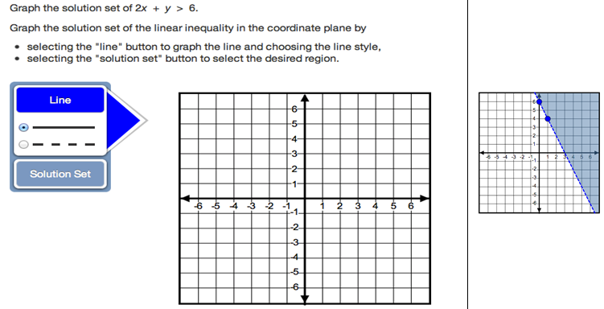
Hotspots: From Algebra 1

Slide 11
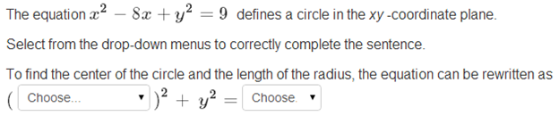
In-Line/Drop Down Menus: From Geometry
Notes:
Machine Scored – All right or All wrong

Slide 12
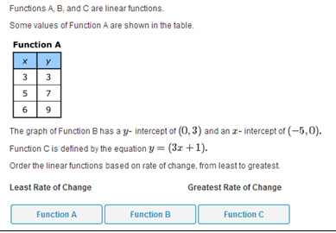
Drag-and-Drop: From 8th Grade

Slide 13
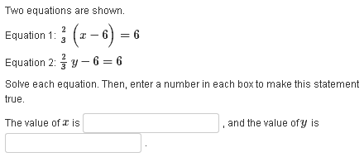
Fill-In-The-Blank: From 7th Grade

Slide 14
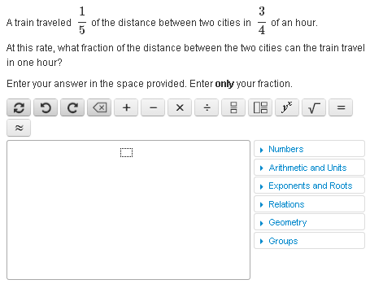
Equation Editor: From 7th Grade EOY

Slide 15
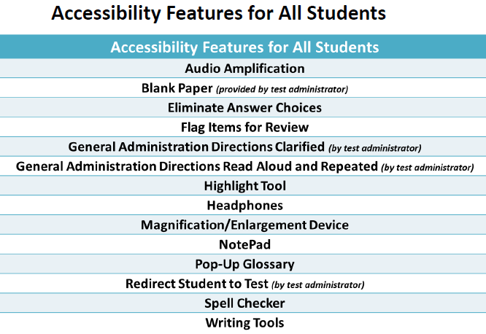
#4 Accessibility & Accommodations Support
, Line Reader Tool

Slide 16
Accessibility Features
Identified In Advance
Since reading is not the construct being tested on the math, ALL students can have access to
  Text to Speech Through the Use of Headphones
    Does NOT require IEP, 504 or ELL plan
    Should be determined by parents, students and teacher
Notes:
will be selected and “turned on” by school-based educators prior to the assessment, based on each student’s Personal Needs Profile (PNP).
Based on each student’s individual needs, a PNP is created for the student to ensure that he or she receives appropriate access without the distraction of other tools and features that are not required by the student.
Although school-based educators will enable specific accessibility features for students, the student will decide whether or not to use the feature. These accessibility features will be readily available on the computer-delivered testing platform.
ADMINISTRATIVE CONSIDERATIONS FOR ALL STUDENTS:
Detailed guidelines on the administration of the PARCC assessments will be included in the PARCC Test Administration Manual.
Principals may determine that any student may require one or more of the following test administration considerations, regardless of the student’s status as a student with a disability or who is an English learner:
Small group testing
Frequent breaks
Time of day
Separate or alternate location
Specified area or seating
Adaptive and specialized equipment or furniture

Slide 17
#5: Calculator Use
Grades 3 – 5 – No Calculators
Grades 6 – 7: Four Function with Square Root & %
Grade 8: Scientific Calculator
Algebra 1, Geometry, Algebra 2: Graphing Calculator
Notes:
NOTE: all grade levels have 2 units (sessions) in the PBA and the EOY
In HS: The unit 1 is about half without a calc and the remainder with a calc, while the unit 2 is 100% calculator

Slide 18
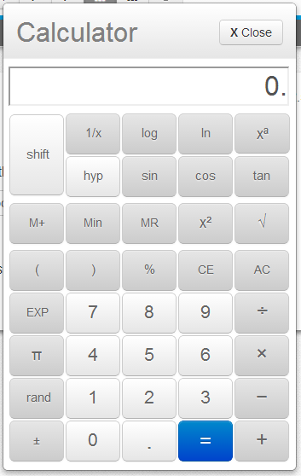
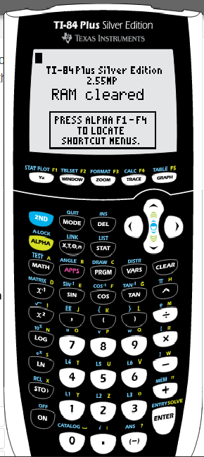
Grades 6 - 12
Drop Down
Calculators
Additionally,
Students will be allowed to bring their own calculators. (No qwerty or CAS)
scientific calculator (Grade 8)
Grades 3 – 5 No Calculator
Grades 6 – 7: Four Function with
% and square root key
Notes:
See Section 2.9 of testing manual for limitations.
There are calculator limitations, but they are basically the same as ACT – No CAS, but any graphing calculator or scientific calculator will work for S’s.

Slide 19
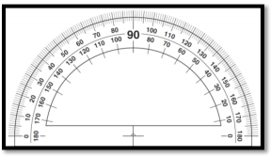

#6: Math Tools
On-Line Grades 4 - 12:
  Rulers & Protractors available as
  on-line tools (shown to the right)
8th Grade, Geometry & Integrated Math:
  Not Provided as On-Line Tools, but . . .
    Schools or Students May Provide: tracing paper, reflection tools, straight edge and compass – think Transformational Geometry Tools

Slide 20
#7 – Scratch Paper
Test Administrators Must Provide:
  At least 2 sheets of blank paper or graph paper per test/session (unit)
  Scratch paper is NOT limited

Slide 21
#8: Reference Sheets
Think about how to incorporate these into your instruction
Will be provided as a dropdown
  Hard copies may be provided as well

Slide 22
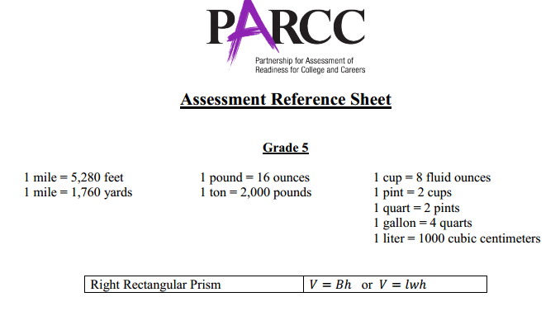
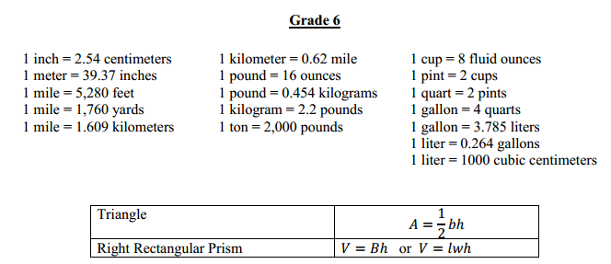

Slide 23
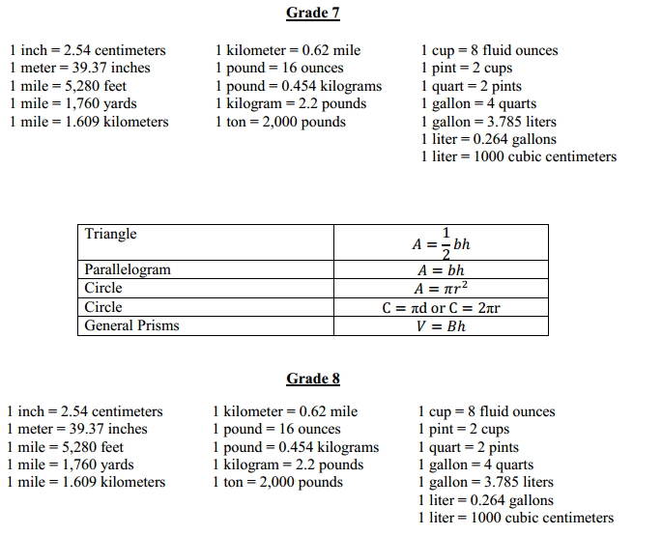
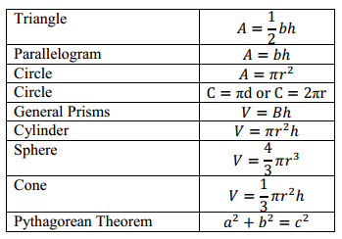

Slide 24
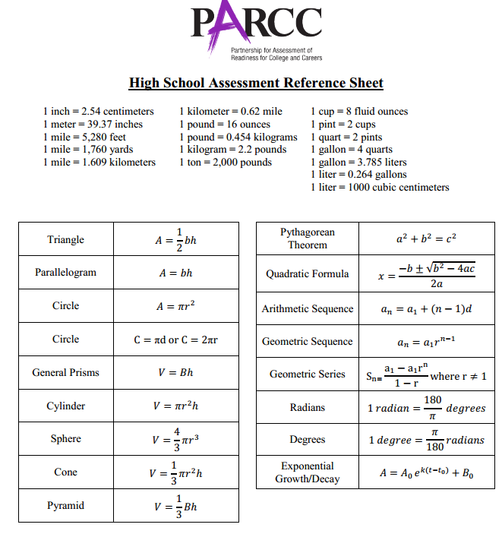

Slide 25
#9: Evidence-Centered Design (ECD)
Claims
Evidence
ECD is a deliberate and systematic approach to assessment development that will help to establish the validity of the assessments, increase the comparability of year-to year results, and increase efficiencies/reduce costs.
Design begins with the inferences (claims) we want to make about students
Tasks
In order to support claims, we must gather evidence
Tasks are designed to elicit specific evidence from students in support of claims
ECD is a deliberate and systematic approach to assessment development that will help to establish the validity of the assessments, increase the comparability of year-to year results, and increase efficiencies/reduce costs.
Notes:
Now lets look at the Evidence Centered Design as it relates to Mathematics. This links the claims we want to make about students to the evidence collected in order to support those claims, to the tasks that are intended to elicit that evidence.

Slide 26
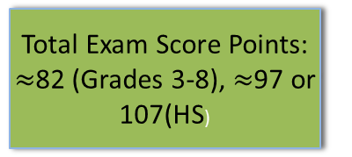
Claims Structure: Mathematics
Master Claim: On-Track for college and career readiness. The degree to which a student is college and career ready (or “on-track” to being ready) in mathematics. The student solves grade-level /course-level problems in mathematics as set forth in the Standards for Mathematical Content with connections to the Standards for Mathematical Practice.
Sub-Claim A: Major Content¹ with Connections to Practices
The student solves problems involving the Major Content¹ for her grade/course with connections to the SMP’s
Sub-Claim B: Additional & Supporting Content² with Connections to Practices
The student solves problems involving the Additional and Supporting Content² for her grade/course with connections to the SMP’s.
Sub-Claim C: Highlighted Practices MP.3,6 with Connections to Content³ (expressing mathematical reasoning)
The student expresses grade/course-level appropriate mathematical reasoning by constructing viable arguments, critiquing the reasoning of others, and/or attending to precision when making mathematical statements.
~43%
~37 pts (3-8),
~42 pts (HS)
~24%
~14 pts (3-8),
~23 pts (HS)
~14%
14 pts (3-8),
14 pts (HS)
4 pts (Alg II/Math 3 CCR)
Sub-Claim D: Highlighted Practice MP.4 with Connections to Content (modeling/application)
The student solves real-world problems with a degree of difficulty appropriate to the grade/course by applying knowledge and skills articulated in the standards for the current grade/course (or for more complex problems, knowledge and skills articulated in the standards for previous grades/courses), engaging particularly in the Modeling practice, and where helpful making sense of problems and persevering to solve them (MP. 1),reasoning abstractly and quantitatively (MP. 2), using appropriate tools strategically (MP.5), looking for and making use of structure (MP.7), and/or looking for and expressing regularity in repeated reasoning (MP.8).
Total Exam Score Points:
$≈$82 (Grades 3-8), $≈$97 or 107(HS)
~19%
12 pts (3-8),
18 pts (HS)
6 pts (Alg II/Math 3 CCR)
Notes:
The assessment is based on the CCSS; therefore it is imperative that students have access to the standards during instruction
Claim: A statement about student performance based on how students respond to test questions. PARCC
tests are designed to elicit evidence from students that support valid and reliable claims about the extent to
which they are college and career ready or on track toward that goal and are making expected academic gains
based on the Common Core State Standards. To support such claims, PARCC assessments are designed to
measure and report results in multiple categories called master claims and sub-claims.

Slide 27
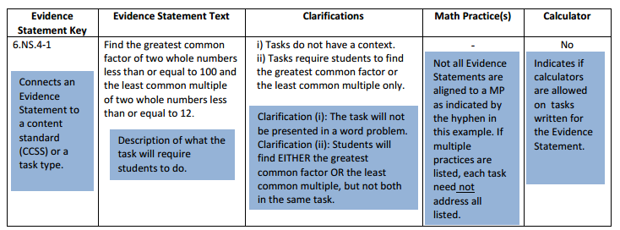
#10 Evidence Statements Have
Useful Clarifications

Slide 28
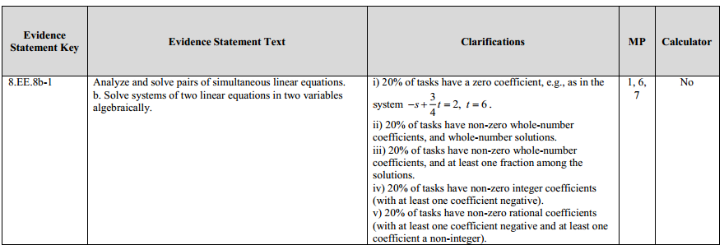

More Evidence Statement Samples
Ca
EOY
, and estimate solutions by graphing the equations. Solve simple cases by inspection. For example, 3x + 2y = 5 and 3x + 2y = 6 have no solution because 3x + 2y cannot simultaneously be 5 and 6.
Alg 1
Calculate and interpret the average rate of change of a function (presented symbolically or as table) over a specified interval. Estimate the rate of change from a graph
Notes:
NOTE: Orange boxes denote extra info I added.
8.EE.8b-1 has more info in the actual CCSS
F-IF.6-1b comes from the Algebra 1 EOY – Note the actual clarifications of the function types.
Think of the Evidence Statements as ways to integrate and connect all the CCSS – NOT as a checklist!
• Evidence Statements describe what students might say or do to demonstrate mastery of the standards with connections to
the mathematical practices.
• An Evidence Statement table includes all the evidences to be measured on each of the PARCC Summative Assessments and
include clarifications for item writing purposes.
• Evidence Statements unpack the standards in a way that is meaningful to test developers and educators.
• Evidence Statements are directly aligned to the claims presented by PARCC.
• Evidence Statements indicate when the PARCC assessment will measure multiple standards and practices.

Slide 29

#11 Securely Held Knowledge
Geom

Slide 30
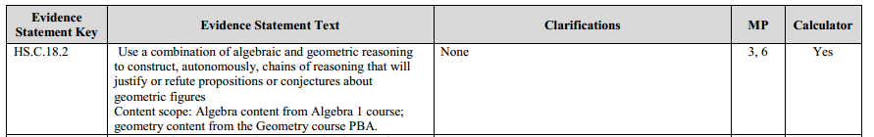
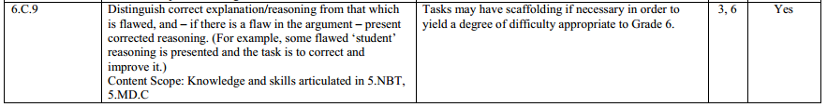
#12 C & D Claims are NOT explicitly found in the CCSSM document
Based on Reasoning and Modeling
  Connecting CCSS to applications and modeling
For example:
Geom

Slide 31
#13 Practice Tests
http://practice.parcc.testnav.com/#
Taking the tutorial and practice test is the best way to become more familiar with PARCC tools and functionalities
PBA Practice Tests will be released later this fall

Slide 32
Field Test Lesson Learned
Teachers NOT students press Exit at the End of the Test
Keyboarding Skills

Slide 33
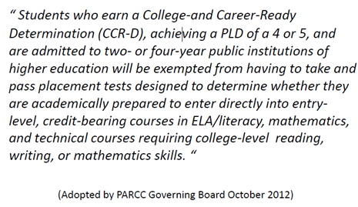
#14 NMPARCC Results Will Have Meaning
Beyond High School

Slide 34

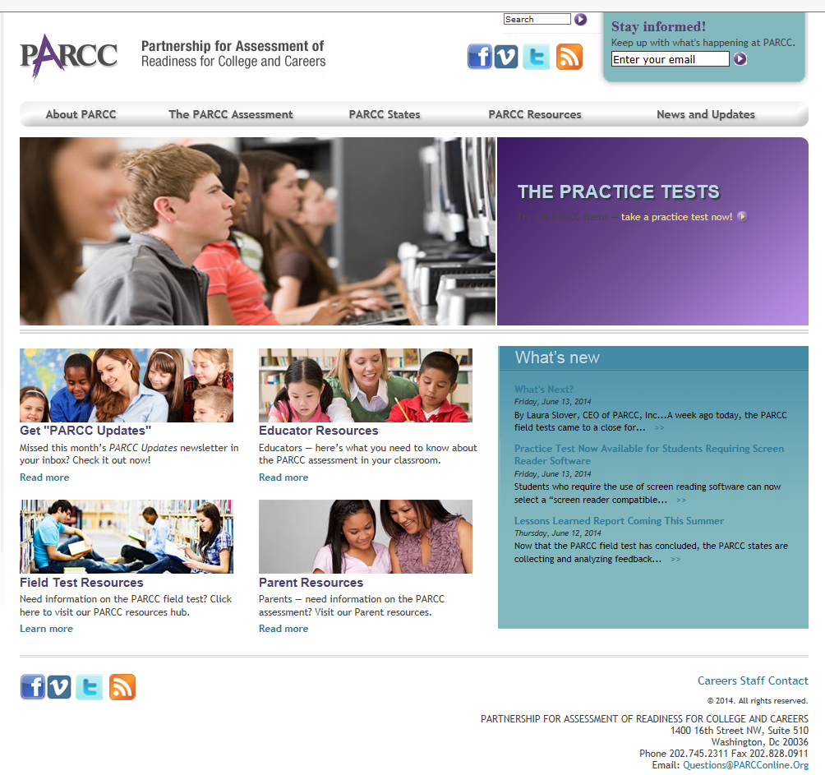


Updates and more information
wanderson@parcconline.org
@parccplace
parcconline.org
Sign up for the
PARCC Updates newsletter
Sign up for PARCC Updates
parcconline.org

Slide 35
Resources
Assessments: the Next Generation: (links to all PARCC practice items, smarter balance, & other good next gen sources)
  http://nextgen.apps.sparcc.org/math
Basic PARCC implementation Videos:
  http://www.marlboro.k12.nj.us/curriculum.cfm?subpage=67284
APS Assessment Information:
  http://apsassessment.wordpress.com
Notes:
Note that Illustrative Mathematics is an awesome Instructional Site – and can be used for formative assessment. However, it is not designed to be used for large scale assessments.
Think about PD in PLC’s of looking at MC questions from SBA, ACT, SAT, PSAT and examine WHY S’s chose the wrong answer.

Slide 36
Q & A
What specific support do you need for your next steps?
  Write your name, school & the specific request on a post-it and place it on the poster

