Slide 1
Michael Loughrey
Attended (8) week-long PARCC Item/Passage Bias & Content Reviews
Long-time HS English teacher & Measurement Professional
Former RDA Assessment Manager
PARCC English/Language Arts
PARCC: Partnership for Assessment of Readiness for College and Career
18 Facts Every ELA Educator Should Know – Q & A
10/13/14 (MS & HS Teachers)

Slide 2
Objective
To get all your current questions about PARCC answered.
Notes:
Write down any questions that come up during the .
Time will remain to answer any questions that aren’t covered in the presentation.
I will try to address the most common questions RDA gets from teachers.

Slide 3
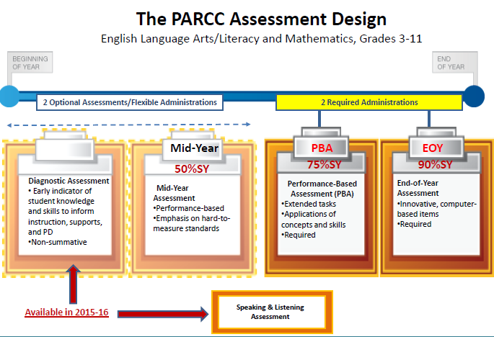
#1 PARCC Replaces the SBA This Year
Notes:
#1 in your packet has a timeline with more explanation at the bottom.
CCSS were adopted in 2010 by most states
APS piloted math items in spring 2012 & some schools took the field test in math and ELA in spring 2014.
Schools should have started teaching CCSS last year.
The design of the PARCC assessment is driven by the following priorities:
Determine whether students are college and career ready or on track
Assess the full range of the CCSS, including stds that are difficult to measure
Measure the full range of S performance, including the performance of high & low performing S’s
Provide data from diagnostic tests during the academic year to inform instruction, interventions & PD
Provide data for accountability, including measures of growth
Incorporate innovative approaches throughout the assessment system.

Slide 4
NMPARCC Windows for
2014-15 School Year
PBA window: March 2 - March 27, 2015
  Each student takes 3 sessions of ELA
  Each student takes 2 sessions of Math
EOY window: April 13 – May 8, 2005
  Each MS/HS student takes 2 ELA sessions
  Each student takes 2 sessions of Math
Notes:
For this year’s testing, results will not be available until Fall 2015.
Based on the results of the field test, the operational test this spring will have one less EOY passage and four fewer items.

Slide 5
#2 Three ELA Shifts
Complexity: Regular practice with complex texts and their academic language.
Evidence: Reading, writing and speaking grounded in evidence from texts, both literary and informational.
Knowledge: Building knowledge through content-rich nonfiction.
Notes:
These shifts are the crux of the PARCC assessment.
Without students reading and pulling evidence from what PARCC calls “authentic” passages that may have challenging vocabulary, students will not be prepared for the spring assessment.
#2 in the packet give some tips for helping your students to read “closely.”
#3 in the packet is a guide for text dependent questions.
#4 in the packet is Webb’s Depth of Knowledge chart. The verbs in levels 2, 3, and 4 may be useful as you think of text dependent questions.

Slide 6
#3 Reading Standards 1 & 10 Are at the Core of Every Part of the ELA Assessment
Two standards are always in play—whether they be reading or writing items, selected-response or constructed-response items on any one of the four components of PARCC. They are:
  Reading Standard 1 (Use of Evidence)
  Reading Standard 10 (Complex Texts)
Notes:
Read these RI standards to them for grade 6.

Slide 7
#4 “Stretch” Lexile Bands
Grade Band | Current Lexile Band | "Stretch" Lexile Band
2–3 | 450L–725L | 420L–820L
4–5 | 645L–845L | 740L–1010L
6–8 | 860L–1010L | 925L–1185L
9-10 | 960L–1115L | 1050L–1335L
11–CCR | 1070L–1220L | 1185L–1385L
Metametrics 2014
Notes:
Cite Metametrics.
PARCC also uses
RMM=Reading Maturity Index (Pearson)
SR uses sentence as measure(?)
Staircase of complexity illustrated in stretch lexiles.
(#5) In packet “On the Spot Scaffolding for Students.”
Lev Vygotsky’s Scaffolding and Zone of Proximal Development.

Slide 8
#5 Authentic Texts
All texts (passages) will be authentic.
    Sources
    No longer copyrighted (75 years)
    Open source
    Copyright purchased
  PARCC will not necessarily shy way from controversial topics.
  Wide variety of genres, styles, time periods, etc.
Notes:
PARCC defines authentic as, texts written by writers who show exceptional craft and who incorporate rich repositories of ideas and information in their texts.
See p. 57 in CCSS document for genres pulled from for PARCC assessment.

Slide 9
#6 “Rule of Thumb” for Text Length: Both Literary & Informational
Min/Max Length*
Grade Level
  3 – 5
  6 – 8
  9 - 11
200 – 800 words
400 – 1,000 words
500 – 1,500 words
*Texts below word length, e.g., poetry, political cartoons, advertisements, etc. must be robust to support sufficient questions.

Slide 10
#7 Context Clues
Most questions sets will have vocabulary questions.
PARCC uses “glossing” sparingly.
Knowing how to use context clues will be essential.

Slide 11
#8 Examples of where “glossing” may be appropriate
Antiquated word or phrase
Historical references
Technical/scientific words
Allusions
Idioms
Glossing will only be done when a word, term, phrase, or reference interferes with students’ ability to demonstrate the reading skills called for in CCSS.

Slide 12
#9 Academic Vocabulary from www.marileesprenger.com/the-critical-words.html
Check for words at your grade level in CCSS and Appendix B exemplars
“Some” Critical Verbs
“Some” Critical Nouns
Analyze
Determine
Evaluate
Infer
Integrate
Paraphrase
Summarize
Trace
Distinguish
Alliteration
Argument
Connotative Language
Evidence
Point of View
Rhetoric
Stanza
Theme
Claim/Counterclaim
Notes:
#6 in your packet, is a longer listing of academic words.
Do what Marilee Sprenger did and go through the CCSS with teachers in your PCL who teach the same grade level and pull out the academic vocabulary that you think students will have trouble.
Reinforce those words every time your students come across them in an assignment.

Slide 13
#10 Many Different ELA Standards
RL (literature)
RI (informational)
*RH (literacy in history & social studies)
*RST (literacy in science & technical subjects) (gr. 6-11)
*grades 6-11 only
W(writing)
  Argumentation
  Informative/explan-atory
  Narratives
L(language)
**RF(reading foundational skills)
**grades K-5 standards not tested
Notes:
#7 in your packet does a good job of explaining argumentation and distinguishing it from persuasion.

Slide 14
#11 Next Gen Item Types
PBA
EOY
*PCR Tasks
  NT (Narration Task)
  LAT (Literary Analysis Task)
  RST (Research Simulation Task)
EBSR (Extended-Based Selected Response)
TECR (Technology- Enhanced Constructed Response)
*Prose Constructed Response
Quick Scoring Items
  EBSR
  TECR, (e.g., drag and drop, cut & paste)
  Multiple select response
  Multiple choice
Notes:
As of July 29 2014, PARCC has revised the writing rubric.
(#8 & #9) in your packet are the revised rubrics and are now separate rubrics for the NT and for both the RST and LAT .
These are for grades 6-11.
#10 is an example of a task model PARCC uses with its contractors, ETS and Pearson.

Slide 15
#12 PBA & EOY Scoring
Machine-scored whether on the PBA or EOY
    EBSR
    Multiple select
    Multiple choice
    TECR
      drag & drop
      cut & paste
      shade text
      move items to show relationships
3 hand-scored Prose Constructed Response (PCR) tasks on the PBA
Notes:
There are other types of TECR than noted here. There are probably more TECR in math than ELA.

Slide 16
#13 ELA Session Times for MS & HS
 |  | PBA Unit 1 | PBA Unit 2 | PBA Unit 3 | EOY Unit 1 | EOY Unit 2
Grades 6-8 | Unit Time | 75 | 90 | 60 | 60 | 60
 | Est. Time on Task | 50 | 60 | 40 | 40 | 40
Grades 9-11 | Unit Time | 75 | 90 | 60 | 60 | 60
 | Est. Time on Task | 50 | 60 | 40 | 40 | 40
Notes:
While it is anticipated that most students will complete the test sessions within these estimated times, all
participating students will have a set amount of additional time for each session to provide them with ample
time to demonstrate their knowledge. Students with disabilities who have a documented (e.g., IEP) for extended
time accommodation will be given time beyond the set additional time.
Note that a change from the field test is that grades 6-11 will only have two units (sessions) for the EOY.

Slide 17
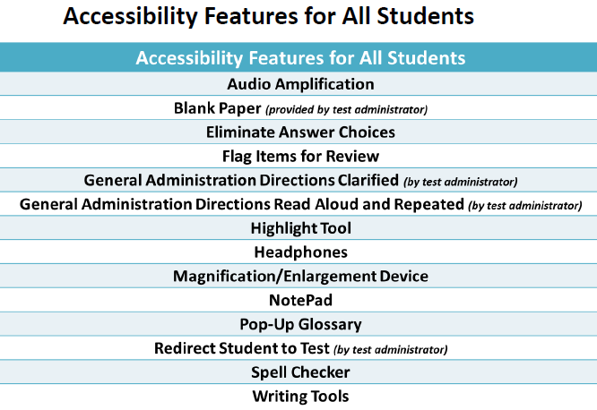
# 14 Accessibility & Accommodations Support
, Line Reader Tool
Notes:
Note that every student is entitled to blank (scratch) paper provided by the test administer.
The test administer will collect the scratch paper after the test and shred it.
On the Resources slide which you will see later, there are two links that allow students to see some of these features in practice.

Slide 18
Middle School Sample Items
Research Simulation Task Grade 7

Slide 19
Understanding the Research Simulation Task (Scaffolding)
  Students begin by reading an anchor text that introduces the topic.
  EBSR and TECR items ask students to gather key details about the passage to support their understanding.
  Students read two additional sources (or one reading source and a 4 minute video) and answer a few questions about each text to learn more about the topic, so they are ready to write the final essay and to show their reading comprehension.
  Finally, students mirror the research process by synthesizing their understandings into a writing that uses textual evidence from the sources.
Notes:
One of the additional “texts” for grade 6-11 may be a 4 minute video clip. PARCC calls all three “texts” or “stimuli.”

Slide 20
Sample Item #2
According to the article “The Biography of Amelia Earhart,” which events had the most significant impact on Earhart’s life? From the list, create a summary by dragging the four most significant events and dropping them in chronological order into the table.
1 | Earhart becomes the first woman to fly across the Atlantic Ocean by herself.
2 | Earhart attends a finishing school in Philadelphia.
3 | Earhart purchases her first plane.
4 | Earhart works as a nurse’s aide in Canada.
5 | Earhart attends an air show, where a stunt pilot flies close to her.
6 | Earhart sets off on a flight around the world.
7 | Earhart places third at the Cleveland Women’s Air Derby.
Event 1
Event 2
Event 3
Event 4
Correct Response: 5, 3, 1, 6

Slide 21
Sample Item #3—Part A
Which sentence explains how paragraph 4 is important to the development of the ideas in “The Biography of Amelia Earhart”?
  Paragraph 4 provides details that explain why Earhart chose flying as a career.
  Paragraph 4 relates Earhart’s love of hard work to her success in flying.
  Paragraph 4 illustrates how Earhart’s enjoyment of flying changed her personal life.
  Paragraph 4 retells a key event that enabled Earhart to become a celebrity pilot.*

Slide 22
Sample Item #3—Part B
Which quotation from paragraph 4 best supports the answer in Part A?
  “’I’m too busy to answer just now,’ she said.”
  “It wasn’t until the caller supplied excellent references that she realized the man was serious.”
  “’How would you like to be the first woman to fly the Atlantic?’ he asked, to which Earhart promptly replied, ‘Yes!’”*
  “…she was asked to join pilot Wilmer ‘Bill’ Stulz and co-pilot/mechanic Louis E. ‘Slim’ Gordon.”

Slide 23
Sample Item #7—Part A (prototype)
Below are three claims that could be made based on the article “Earhart’s Final Resting Place Believed Found.”
Select the conclusion that is supported by the most relevant and sufficient evidence within the article “Earhart’s Final Resting Place Believed Found.”
Claims | Earhart and Noonan lived as castaways on Nikumaroro Island.
 | Earhart and Noonan’s plane crashed into the Pacific Ocean.
 | People don’t really know for certain where Earhart and Noonan died.*

Slide 24
Sample Item #7—Part B
Select evidence from the article that best supports the answer in Part A. Drag two sentences from the list and drop them into the table.
1 | “A tiny coral atoll, Nikumaroro was some 300 miles southeast of Earhart’s target destination, Howland Island.” (paragraph 3)
2 | “Although she did not succeed in her around-the-world expedition, Earhart flew off into legend just after her final radio transmission.” (paragraph 10)
3 | “Books, movies, and television specials about her disappearance abound as well as speculation about her fate.” (paragraph 11)*
4 | “Eventually, Earhart’s twin-engine plane, the Electra, was ripped apart by Nikumaroro’s strong waves and swept out into deep water, leaving no visible trace.” (paragraph 16)
5 | “’The evidence is plentiful—but not conclusive yet—to support the hypothesis that Amelia landed and died on the island of Nikumaroro,’ forensic anthropologist Karen Ramey Burns told Discovery News.” (paragraph 17)*
Evidence 1
Evidence 2

Slide 25
Sample Item #8—Part A
In the video “Amelia Earhart: Life and Disappearance,” the narrator mentions people who “qualified [Earhart’s] skill as adequate” (1:04).
What meaning is this phrase intended to suggest to the viewer of the video?
  that Earhart’s skill as a pilot deserved popular admiration
  that Earhart’s skill as a pilot eventually allowed her to receive a license
  that Earhart’s skill as a pilot may sometimes have been overrated*
  that Earhart’s skill as a pilot was surprising in a woman
Notes:
There will also be EBSR and TECR items about the video.

Slide 26
Sample Item #11 (RST prototype)
You have read two texts and watched a video describing Amelia Earhart. All three include information that supports the claim that Earhart was a daring, courageous person. The three texts are:
“The Biography of Amelia Earhart”
“Earhart’s Final Resting Place Believed Found”
“Amelia Earhart’s Life and Disappearance” (video)
Consider the argument each author uses to demonstrate Earhart’s bravery.
Write an essay that analyzes the strength of the arguments related to Earhart’s bravery in at least two of the texts. Remember to use textual evidence to support your ideas.

Slide 27
Narrative Task
Grade 6
Notes:
The narrative task will only involve reading the one text.

Slide 28
Grade 6 Prose Constructed-Response (PCR) Item
In the passage, the author developed a strong character named Miyax. Think about Miyax and the details the author used to create that character. The passage ends with Miyax waiting for the black wolf to look at her.
Write an original story to continue where the passage ended. In your story, be sure to use what you have learned about the character Miyax as you tell what happens to her next.

Slide 29
High School Sample Items
End of Year
Grade 9

Slide 30
#15 Informational Texts vs. Literature
Although the split is 70% informational texts to 30% literature in grades 9-11, disciplines such as social studies and science focus almost solely on informational text.
English Language Arts Teachers will have more of a 50%-50% split between informational and literary text, with informational text including literary non-fiction such as memoirs and biographies.
Notes:
This is the elephant in the room.
For grades 6-8, the split is 55 informational/45 literature with science and social studies taking up some of the informational percentage.

Slide 31
Sample Item #2—Part A
According to the information in paragraph 1, how is solving crop crimes similar to solving high-profile murder cases?
  Solving crop crimes uses the science of human fingerprint analysis to examine evidence.
  Solving crop crimes uses genetic material inside the cells of living things to examine evidence.*
  Solving crop crimes uses specialized computers at crime scenes to examine evidence.
  Solving crop crimes uses information about the general appearance of living things to examine evidence.
Notes:
This is a good example of an article from a scientific journal/periodical or website that tests Reading for Science and Technical Subjects (RST) standards.
Students in grades 6-11 will be tested on these standards in an RST (Research Simulation Task).
Note there are two RST abbreviations.

Slide 32
Sample Item #2—Part B
Which detail from the article best supports the answer to Part A?
  “Several organizations have started offering DNA testing to the North American plan breeding and seed industry.”
  “…the test will be used by plant breeders and research scientists to identify important genes.”
  “…DNA fingerprints will make it possible for police investigators or researchers to pinpoint specific plant traits and accurately identify seed varieties.”*
  “Easy to use DNA test kits for certain crops should be on the market within the next few years.”

Slide 33
Sample Item #3—Part B
Based on information from the text, what are the two ways that the procedure for developing a DNA fingerprint simplifies the search identified in Part A?
  Plant breeders no longer have to guess which crop trait will be desirable.
  Plant breeders no longer have to wait for seeds to grow into plants before learning if the plants possess a desired crop trait.*
  Plant breeders can look for a desired crop trait that has the same DNA as a trait that is not desired.
  The DNA test can be performed to look for markers for a desired crop trait rather than for its actual DNA.*
  The DNA test can tell plant breeders which crop trait will be most desired by seed companies.
  The DNA test can indicate which genes will eventually produce a desired crop trait.
Notes:
This is a multiple select response. Multiple select responses will have a square, which the student clicks, next to the possible responses.
Typical multiple choice items which have one answer like the previous items will have a circle to the left of the possible responses.

Slide 34
Sample Item #4
The article shows that understanding plan DNA offers many advantages to plant growers and scientists. To complete the chart below, first select the two statements from the left column that are advantages of understanding plant DNA.
Then, drag and drop one quotation from the list of possible supporting evidence into the “Supporting Evidence” column to provide textual support for each advantage you selected. You will not use all of the statements from the box titled “Possible Supporting Evidence.”
Possible Supporting Evidences
1. “Easy to use DNA test kits for certain crops should be on the market within the next few years.”
2. “Specialized computer-based analysis programs identify the fingerprint, or specific genes carried in the seed of individual crop varieties.”
3. “The technique of DNA fingerprinting has been developed using the science of genetics.”
4. “An organism’s DNA contains the blueprint of its characteristics—in the case of plants, that would include features like yield, drought resistance and starch content. (correct answer for C)*
5. “At one time, the researcher would have to grow the crop to see if the trait is present. But now, the DNA of the seed batch can be tested to determine if the seeds contain the sought-after gene.” (correct answer for D)*
6. “Since DNA fingerprints are taken from the same DNA that carries the entire genetic blueprint for the plant, pieces of DNA that are close together tend to be passed on together from one generation to the next.”
Advantages of Understanding Plant DNA | Supporting Evidence
A. The study of plant DNA has led to a better understanding of human DNA.
B. The study of plant DNA has led to advancements in computer programs that help with the analysis of genes.
C. The study of plant DNA has enabled scientists to isolate the genes responsible for more useful plants.*
D. Scientists can now determine if a crop has desired characteristics much earlier in the growth cycle.*
E. Plant DNA now enables scientists to recreate species of plants that have become extinct.
F. Plant DNA has generated public interest in science and has resulted in new products being sold.
Notes:
There are more than six supporting evidences but the information was too long for the PPt slide.

Slide 35
Sample Item #5
Complete the diagram below by choosing and correctly sequencing the steps of the process of developing a DNA fingerprint, as described in the text. Drag and drop each selected step into the appropriate box. Not all steps will be used.
First… Then… Then… Then… Finally…
Correct Sequence:
Add an extraction solution to a small amount of the sample being studied. (step 1). Add enzymes to the extracted DNA. (step 2) Sort the DNA fragments into a pattern. (step 3) Shift the pattern to a nylon sheet and inject radioactive probes. (step 4) Identify the pattern by locating the sites where the radioactive probes bonded to the DNA fragments. (step 5).
STEPS OF THE PROCESS
Sort the DNA fragments into a pattern.
Use scissors to cut the DNA into strands of differing lengths and shapes.
Identify the pattern by locating the sites where the radioactive probes bonded to the DNA fragments.
Place particles in a series of sieves to separate them by size.
Add an extraction solution to a small amount of the sample being studied.
Shift the patterns to a nylon sheet and inject radioactive probes.
Add enzymes to the extracted DNA.
Notes:
The correct sequence is given to us at the right.

Slide 36
Literary Analysis Task (LAT)
Grade 10
Notes:
The texts will be related because of their themes, plots, characterization, etc.

Slide 37
Understanding the Literary
Analysis Task
Students carefully consider two literary texts worthy of close study.
They are asked to answer a few EBSR and TECR questions about each text to demonstrate their ability to do close analytic reading and to compare and synthesize ideas.
Students write a literary analysis about the two texts.

Slide 38
Sample Item #4—Part A
In line 11 of Sexton’s poem, what does the use of the idea of “tunneling” reveal about Icarus at this point in the poem?
  He is engaging in an intensely concentrated action.*
  He is doomed to become the victim of an accident.
  He is trying to visualize an impossible goal.
  He is forced to begin a puzzling quest.

Slide 39
Sample Item #4—Part B
Which words from Sexton’s poem best help the reader understand the meaning of “tunneling”?
“Admire his wings” (line 9)
“Feel the fire at his neck….” (line 10)
“…he glances up and is caught.” (line 11)
“Who cares that he fell back….” (line 12)

Slide 40
Sample Item #5—Part A
Determine the central idea in Sexton’s poem, as well as specific details that help develop that idea over the course of the poem. From the list of possible central ideas, drag the best statement to the “Central Idea” box in the table. Then drag and drop into the table three supporting details in order to show how that idea is developed over the course of the poem.
Possible Central Ideas
1) Individuals who take unusual paths in life may regret their choices later.
2) Protective parents keep their children from learning important life lessons.
3) Risk-takers are admirable people because they are most likely to experience the highs and lows of life.*
4) People who follow society’s rules are most likely to have productive futures.
Possible Supporting Details
5) “Consider Icarus, pasting those sticky wings on,” (line 1)
6) “…think of that first flawless moment over the lawn / of the labyrinth. Think of the difference it made!” (lines 3-4)*
7) “…here are the shocked starlings pumping past” (line 6)
8) “Larger than a sail, over the fog and the blast / of the plushy ocean, he goes….” (lines 8-9)
9) “…see how casually / he glances up and is caught,…” (lines 8-9)
10) “…Who cares that he fell back to the sea?” (line 12)*
11) “See him acclaiming the sun and come plunging down” (line 13)*
Central Idea:
Supporting Detail:
Supporting Detail:
Supporting Detail:
Notes:
Think of the advantages of testing the concepts of central (main) idea and supporting details electronically instead of with individual multiple choice questions.

Slide 41
Sample Item #7—LAT Prototype Item
Use what you have learned from reading “Daedalus and Icarus” by Ovid and “To a Friend Whose Work Has Come to Triumph” by Anne Sexton to write an essay that provides an analysis of how Sexton transforms “Daedalus and Icarus.”
Develop your claim(s) of how Sexton transforms “Daedalus and Icarus” with evidence from both texts. As a starting point, you may want to consider what is emphasized, absent, or different in the two tests, but feel free to develop your own focus for analysis.

Slide 42
Research Simulation Task (RST)—Grade 11

Slide 43
Sample Item #10—Grade 11
Both John and Abigail Adams believed strongly in freedom and independence. However, their letters suggest that each of them understood these terms differently based on their experiences.
Write an essay that explains their contrasting views on the concepts of freedom and independence. In your essay, make a claim about the idea of freedom and independence and how John and Abigail Adams add to that understanding and/or illustrate a misunderstanding of freedom and independence. Support your response with textual evidence and inferences drawn from all three sources.
Notes:
Three written sources were used for this RST. Note the level of performance expected for 11th graders.

Slide 44
#16 Practice Tests
http://practice.parcc.testnav.com/#
Taking the tutorial and practice test is the best way to become more familiar with PARCC tools and functionalities.
PBA Practice Tests will be released later this fall.

Slide 45
#17 Field Test Lessons Learned
Teachers can log a student back into the PARCC test if a student has unintentionally or purposefully logged off before finishing the test.
Keyboarding Skills and knowing how to use online tools are important.
Notes:
On the Resources slide, which is yet to come, you can see a couple of links to students practice with online tools.

Slide 46
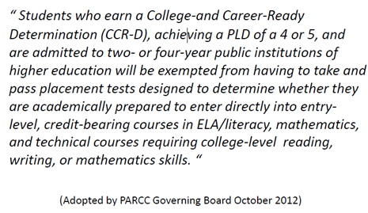
#18 NMPARCC Results Will Have Meaning
Beyond High School
Notes:
When CCSs were put together, they started from the top, grade 12, and asked what abilities and skills would make students college and career ready.
They then worked backwards down the grade levels to determine what abilities and skills students should have at each level.
NM post secondary institutions agreed to this statement, as have higher educations institutions across the country.

Slide 47
Evidence-Centered Design (ECD)
Claims
Evidence
ECD is a deliberate and systematic approach to assessment development that will help to establish the validity of the assessments, increase the comparability of year-to year results, and increase efficiencies/reduce costs.
Design begins with the inferences (claims) we want to make about students
Tasks
In order to support claims, we must gather evidence
Tasks are designed to elicit specific evidence from students in support of claims
ECD is a deliberate and systematic approach to assessment development that will help to establish the validity of the assessments, increase the comparability of year-to year results, and increase efficiencies/reduce costs.
Notes:
This links the claims we want to make about students to the evidence collected in order to support those claims, to the tasks that are intended to elicit that evidence.

Slide 48
What are ELA Evidence tables?
The tables contain the Reading, Writing and Vocabulary Major claims and the evidences to be measured on the PARCC Summative Assessment.
Evidences are attached to the Reading, Writing and Vocabulary claims presented by PARCC.
Evidences describe what students might say or do to demonstrate mastery of the standards.
An item on the PARCC assessment may measure multiple standards and multiple evidences.
Notes:
The evidences are attached to the Reading, Writing and Vocabulary claims presented by PARCC. Reading and Writing will be shared on the following slides.
Evidences describe what students might say or do to demonstrate mastery of the standards and on the PARCC assessment an item may measure multiple standards and multiple evidences.

Slide 49
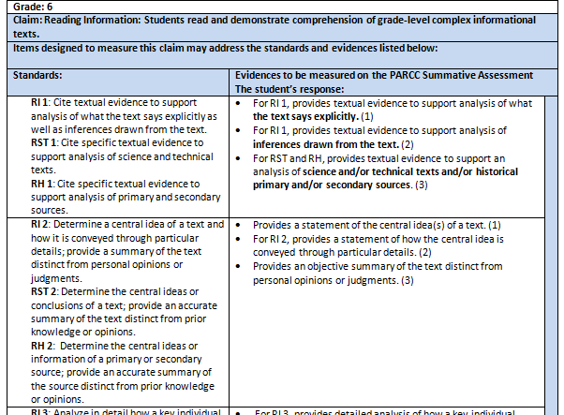
Reading an Evidence Table for Grades 6 -11
Standards:
In Grades 6 – 11 Literacy Standards
for Reading History/Social Studies and for Reading Science/Technical
are added
RH – Reading History/Social Studies
RST – Reading Science/Technical
Notes:
In the evidence tables for grades 6th – 11th the first column on the table also lists the literacy standards for science using RST to identify the standard and the literacy standards for history using RH to identify the standard. These are circled in yellow on the chart.

Slide 50
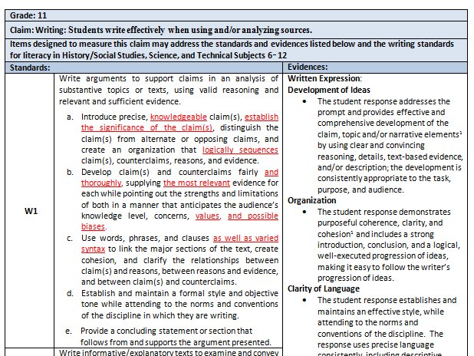
Reading the Writing Evidence Tables
Grade
Claim
Standards:
W - Writing
Evidences
Notes:
On each evidence chart the first line indicates the grade. This is followed by the second line which lists the claim for writing. Next is a statement that the standards and evidences listed below may be reflected in the items designed to measure the claim.
In the first column on the left is a list of the standards.
In the next column are the evidences to be measured on the PARCC Summative Assessment. The evidences can serve as a basis for guiding classroom instruction when teaching reading.

Slide 51
Instructional uses of the evidence statements/tables for teachers
To see ways to combine standards naturally when designing instructional tasks
To help determine alignment of a complex text with standards for instructional passage selection
To develop the stem for questions/tasks for instruction aligned with the standards
To determine and create instructional scaffolding (to think through which individual, simpler skills can be taught first to build to more complex skills)
To develop rubrics and scoring tools for classroom use

Slide 52
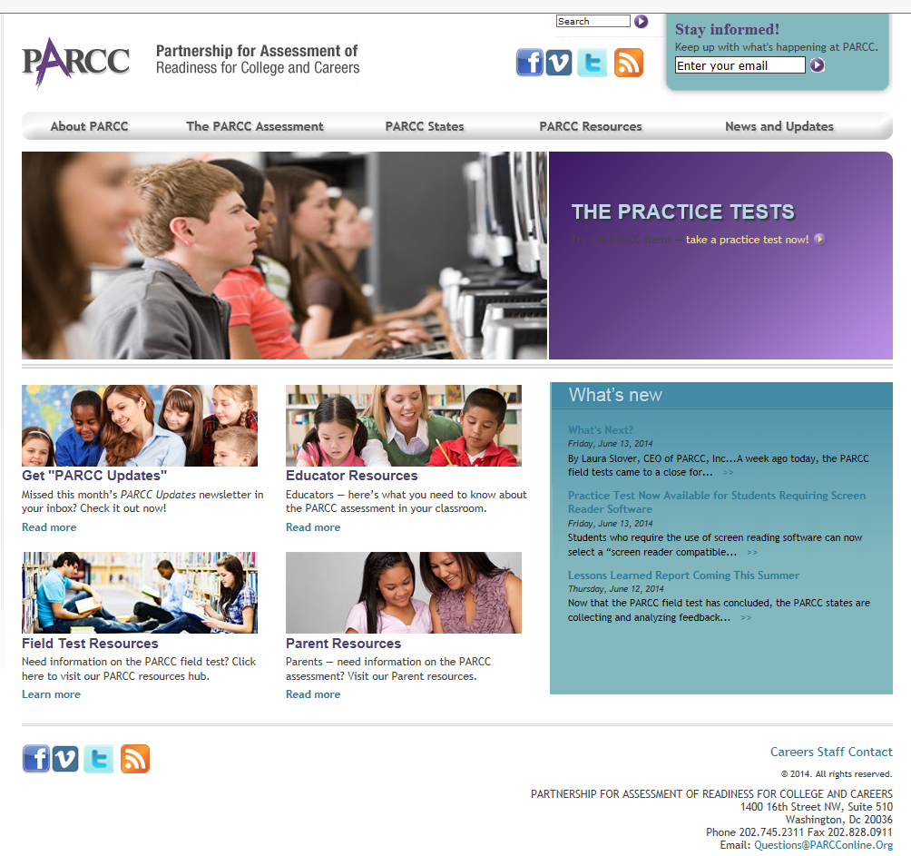


Updates and more information
@parccplace
parcconline.org
Sign up for the
PARCC Updates newsletter
Sign up for PARCC Updates
parcconline.org

Slide 53
Resources
Assessments: the Next Generation: This is the quickest link to all PARCC online practice items. Also, included are practice items from Smarter Balance. Access for Newsela, daily news articles at adjustable Lexile ranges with quizzes.
  http://nextgen.apps.sparcc.org/la
Basic PARCC implementation Videos: 23 Basic student training videos for PARCC ELA TECR items.
  http://www.marlboro.k12.nj.us/curriculum.cfm?subpage=67355
APS Assessment Information:
  http://apsassessment.wordpress.com
Notes:
Think about PD in PLC’s that looks at MC questions from SBA, ACT, SAT, PSAT and examine WHY students chose the wrong answer.

Slide 54
Q & A
What specific support do you need for your next steps?
  Write your name, school & the specific request on a post-it and place it on the poster

