Slide 1
Michael Loughrey
Attended 8 (week-long) PARCC Item/Passage Bias & Content Reviews
Long-time HS English teacher & Measurement Professional
Former RDA Assessment Manager
PARCC English/Language Arts
PARCC: Partnership for Assessment of Readiness for College and Career
17 Facts Every ELA Educator Should Know – Q & A
10/8/14 (ES teachers)

Slide 2
Objective
To get all your current questions about PARCC answered.
Notes:
Write down any questions that come up during the presentation
At least an hour will remain to answer any questions that aren’t covered in the presentation
This tries to address the most common questions teachers have.

Slide 3
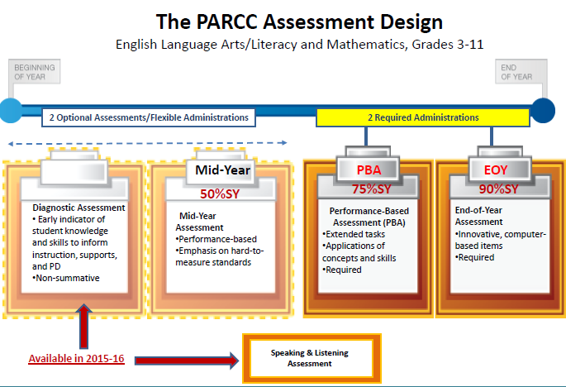
#1 PARCC Replaces the SBA This Year
Notes:
A little history----CCSS were adopted in 2010 by most states
APS piloted in (math) 2011-12 & 2012-13 in school grade levels
According to the state, each school should have taught CCSS in 2013-2014
(#1) In packet, there is a similar timeline with more explanation.
The design of the PARCC assessment is driven by the following priorities:
Determine whether students are college and career ready or on track
Assess the full range of the CCSS, including stds that are difficult to measure
Measure the full range of S performance, including the performance of high & low performing S’s
Provide data during the academic year to inform instruction, interventions & PD
Provide data for accountability, including measures of growth
Incorporate innovative approaches throughout the assessment system.
Timed – yes, but generally speaking SBA was timed as well. Estimated about 50-60 minutes per session/unit
All work done & submitted on the computer WITHOUT any answer booklets

Slide 4
NMPARCC Windows for
2014-15 School Year
Performance-Based Assessment (PBA) 20-day window: March 2 - March 27, 2015
  About 75% of way through the year.
  Each student takes 3 sessions of ELA
  Each student takes 2 sessions of Math
End of Year (EOY) 20-day window: April 13 – May 8, 2015
  About 90% of way through the year
  Each ES student takes 1 ELA session
  Each MS/HS student takes 2 ELA sessions
  Each student takes 2 sessions of Math
Notes:
For this year’s testing, results will not be available until Fall 2015.

Slide 5
#2 Three ELA Shifts
Complexity: Regular practice with complex texts and their academic language.
Evidence: Reading, writing and speaking grounded in evidence from texts, both literary and informational.
Knowledge: Building knowledge through content-rich nonfiction.
Notes:
In packet, see
(#2) “Tips to Turn Students into Close Readers”
(#3) “ A guide to Creating Text Dependent Questions.”
(#4) Webb’s “Depth of Knowledge.” For text dependent questions, pay attention to levels 2, 3, & 4.

Slide 6
#3 Reading Standards 1 & 10 Are at the Core of Every Part of the ELA Assessment
Two standards are always in play—whether they be reading or writing items, selected-response or constructed-response items on any one of the four components of PARCC. They are:
  Reading Standard 1 (Use of Evidence)
  Reading Standard 10 (Complex Texts)
Notes:
Read the two standards from CCSS.

Slide 7
#4 “Stretch” Lexile Bands
Grade Band | Current Lexile Band | "Stretch" Lexile Band
2–3 | 450L–725L | 420L–820L
4–5 | 645L–845L | 740L–1010L
6–8 | 860L–1010L | 925L–1185L
9-10 | 960L–1115L | 1050L–1335L
11–CCR | 1070L–1220L | 1185L–1385L
Metametrics 2014
Notes:
Cite Metametrics.
PARCC also uses
RMM=Reading Maturity Index (Pearson)
SR uses sentence as measure(?)
Staircase of complexity (overlap but increasing) illustrated in stretch lexiles.
(#5) In packet “On the Spot Scaffolding for Students.”
Lev Vygotsky’s Scaffolding and Zone of Proximal Development.

Slide 8
#5 Authentic Texts
All texts (passages) will be authentic.
    Sources
    No longer copyrighted (75 years)
    Open source
    Copyright purchased
  PARCC will not necessarily shy way from controversial topics.
  Wide variety of genres, styles, time periods, etc.
Notes:
PARCC means authentic texts as in texts written by writers who show exceptional craft and or rich repositories of ideas and information.
See p. 31 in CCSS document for many genres.

Slide 9
#6 “Rule of Thumb” for Text Length: Both Literary & Informational
Min/Max Length*
Grade Level
  3 – 5
  6 – 8
  9 - 11
200 – 800 words
400 – 1,000 words
500 – 1,500 words
*Texts below word length, e.g., poetry, political cartoons, advertisements, etc. must be robust to support sufficient question.

Slide 10
#7 Context Clues
Most item sets will have vocabulary questions.
PARCC uses “glossing” sparingly.
Knowing how to use context clues will be essential.

Slide 11
#8 Examples of where “glossing” may be appropriate
Antiquated word or phrase
Historical references
Technical/scientific words
Allusions
Idioms
Glossing will only be done when a word, term, phrase, or reference interferes with students’ ability to demonstrate the reading skills called for in CCSS.

Slide 12
#9 Academic Vocabulary from www.marileesprenger.com/the-critical-words.html
Check for words at your grade level in CCSS & Appendix B exemplars.
“Some” Critical Verbs
“Some” Critical Nouns
Analyze
Determine
Evaluate
Infer
Integrate
Paraphrase
Summarize
Trace
Distinguish
Alliteration
Evidence
Point of View
Stanza
Theme
Central idea
Conclusions
Details
Notes:
Sprenger went through all the CCSS and pulled out academic vocabulary that students struggle with.
(#6) In your packet, there is a longer list.
Go to her website which is underneath the title of this slide.

Slide 13
#10 Many Different ELA Standards
RL (literature)
RI (informational)
*RH (literacy in history & social studies)
*RST (literacy in science & technical subjects) (gr. 6-11)
*grades 6-11 only
W(writing)
  Opinion
  Informative/explan-atory
  Narrative
L(language)
**RF(reading foundational skills)
**grades K-5 RF standards not tested

Slide 14
#11 Next Gen Item Types
PBA
EOY
*PCR Tasks
  NT (Narration Task)
  LAT (Literary Analysis Task)
  RST (Research Simulation Task)
EBSR (Extended-Based Selected Response)
TECR (Technology- Enhanced Constructed Response)
*Prose Constructed Response
Quick Scoring Items
  EBSR
  TECR (e.g., drag & drop, cut & paste)
  Multiple select response
  Multiple choice
Notes:
As of July 29 2014, PARCC has revised the writing rubric.
(#7 & #8) In your packet, there is the revised separate rubric for the NT and a rubric for both the RST and LAT for grade 3.
(#9 # 10) In your packet, there is the revised separate rubric for the NT and a rubric for both the RST and LAT for grades 4-5.
Let’s look at it.

Slide 15
#12 PBA & EOY Scoring
Machine-scored whether on the PBA or EOY
    EBSR
    Multiple select
    Multiple choice
    TECR
      drag & drop
      cut & past
      shade text
      move items to show relationships
3 hand-scored Prose Constructed Response (PCR) tasks on the PBA
Notes:
There are other types of TECR than noted here. There are probably more for math.
Not sure student will get Part B of EBSR correct if Part A is wrong.

Slide 16
#13 ELA Session Times for ES
 |  | PBA Unit 1 | PBA Unit 2 | PBA Unit 3 | EOY Unit 1 | EOY Unit 2
Grade 3 | Unit Time | 75 | 75 | 60 | 75 | -
 | Est. Time on Task | 50 | 50 | 40 | 50 | -
Grades 4-5 | Unit Time | 75 | 90 | 60 | 75 | -
 | Est. Time on Task | 50 | 60 | 40 | 50 | -
Notes:
While it is anticipated that most students will complete the test sessions within these estimated times, all
participating students will have a set amount of additional time for each session to provide them with ample
time to demonstrate their knowledge. Students with disabilities who have a documented (e.g., IEP) for extended
time accommodation will be given time beyond the set additional time.
Accommodations manual is being revised.
Note that a change from the field test is that grades 3-5 will only have one unit (session) for the EOY.

Slide 17
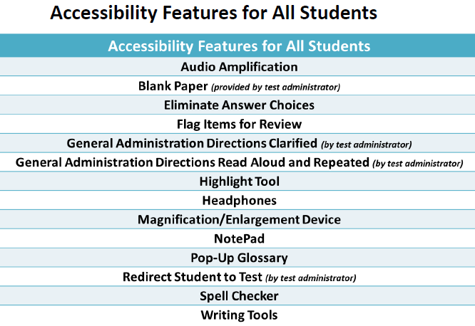
#14 Accessibility & Accommodations Support
, Line Reader Tool
Notes:
Note that every student is entitled to blank (scratch) paper provided by the test administer.
The test administer will collect the scratch paper after the test and shred it.
On the Resources slide which you will see later, there are two links that allow students to see some of the above features in practice.

Slide 18
Elementary School Sample Items
End of Year
Grade 3
“How Animals Live”

Slide 19
Grade 3 Evidence-Based Selected-Response Item #1
Part A
What is one main idea of “How Animals Live?”
There are many types of animals on the planet.
Animals need water to live.
There are many ways to sort different animals.*
Animals begin their life cycles in different forms.
Part B
Which sentence from the article best supports the answer to Part A?
“Animals get oxygen from air or water.”
"Animals can be grouped by their traits.”*
"Worms are invertebrates.”
"All animals grow and change over time.”
"Almost all animals need water, food, oxygen, and shelter to live."

Slide 20
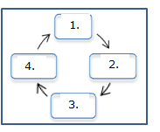
Grade 3 Technology-Enhanced Constructed-Response Item
Drag the words from the word box into the correct locations on the graphic to show the life cycle of a butterfly as described in “How Animals Live.”
Words:
Pupa
Adult
Egg
Larva

Slide 21
Understanding the Research Simulation Task (Scaffolding)
  Students begin by reading an anchor text that introduces the topic.
  EBSR and TECR items ask students to gather key details about the passage to support their understanding.
  Students read one (Grade 3) or two additional sources (Grades 5 and 6) and answer a few questions about each text to learn more about the topic, so they are ready to write the final essay and to show their reading comprehension.
  Finally, students mirror the research process by synthesizing their understandings into a writing that uses textual evidence from the sources.
Notes:
One of the additional “texts” for grade 4 or 5 may be a 4 minute video clip. PARCC calls all three “texts” or “stimuli.”

Slide 22
Grade 3 Sample of RST
Includes total of 7 items:
  4 EBSR
  2 TECR
  1 PCR
Student reads a purpose setting statement for the task.
Student reads each passage and answers questions for that passage.
(Next slide states purpose setting task followed by four machine-scored questions.)
Notes:
(#11) In your packet is one of the 3rd grade passages, An excerpt from Eliza’s Cherry Trees: Japan’s Gift to America.
This passage was rated at the low end of moderately complex.

Slide 23
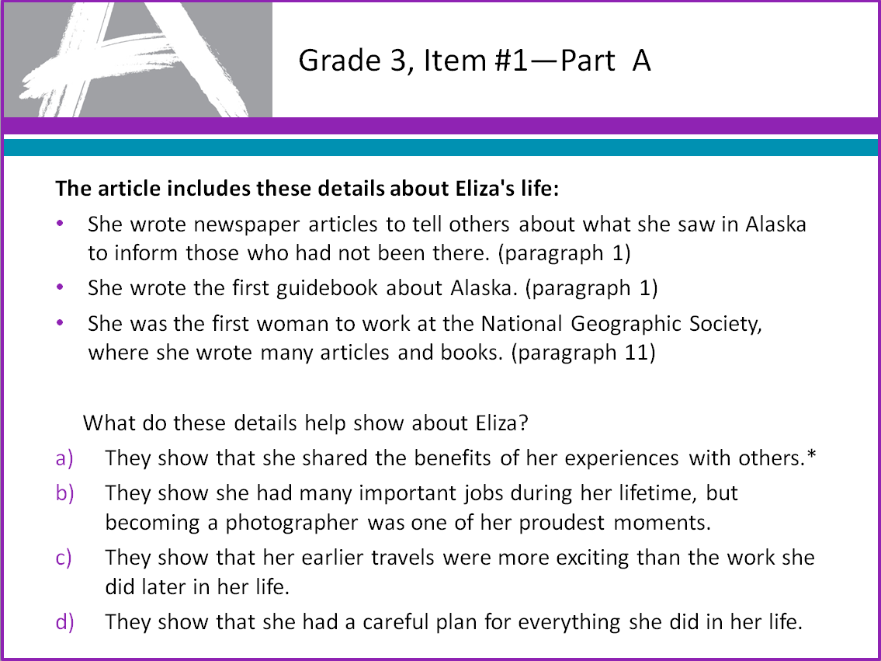
Grade 3, Item #1—Part A
The article includes these details about life:
She wrote newspaper articles to tell others about what she saw in Alaska to inform those who had not been there. (paragraph 1)
She wrote the first guidebook about Alaska. (paragraph 1)
She was the first woman to work at the National Geographic Society, where she wrote many articles and books. (paragraph 11)
What do these details help show about?
They show that she shared the benefits of her experiences with others.*
They show she had many important jobs during her lifetime, but becoming a photographer was one of her proudest moments.
They show that her earlier travels were more exciting than the work she did later in her life.
They show that she had a careful plan for everything she did in her

Slide 24
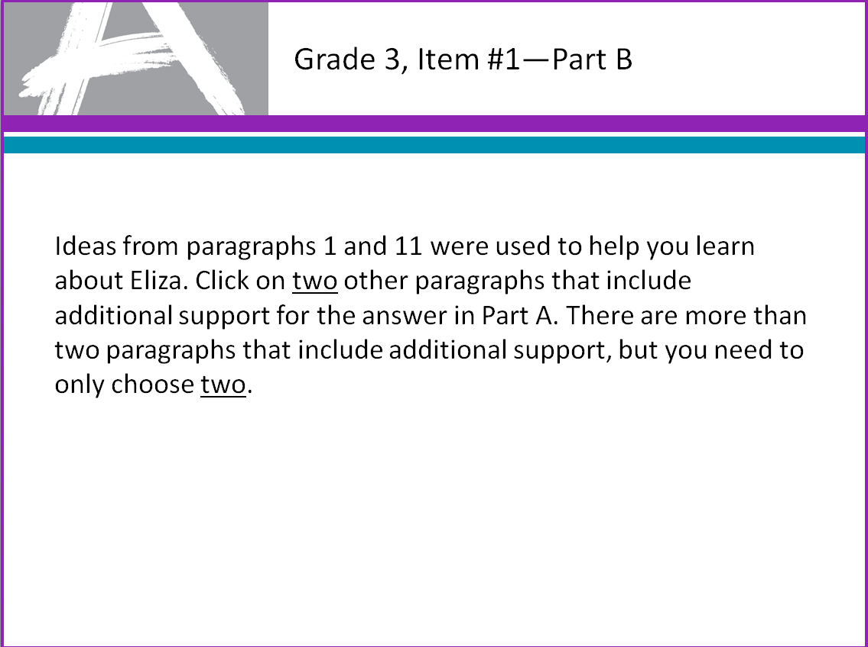
Grade 3, Item #1—Part B
Ideas from paragraphs 1 and 11 were used to help you learn about her. Click on two other paragraphs that include additional support for the answer in Part A. There are more than two paragraphs that include additional support, but you need to only choose two.

Slide 25
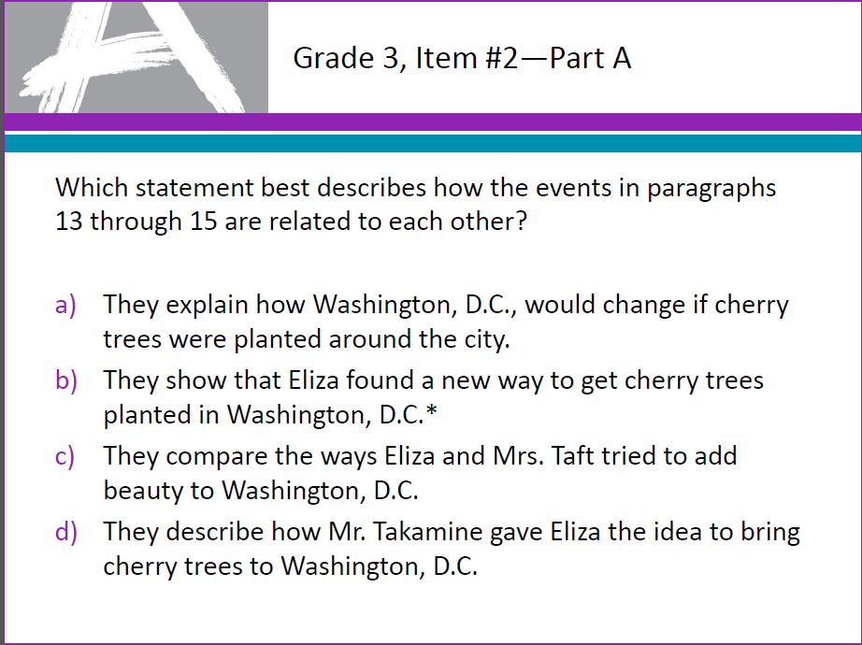
Grade 3, Item #2—Part A
Which statement best describes how the events in paragraphs 13 through 15 are related to each other?
They explain how Washington, D.C., would change if cherry trees were planted around the city.
They show that found a new way to get cherry trees planted in Washington, D.C.*
They compare the ways and Mrs. Taft tried to add beauty to Washington, D.C.
They describe how Mr. gave the idea to bring cherry trees to Washington, D.C.

Slide 26
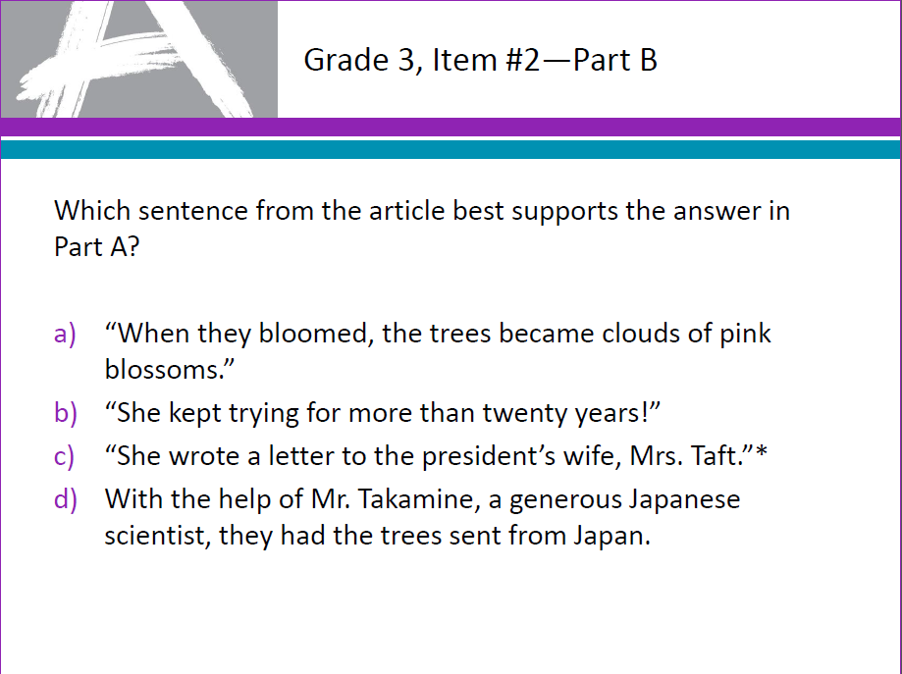
Grade 3, Item #2—Part B
Which sentence from the article best supports the answer in Part A?

Slide 27
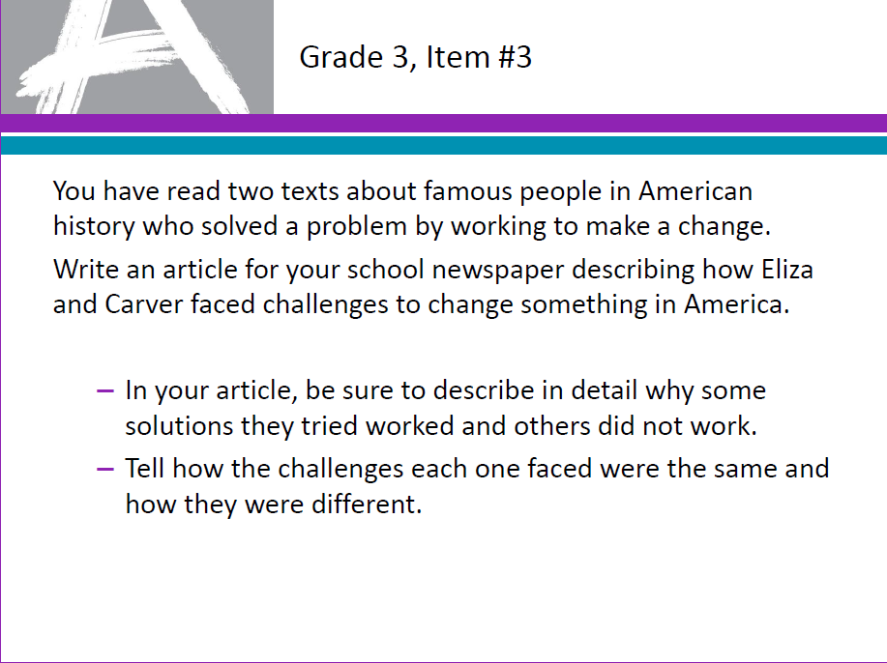

Slide 28
Understanding the Literary
Analysis Task
Students carefully consider two literary texts worthy of close study.
They are asked to answer a few EBSR and TECR questions about each text to demonstrate their ability to do close analytic reading and to compare and synthesize ideas.
Students write a literary analysis about the two texts.
Notes:
The two texts will be related because of their themes, plots, characterization, etc.

Slide 29

Understanding the Narrative
Writing Task
Students read one brief text and answer a few questions to help clarify their understanding of the text(s).
Students then write a narrative story.
Notes:
The narrative task will only involve reading the one text.

Slide 30
End of Year
  Grade 5
  See the passage, “Life in the Limbs,” in your packet. There is also a second text, an interview, in the side bar of the passage.
  The sample items provide students an opportunity to read an article and a corresponding side bar piece on the same topic.
Notes:
(#12) In your packet is the passage, “Life in the Limbs” with the accompanying side bar.

Slide 31
Grade 5, Item #4—Part A
Which idea is found in both the article about Fairoaks and the side bar about Nelson?
Each tree house should be special for its owner.*
People should climb trees for practice before building a tree house.
Having a tree house is good for people.
Going to a tree house school can be helpful in getting started.

Slide 32
Grade 5, Item #4—Part B
Choose one detail from the article and one detail from the side bar that support the answer to Part A. Drag each of the details into the box labeled "Supporting Details."
Supporting Detail from Article | Supporting Detail from Side Bar

Slide 33
#15 Practice Tests
http://practice.parcc.testnav.com/#
Taking the tutorial and practice test is the best way to become more familiar with PARCC tools and functionalities
PBA Practice Tests will be released later this fall

Slide 34
#16 Field Test Lessons Learned
Teachers can log a student back into the PARCC test if a student has unintentionally or purposefully logged off before finishing the test.
Keyboarding Skills and knowing how to use online tools are important.
Notes:
On the Resources slide, which is yet to come, you can see a couple of links to students practice with online tools.

Slide 35
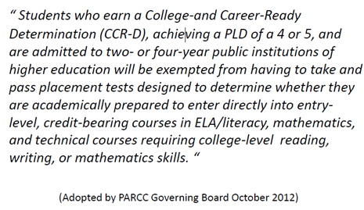
#17 NMPARCC Results Will Have Meaning
Beyond High School
Notes:
When CCSs were put together, they started from the top, grade 12, and asked what abilities and skills would make students college and career ready.
They then worked backwards down the grade levels to determine what abilities and skills students should have at each level.
NM post secondary institutions agreed to this statement, as have higher educations institutions across the country.

Slide 36
Evidence-Centered Design (ECD)
Claims
Evidence
ECD is a deliberate and systematic approach to assessment development that will help to establish the validity of the assessments, increase the comparability of year-to year results, and increase efficiencies/reduce costs.
Design begins with the inferences (claims) we want to make about students
Tasks
In order to support claims, we must gather evidence
Tasks are designed to elicit specific evidence from students in support of claims
ECD is a deliberate and systematic approach to assessment development that will help to establish the validity of the assessments, increase the comparability of year-to year results, and increase efficiencies/reduce costs.
Notes:
ECD was created by Robert Mislevy (ETS), considered the premier psychometrician in the world.
This model is the foundation for the building of the PARCC assessments.
This model shows the link the claims we want to make about students to the evidence collected in order to support those claims, to the task models that are intended to elicit that evidence.
Now lets look at Evidence Tables which support ECD.

Slide 37
What are ELA Evidence tables?
The tables contain the Reading, Writing and Vocabulary Major claims and the evidences to be measured on the PARCC Summative Assessment.
Evidences are attached to the Reading, Writing and Vocabulary claims presented by PARCC.
Evidences describe what students might say or do to demonstrate mastery of the standards.
An item on the PARCC assessment may measure multiple standards and multiple evidences.
Notes:
The evidences are attached to the Reading, Writing and Vocabulary claims presented by PARCC.
Evidences describe what students might say or do to demonstrate mastery of the standards and on the PARCC assessment an item may measure multiple standards and multiple evidences.

Slide 38
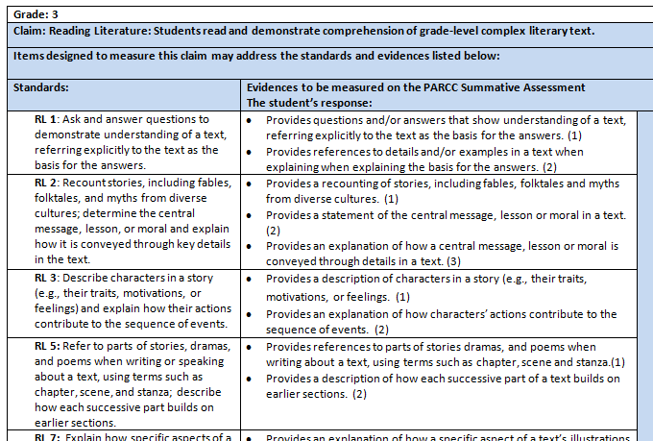
Reading an Evidence Table for Grade 3
Grade
Claim
Standards:
RL –Reading Literary
RI – Reading Information
Evidences
Notes:
On each evidence chart the first line indicates the grade. This is followed by the second line which lists the claim for reading literature or reading informational text or vocabulary. Next is a statement that the standards and evidences listed below may be reflected in the items designed to measure the claim.
In the first column on the left is a list of the standards. If it is a reading literature standard it be identified with the letters RL and if it is an reading informational text standard it will be identified with the letters RI.
In the next column are the evidences to be measured on the PARCC Summative Assessment. The evidences can serve as a basis for guiding classroom instruction when teaching reading.

Slide 39
Instructional uses of the evidence statements/tables for teachers
To see ways to combine standards naturally when designing instructional tasks
To help determine alignment of a complex text with standards for instructional passage selection
To develop the stem for questions/tasks for instruction aligned with the standards
To determine and create instructional scaffolding (to think through which individual, simpler skills can be taught first to build to more complex skills)
To develop rubrics and scoring tools for classroom use

Slide 40



Updates and more information
@parccplace
parcconline.org
Sign up for the
PARCC Updates newsletter
Sign up for PARCC Updates
parcconline.org

Slide 41
Resources
Assessments: the Next Generation: This is the quickest link to all PARCC online practice items. Also, included are practice items from Smarter Balance. Access for Newsela, daily news articles at adjustable Lexile ranges with quizzes.
  http://nextgen.apps.sparcc.org/la
Basic PARCC implementation Videos: 23 Basic student training videos for PARCC ELA TECR items.
  http://www.marlboro.k12.nj.us/curriculum.cfm?subpage=67355
APS Assessment Information:
  http://apsassessment.wordpress.com
Notes:
Think about PD in PLC’s that looks at MC questions from SBA, ACT, SAT, PSAT and examine WHY students chose the wrong answer.

Slide 42
Q & A
What specific support do you need for your next steps?
  Write your name, school, email & the specific request on a post-it and place it on the poster.

