Slide 1
PARCC Math Evidence Tables for Algebra 1, Geometry
& Algebra 2 Teachers
In Preparation for the PARCC Summative Assessments, Spring 2015
& the CCIA for APS in the Interim
Notes:
What exactly is an Evidence Table/statement?
Evidence tables and evidence statements describe the knowledge and skills that an assessment item
or a task elicits from students.
For mathematics, knowing which evidence statements are eligible for the performance-based
assessment (PBA) and the end-of-year assessment (EOY) with accompanying content clarifications
and limits is essential. Also essential in mathematics is to demonstrate the coherent nature of the
standards. As such, some evidence statements include more than one standard.
The most important materials a teacher needs to help students prepare for the PARCC assessments
are the CCSS themselves. The materials provided here may be useful in demystifying the design of
the assessments.

Slide 2
PollEverywhere.Com
At this time, what is your greatest concern in teaching the CCSS?

Slide 3
Today’s Learning Outcomes
Basics of CCSS PARCC assessment design
How to read the PARCC CCSS evidence tables
Evidence Statements to clarify CCSS
Connections to Unit 2 Scope and Sequence
PLD’s – interpreting in light of PBA’s

Slide 4




Assessment Design
English Language Arts/Literacy and Mathematics, Grades 3-11
2 Optional Assessments/Flexible Administration
75%
90%
Diagnostic Assessment
Early indicator of student knowledge and skills to inform instruction, supports, and PD
Non-summative
Mid-Year Assessment
Performance-based
Emphasis on hard-to-measure standards
Potentially summative
Performance-Based
Assessment (PBA)
Extended tasks
Applications of concepts and skills
Required
End-of-Year
Assessment
Innovative, computer-based items
Required
Speaking And Listening Assessment
Locally scored
Non-summative, required
Notes:
PARCC states are developing an assessment system comprised of four components: a Diagnostic Assessment, Mid-Year Assessment, Performance Based Assessment and End-of-Year Assessment. Each component will be computer-delivered and will leverage technology to incorporate innovations.

Slide 5
Evidence-Centered Design (ECD) and PARCC
Design begins with the inferences (claims) we want to make about students
Evidence
In order to support claims, we must gather evidence
Task Models
Tasks are designed to elicit specific evidence from students in support of claims
Claims
ECD is a deliberate and systematic approach to assessment development that will help to establish the validity of the assessments, increase the comparability of year-to year results, and increase efficiencies/reduce costs.
Notes:
Approach to assessment provides clear connection between the Standards and the inferences we want to draw about students (claims), the type of student work/demonstrations that allow us to draw those inferences, and the tasks or activities that allow us to elicit that student work.
This same approach/concept applies in the classroom—with ideas like Understanding By Design—moving backwards from the Standards to Classroom Assessments.
PARCC utilizes Evidence-Centered Design to inform the development of the summative assessments. ECD is a deliberate and systematic approach to assessment development that will help to establish the validity of the assessments, increase the comparability of year-to year results, and increase efficiencies/reduce costs. The Design begins with the inferences (claims) we want to make about students. In order to support claims, we must gather evidence. Tasks are then designed to elicit the specific evidence from students that supports the claims.

Slide 6
“Teaching to the Test” vs. A Test Worth Teaching To
Backwards Planning (UBD)
Evidence-Centered Design in the Classroom
What Enduring Understanding?
What is Acceptable Evidence?
PARCC’s Evidence Centered-Design (ECD)
What Claims?
What Evidence supports the claim?
Which Learning Experiences & What Instruction?
Which Tasks points to the Evidence?
Notes:
UBD (understanding by design) is conceptualized and parallels PARCC. Instead of complaining about teaching to the test, PARCC said, “why don’t we create a test that is worth teaching too?” The idea here is that the test will model what we teach.

Slide 7

Claims Driving Design: Mathematics
Master Claim: Students are on-track or ready for college and careers
Students solve problems involving the major content for their grade level with connections to practices
Student demonstrate fluency in areas set forth in the Standards for Content in grades 3-6
Students solve problems involving the additional and supporting content for their grade level with connections to practices
Students express mathematical reasoning by constructing mathematical arguments and critiques (SMP 3 & 6)
Students solve real world problems engaging particularly in the modeling practice (SMP4)
A
~37 pts (3-8),
~42 pts (HS)
B
~14 pts (3-8),
~23 pts (HS)
C
14 pts (3-8),
14 pts (HS)
4 pts (Alg II/Math 3 CCR)
Sub Claims
D
12 pts (3-8),
18 pts (HS)
6 pts (Alg II/Math 3 CCR)
E
7-9 pts (3-6)
Total Exam Score Points:
82 (Grades 3-8), 97 or 107(HS)
Notes:
Master Claim: Students Are “On Track” to College and Career Readiness
This Master Claim reflects the overall goal of PARCC based on the Common Core State Standards and the PARCC Model Content Frameworks—to prepare students for college and careers, and specifically to ensure students have the skills and understandings required for success. The measure of progress towards this essential goal will be reflected by a student’s overall performance on the summative components (both the Performance-Based Assessment and End-of-Year Assessment) of the PARCC Assessment System.
Master Claim: the degree to which a student is college and career ready or on-track in math.
the student solves grade-level or course-level problems in math as set forth in the CCSS –
the standards for mathematical content with connections to the standards for mathematical practice.
the master claim reflects the overall goal of PARCC based on the CCSS and the PARCC Model Content Frameworks
the measure of progress towards this goal will be reflected by a student’s overall performance on the summative components – PBA & EOY
Sub-Claim A: Major content as identified in the PARCC Model Content Frameworks
Sub-Claim B: Additional & Supporting Content with connections to the Standards for Mathematical Practice
Sub-Claim C: Highlights MP 3 & 6 with connections to content
MP 3: construct viable arguments and critique the reasoning of others
MP 6: Attend to precision
Sub-Claim D: highlights MP 4 with connections to content
MP 4: model with mathematics
Sub-Claim E: Fluency when applicable in grades 3-6

Slide 8
Overview of Task Types
The PARCC assessments for mathematics will involve three primary types of tasks: Type I, II, and III.
Each task type is described on the basis of several factors, principally the purpose of the task in generating evidence for certain sub claims.
Source: Appendix D of the PARCC Task Development ITN on page 17

Slide 9
Overview of PARCC Mathematics Task Types
Task Type | Description of Task Type
I. Tasks assessing concepts, skills and procedures | Balance of conceptual understanding, fluency, and application Can involve any or all mathematical practice standards Machine scorable including innovative, computer-based formats Will appear on the End of Year and Performance Based Assessment components Sub-claims A, B and E
II. Tasks assessing expressing mathematical reasoning | Each task calls for written arguments / justifications, critique of reasoning, or precision in mathematical statements (MP.3, 6). Can involve other mathematical practice standards May include a mix of machine scored and hand scored responses Included on the Performance Based Assessment component Sub-claim C
III. Tasks assessing modeling / applications | Each task calls for modeling/application in a real-world context or scenario (MP.4) Can involve other mathematical practice standards May include a mix of machine scored and hand scored responses Included on the Performance Based Assessment component Sub-claim D

Slide 10
Design of PARCC Math Summative Assessments
Performance Based Assessment (PBA)
  Type I items (Machine-scorable)
  Type II items (Mathematical Reasoning/Hand-Scored – the PLD’s will inform final scoring rubrics)
  Type III items (Mathematical Modeling/Hand-Scored and/or Machine-scored – the PLD’s will inform final scoring rubrics)
End-of-Year Assessment (EOY)
  Type I items only (All Machine-scorable)

Slide 11
Q: What is a Math Evidence Table and what purpose do they serve?
A: Evidence statements are the connectors between the claims and the tasks. They describe the knowledge and skills that an assessment item or task elicits from students.
Notes:
What exactly is an Evidence Table/statement?
Evidence tables and evidence statements describe the knowledge and skills that an assessment item
or a task elicits from students.
For mathematics, knowing which evidence statements are eligible for the performance-based
assessment (PBA) and the end-of-year assessment (EOY) with accompanying content clarifications
and limits is essential. Also essential in mathematics is to demonstrate the coherent nature of the
standards. As such, some evidence statements include more than one standard.
The most important materials a teacher needs to help students prepare for the PARCC assessments
are the CCSS themselves. The materials provided here may be useful in demystifying the design of
the assessments.
For mathematics, the evidence tables show how the content and the mathematical practices go hand-in-hand and should
not be thought of as separate standards

Slide 12
Evidence Statement Tables:
Types of Evidence Statements
Several types of evidence statements are being used to describe what a task should be assessing, including:
1. Those using exact standards language
2. Those transparently derived from exact standards language, e.g., by splitting a content standard
3. Integrative evidence statements that express plausible direct implications of the standards without going beyond the standards to create new requirements
4. Sub-claim C & D evidence statements, which put SMP #3, #4, and #6 as primary with connections to content
Notes:
NOTE: It is evident in the released PARCC prototype questions that teachers must intentionally integrate multiple content and practice standards in their classroom materials and activities
4 types of integrative evidence statements
Integrative for a cluster
(example: 3.NF.A.Int.1; F-IF.A.Int.1)
Integrative for a domain
(example: S-ID.Int.1)
Integrative for a conceptual category
(example: A.Int.1 -- this example is integrative across the algebra category)
Integrative for an elementary grade or for high school

Slide 13
Log onto . . .
parcconline.org
Open tab at top:
The Parcc Assessment
Click on Left side:
Parcc Assessment Design
Then click on:
Assessment Blueprints and . . .

Slide 14
Open the two documents for one content area
Take 5 minutes to look through both of these documents for one content area
After 5 minutes of independent research, you will be directed to do a pair share of what you noticed for another 10 minutes
Then, we will look at these documents with respect to Unit 2 of our Units of Study for Alg 1, Geom & Alg 2

Slide 15
Looking at Unit 2:
the CCSS’s
+ Evidence Tables
+ SMP’s
+ Calculator

Slide 16
Some Instructional Uses of the Evidence Tables
To see ways to combine standards naturally when designing instructional tasks
To determine and create instructional scaffolding (to think through which individual, simpler skills can be taught first to build to more complex skills)
To develop rubrics and scoring tools for instructional tasks
To see how the content and the mathematical practices go hand-in-hand and should not be thought of as separate standards
To use as a tool to guide questions for classroom tests
and assessments

Slide 17
PARCC Calculator Policy
Grades 3 – 5
NO Calculators Allowed *
Grades 6 – 7
Online four function calculator with square root
Accessible for about 50% of the assessment
Grade 8
Online scientific calculator
Accessible for about 50% of the assessment
High School
Online calculator with functionalities similar to that of a TI-84 graphing calculator
Accessible for more than 80% of the assessment
For all grades:
Assessments are to be divided into calculator and non- calculator sessions, provided that the other sessions of the assessment are locked.
NOTE: There is continuing discussion on whether to allow students to use a “real” vs “on-line” calculator in 2015
(*) For students who need accommodation, calculators will be allowed for even non-calculator portions of the assessment, excluding fluency

Slide 18
Reference Sheets for the Assessment
PARCC has approved the following reference sheets that students can use during testing. These reference sheets include the necessary formulas and reference information students need to assist them in answering certain mathematics questions

Slide 19
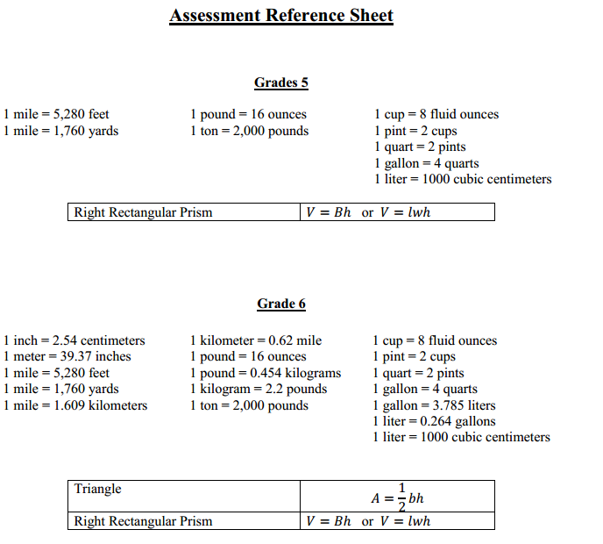

Slide 20
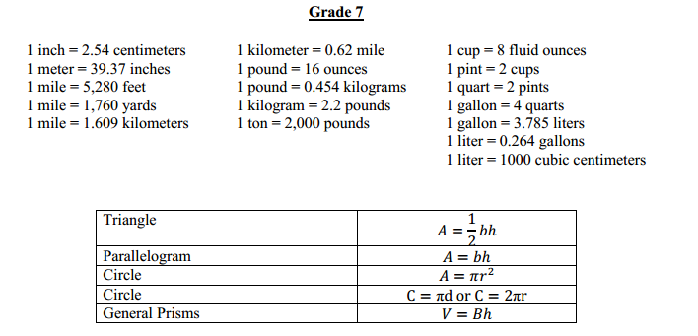

Slide 21
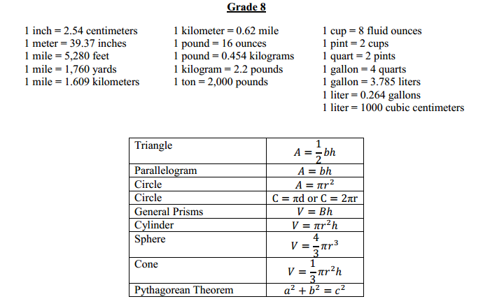

Slide 22
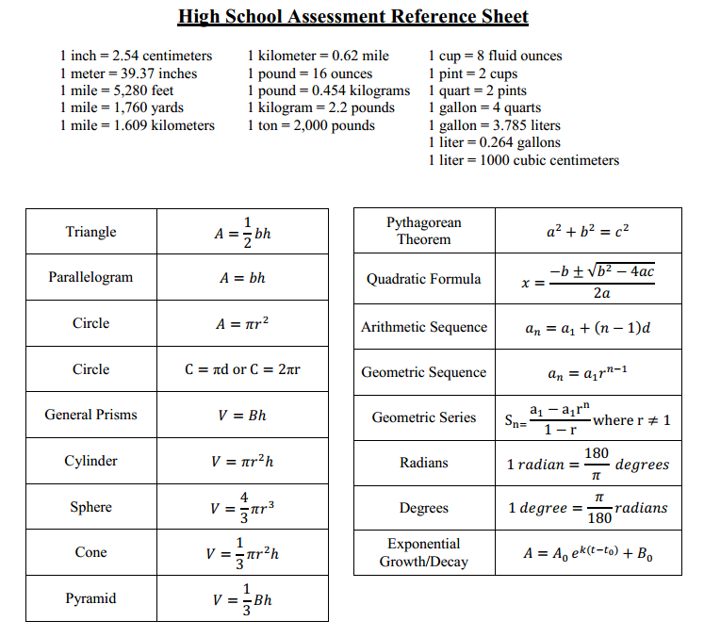

Slide 23
CCSSM Exemplar Assessment Prototypes
PARCC
http://www.parcconline.org/samples/item-task-prototypes
Illustrative Mathematics (IM)
www.illustrativemathematics.org
Mathematics Assessment Resources Service (MARS)
http://map.mathshell.org/materials/lessons.php
New York City Dept of Education (NYC)
http://schools.nyc.gov/Academics/CommonCoreLibrary/CommonCoreClassroom/Mathematics/default.htm

Slide 24

Next Steps
What do you still want to learn?
What questions do you have?
Write these on post-it notes, and place on the parking lot as you leave
Thank you for attending today!
Ronda Davis; davis_r@aps.edu

