Slide 1


Evidence Based Selected Response (EBSR) Items

Slide 2
EBSR and PARCC
Evidence-Based Selected Response (EBSR)—Combines a traditional selected-response question with a second selected-response question that asks students to show evidence from the text that supports the answer they provided to the first question. Underscores the importance of Reading Anchor Standard 1 for implementation of the CCSS.
EBSR items focus on students rigorously citing evidence from texts throughout the PARCC assessment.
EBSR items include questions with more than one right answer to allow students to generate a range of rich insights that are substantiated by evidence from text(s)
Students gather key details about the passage to support their understanding when answering an EBSR question

Slide 3
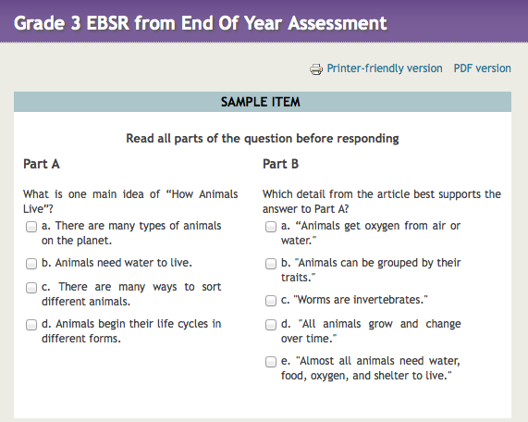


Question about key detail
Support that understanding with evidence from the text

Slide 4
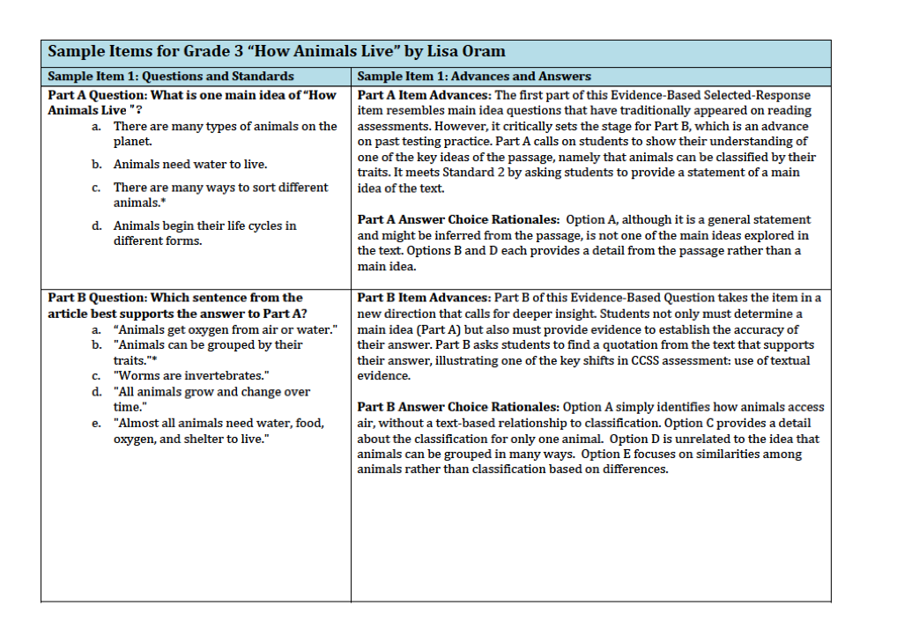
A closer look at EBSR
Main idea question
Deeper Insight: Demonstrate the use of evidence through quotations or examples from the text
Common Core Shift 4: Text Based Answers

Slide 5
Preparation for Prose Constructed Response (PCR) items
EBSR Items draw students into deeper encounters with the text
EBSR Items ask students to do close analytical reading and to compare and synthesize ideas
Students complete one of three PCR responses: Narrative Task, Literary Analysis, and Research Simulation Task

Slide 6
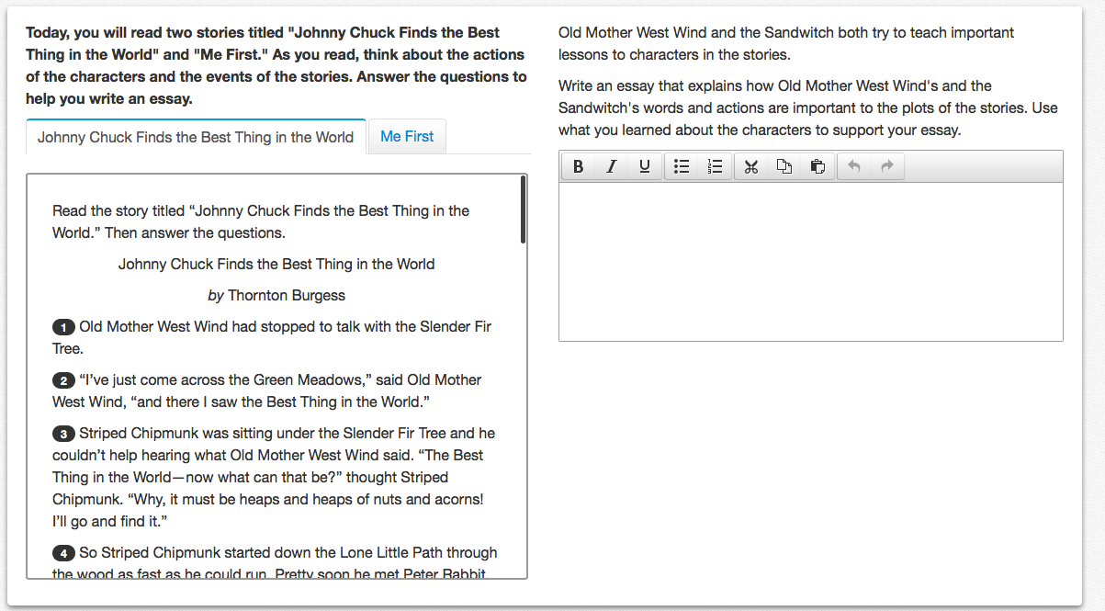
PCR: respond using two texts and text examples from both

Slide 7
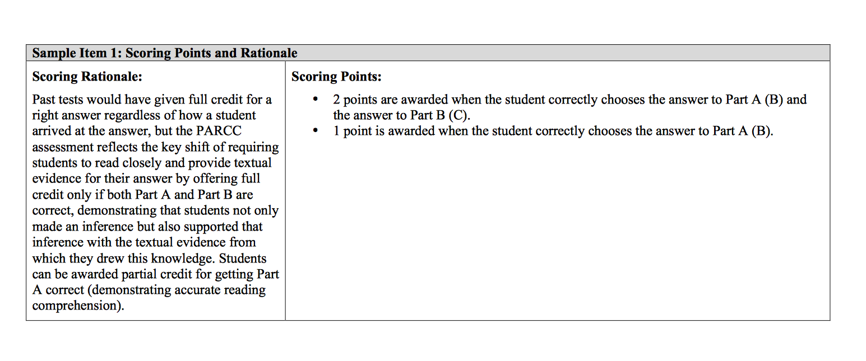
Scoring
2 points when Part
A and B are correct
1 point when Part A is correct

