Slide 1
Teacher and School Leader Evaluations
Update on APS Implementation Plan
ACE 2013
Presented by:
Shelly Green, Chief Academic Officer
Andi Trybus, Asst. Superintendent for Human Resources
Carrie Robin Menapace, Policy Analyst & Legislative Liaison

Slide 2
Agenda for ACE
Thursday Morning:
Expectations
How did we get here?
Teacher Evaluation Plan: APS Alternative & PED Default
Principal Evaluation Plan: APS Alternative & PED Default
Improvement Plans
Friday Morning for schools administrators:
Observation Tool
Another Look at the Domains
Activities for Principals to use at School Staff Meetings
Friday Afternoon:
Level meetings for school administrators
Department meetings for central administrators

Slide 3
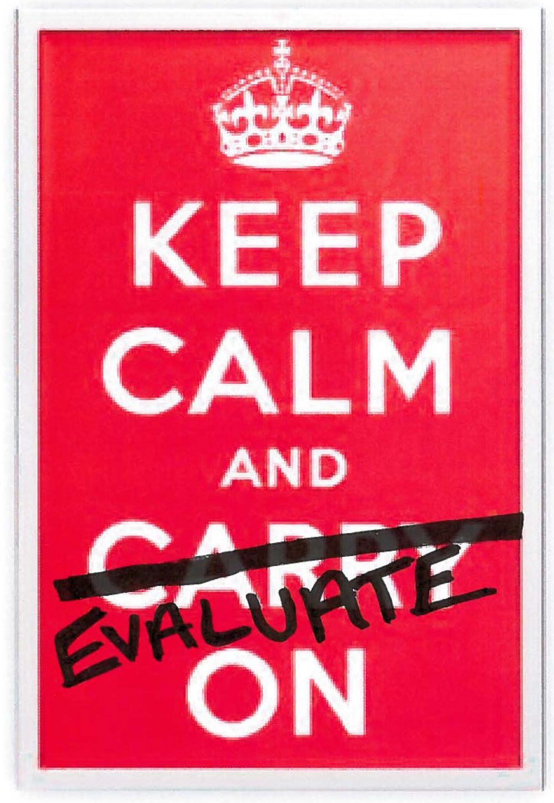

Slide 4
Expectations From the District
Remain Calm…this is a work in progress
It’s imperative that the message from the district to principals and principals to school staff is the same
Worked with ATF to make sure we are giving the same answers
ATF knows it is not going to be easy
There is still a lot of information that has not been clarified by PED
No excuses:
Observations must be completed on time
If a teacher is minimally effective or ineffective, you must put them on an improvement plan
If a teacher is on a plan, the teacher must complete the improvement plan
Walkthroughs should be used to inform conversations

Slide 5
How did we get Here?
Timeline
2012-2013 School Year:
SIG Schools Pilot NMTEACH Observation Protocol
May 2013:
District Plans for Evaluation Due to PED
APS/RRPS Board of Education Joint Meeting
APS submitted an alternative plan that was later denied by PED
June 2013:
PED Mandatory training for all Principals and Asst. Principals on observation protocol
APS Alternative Plan 2.0 submitted to PED – still no denial
July 2013:
ACE Training
August 2013:
Full implementation in every district in the state

Slide 6
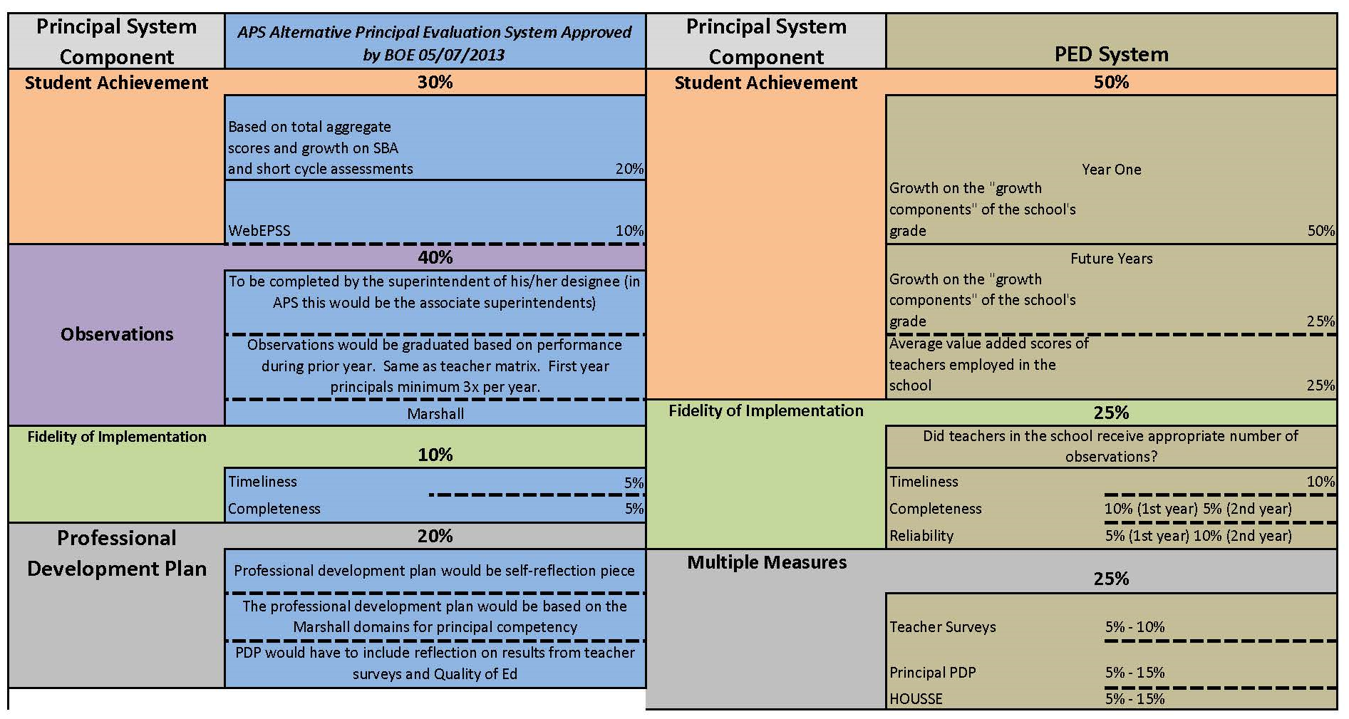

Slide 7
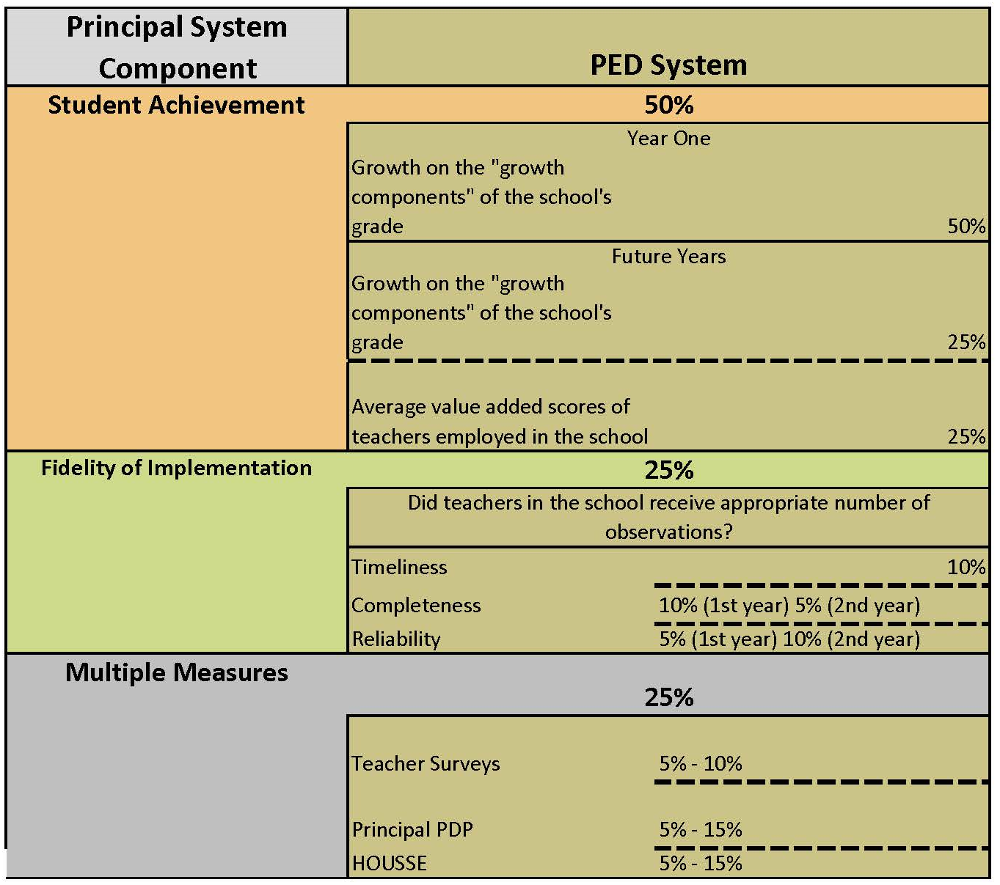

Slide 8
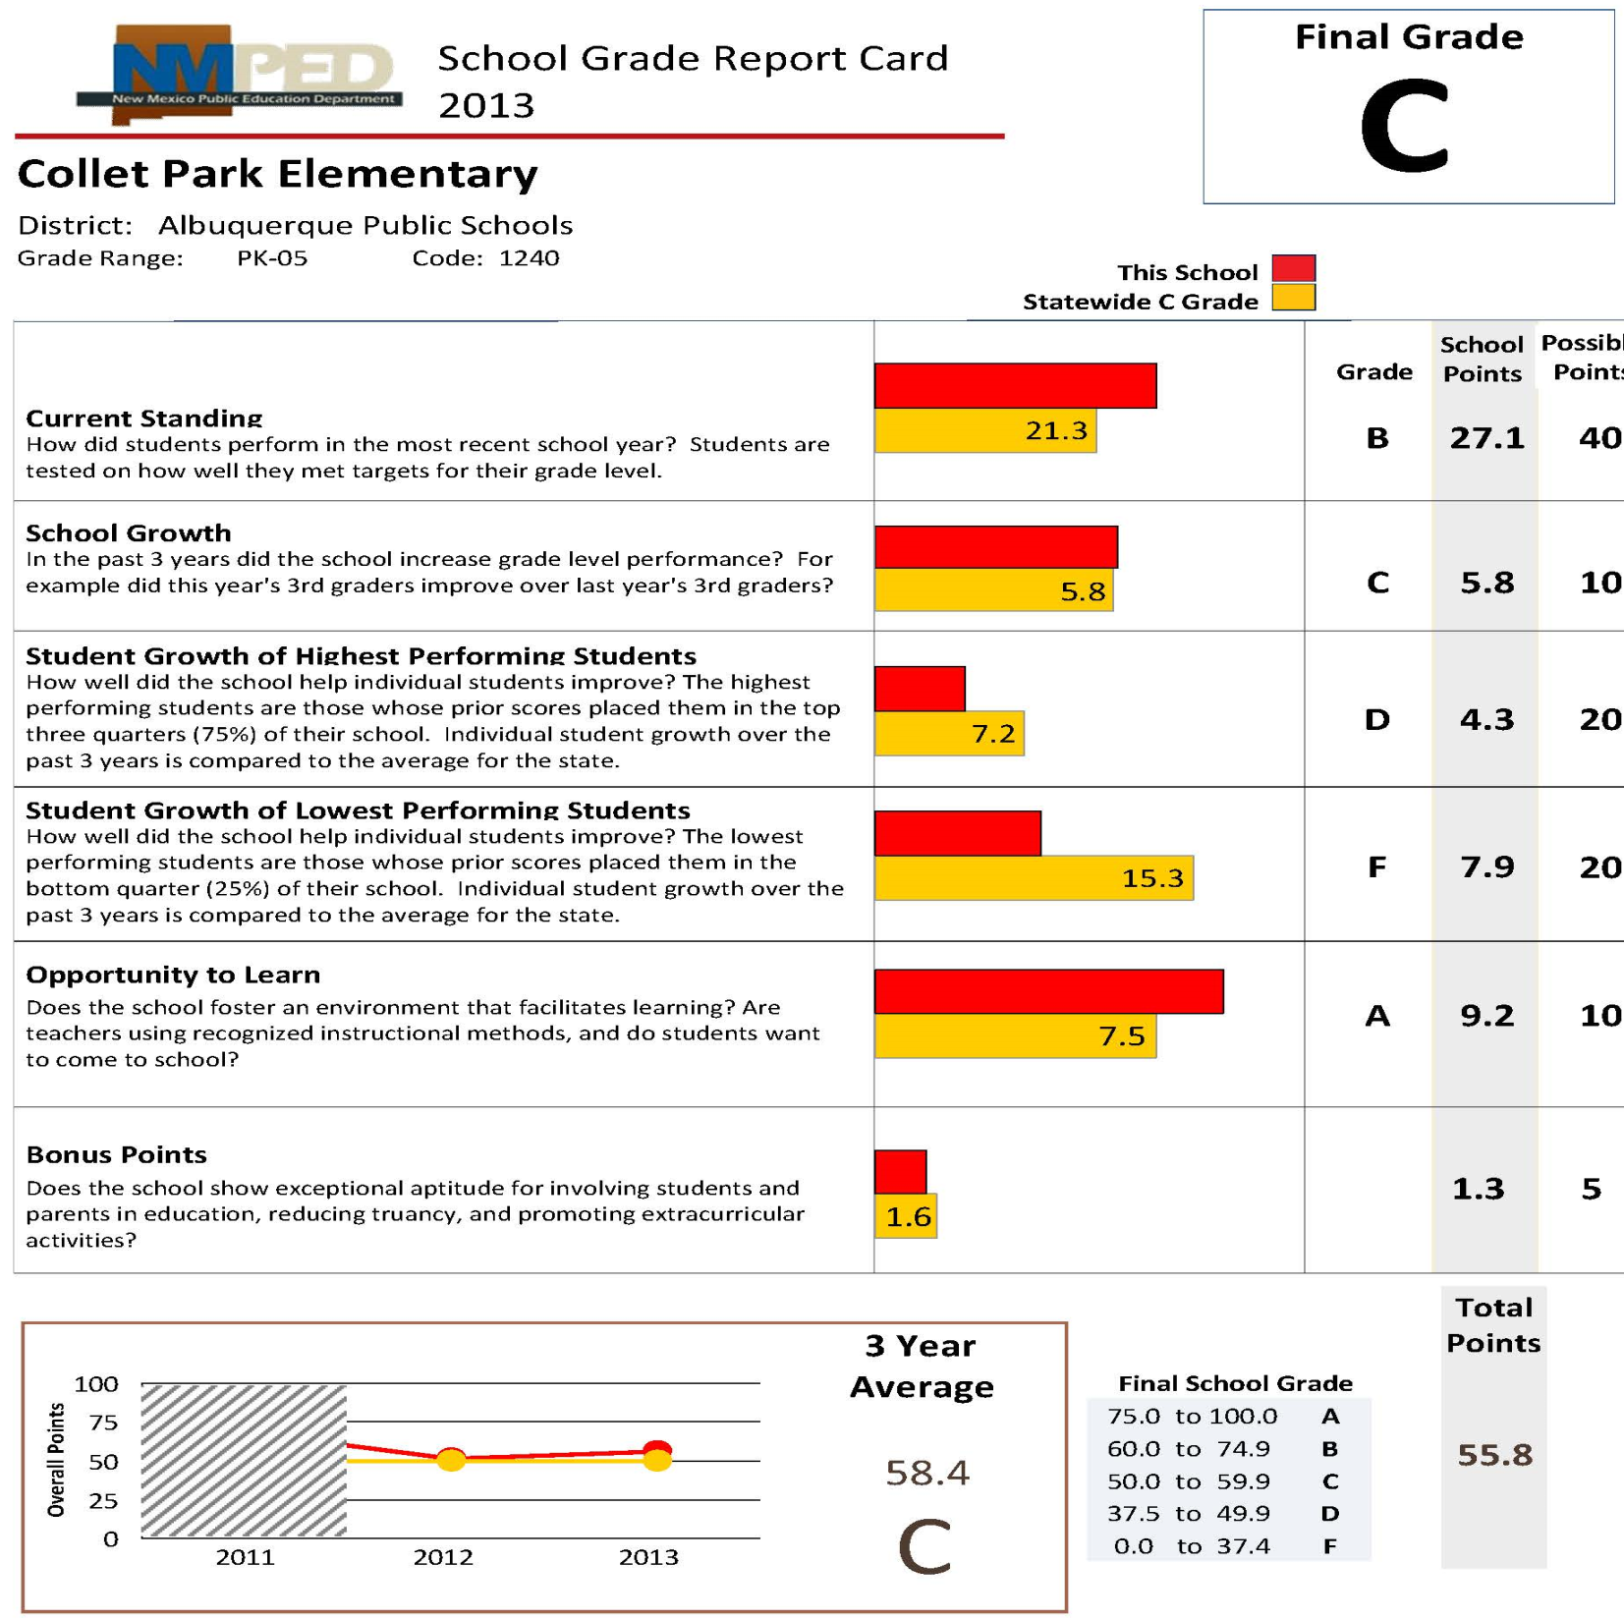

Slide 9
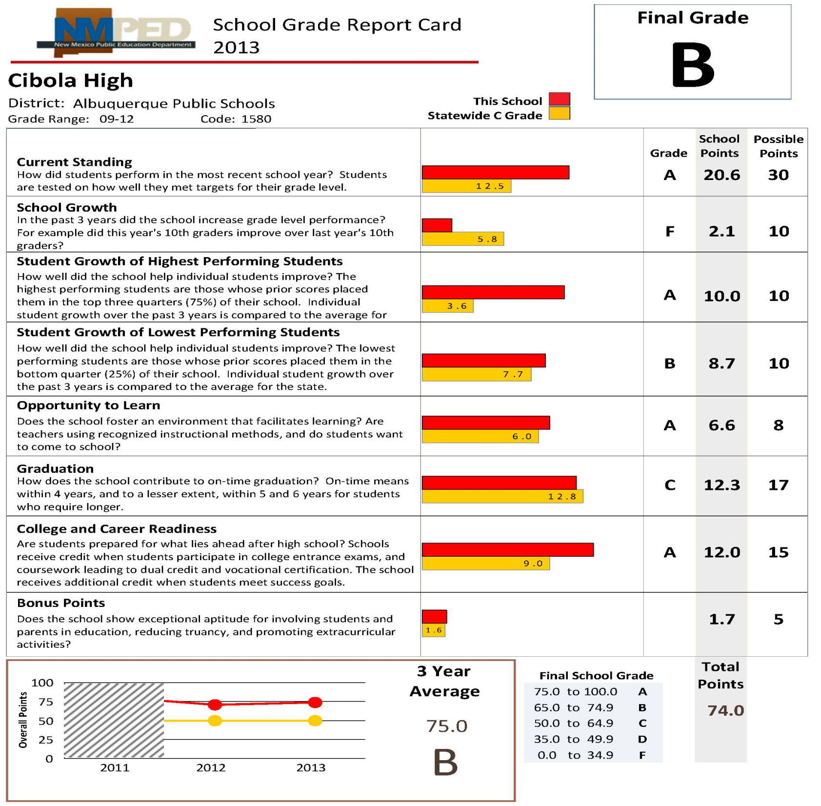

Slide 10
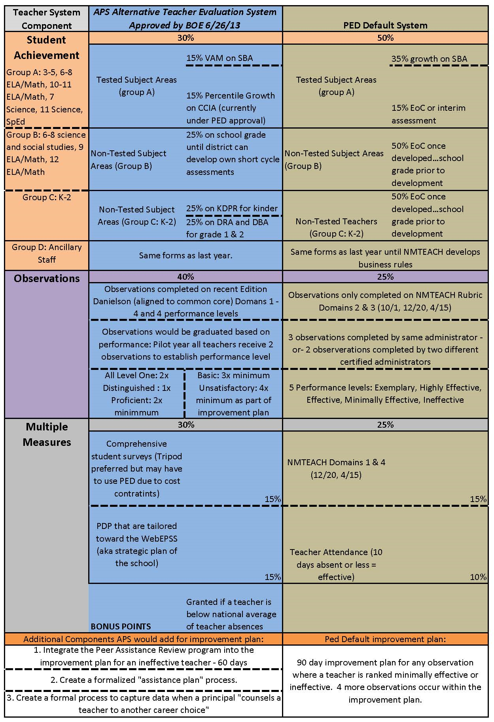

Slide 11
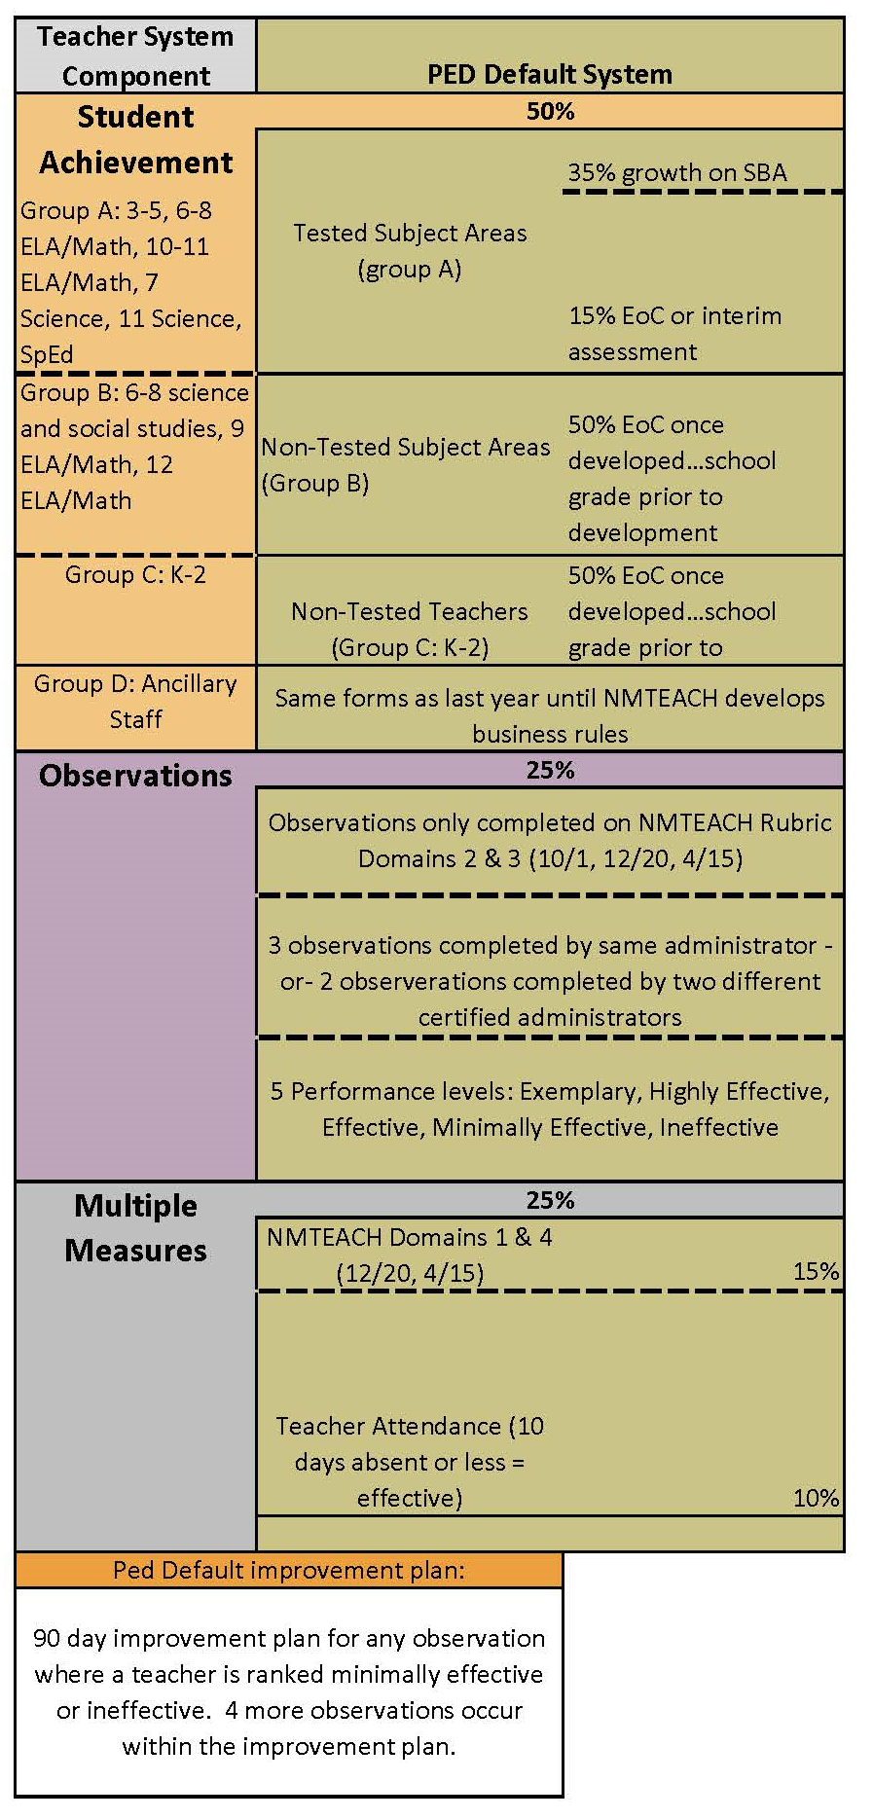

Slide 12
Teacher Categories and Student Achievement
Group A (SBA/CCIA/EOC):
All teachers grades 3-5
ELA/Math teachers grades 6-8, 10-11
Science teachers grades 7, 11
Special education teachers that teach the above categories
Group B (School Grade → EOC):
Science and Social Studies teachers grades 6-8
ELA/Math teachers grades 9, 12
All other licensed teachers not listed (electives, courses not on the SBA, etc.)
Group C (School Grade → EOC):
All teachers grades Kindergarten-2
Group D (?):
Ancillary staff (SLPs, OTs, Counselors, etc.), Instructional Coaches, Librarians
Not Clearly Defined:
Activity Directors, Athletic Directors, Resource Teachers and Interventionists, Pre-K

Slide 13
Observation Timeline
Walkthroughs: APS revamped the walkthrough form to comply with NMTEACH rubric
Formal Observations: Completed on Domains 2 & 3
Professional Practices: Completed on Domains 1 & 4
Walkthrough (informational, not evaluative)
Formal Observation 1 (Completed by October 15)
Walkthrough (informational, not evaluative)
Formal Observation 2 (Completed by December 20)
Walkthrough (informational, not evaluative)
Expectations for School Year (presented by principal)
Formal Observation 3 (Completed by April 15)
Professional Practices Submission 2 (Due by April 15)
Improvement Plans Implemented
Professional Practices Submission 1 (Due by December)
Walkthrough: 5 – 10 mins
Formal: 15 – 20 mins
2 formals may be scheduled
1 formal should be unscheduled

Slide 14
Observation Results v. Evaluation Results
We will go over observation results first because those results are what APS has control over.
We have non-documented, informal information about evaluation results from PED after the 2013-2014 school year.

Slide 15
Results of Observations will be Ranked on a Numerical Scale
Total number of points will be possible
PED will establish “cut scores” for each performance band and then give you a ranking within a performance band
Exemplary: 5.0 – 5.99
Highly Effective: 4.0 – 4.99
Effective: 3.0 – 3.99
Minimally Effective: 2.0 – 2.99
Ineffective: 1.0 – 1.99
*this scale may change based on the observation database tool

Slide 16
Ineffective or Minimally Effective from One Observation
Evaluator has to provide detailed report explaining why the teacher received the rating they did
Must provide the teacher an opportunity to respond in writing
Post-observation conference must be held within 10 calendar days of the observations
Evaluator has to provide recommendations in the post-observation conference to lay the groundwork for the improvement plan

Slide 17
APS Improvement Plans (@ this time…)
Who?
All teachers who rank ineffective or minimally effective on any one formal observation shall be placed on an improvement plan.
What?
The improvement plan is a 90-day plan.
There will be different levels of support depending on the teacher’s score.
TBD (but close):
District Intensive Evaluation: 1.0 – 1.99 (Ineffective)
District Improvement Plan: 2.0 – 2.49 (Minimally Effective)
Site Improvement Plan: 2.5 – 2.99 (Minimally Effective)
Where?
All plans will have to be documented with HR because there must be documentation in the personnel file per the PED rule.
When?
Improvement plans will start no later than October 15 because that is when the first formal observation is due.
Why?
To provide support for struggling teachers. We want teachers to improve their craft and increase achievement for all students.

Slide 18
APS Improvement Plan Progression
Site Improvement Plan
District Improvement Plan
District Intensive Evaluation
“High Range” Minimally Effective Teachers
Scores from 2.6 – 2.99
Implemented after one observation ranking of minimally effective (as early as October 15)
90-day duration – required
Teachers who score effective on future observations may exit the improvement plan entirely
Teachers who do not improve, or score worse on observations, may move to the district improvement plan
Principals will be primarily responsible for this plan
“Low Range” Minimally Effective Teachers
Scores from 2.0 – 2.5
This will be a joint effort between school principals and central administration – support may depend on number of teachers on the district intensive evaluation plan
Implemented after one observation ranking of minimally effective (as early as October 15)
90-day duration – required
Teachers who score effective on future observations may exit the improvement plan entirely
Teachers who do not improve, or score worse on observations, may move to district intensive evaluation
All Ineffective Teachers
Scores from 1.0 – 1.99
This program will most closely model the PAR program with intense central administration support
Implemented after one observation ranking of ineffective (as early as October 15)
90-day duration – required
Teachers who score minimally effective on future observations may graduate to a district or site improvement plan
Teachers who do not improve, or score worse on observations, may be subject to due process
Site Improvement Plan
District Improvement Plan
District Intensive Evaluation
*Per PED Rule, all improvement plans must be in place for 90-days, however there is little definition regarding the requirements of the plan. APS may be fluid in the 90-days, moving teachers from one level to another depending on the teacher and school needs.

Slide 19
PED Evaluation System Results
There will be a summative report card from PED for every teacher at the end of the school year which will include:
Total of all three observation results
Student achievement VAM
Multiple measures
The report card will weight each component according to the pie chart for the teacher designation
The results of that report card will place teachers in performance bands
Low performing teachers will be required to be on a state improvement plan for SY2014-2015 in addition to any district plans.
Formal guidance from PED regarding state improvement plans may change the district improvement plans – we do not know how the two will interact

Slide 20
Central Administration Support
HR: Implementation of improvement plans
CAO/Associate Superintendents: General questions and support, implementation oversight at schools
RDA: Help understanding teacher/student data, VAM and observation database tool
Policy Analyst: Specifics on the PED rule and Board of Education plan

