Slide 1
MISSION: EVALUATION
Albuquerque Public School
2013-14
Fall Professional Development
Notes:
The intent of this presentation is to not only review/remind you about elements of the new evaluation system that must be shared with your staff on August PD days, but also to serve as a template for your presentation that can be easily customized for your site while maintaining a consistent message given by all school administrators to all teachers in our system.

Slide 2
Your mission:
This system is about making you the best teacher possible.
Being a better teacher benefits not only the student, but the teacher as well.
What do you already know? Learn how Competencies align to Domains
How does this tie to CCSS instruction?
Understanding the three-part evaluation system.
What is the new teacher observation cycle?
Dig deeply into the Domains 1-4.
This new system is not optional, and is the new evaluation system for all NM teachers.
Notes:
When teachers return they will have high anxiety about the new evaluation. Here are some suggestions to help: Set the tone for your staff. Keep it positive. Reassure your staff that you will be right by their side walking them through the change. When presenting the information start with what they know: Competencies. Show how the Domains and the competencies fit together.
REMEMBER……People become afraid of things they do not understand and will resist and react negatively.
So, make this process as positive as you possibly can.

Slide 3
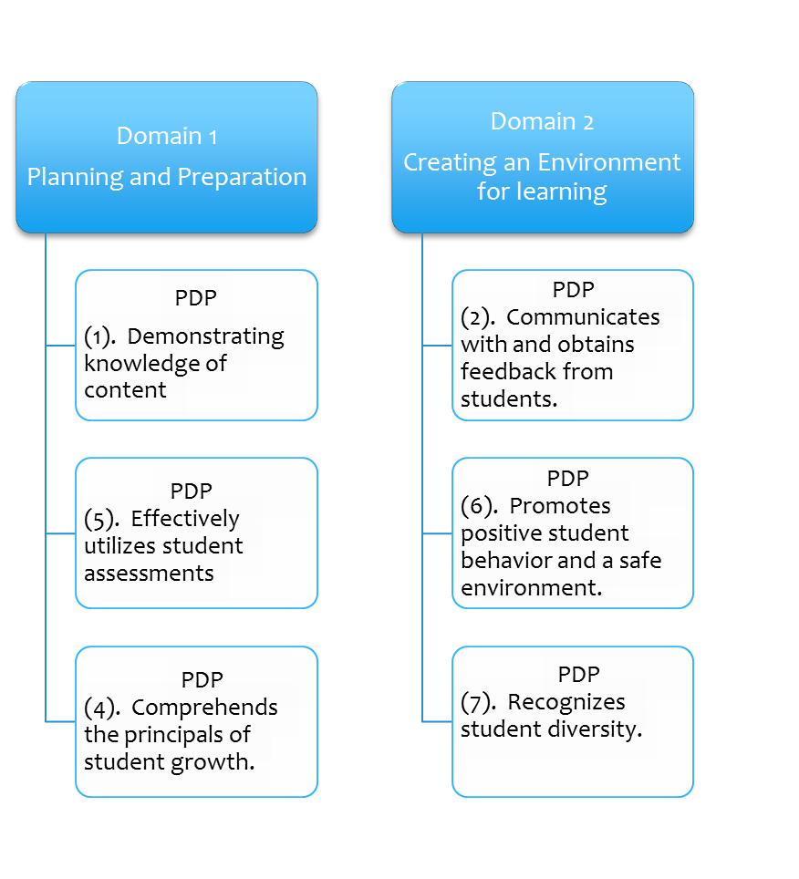
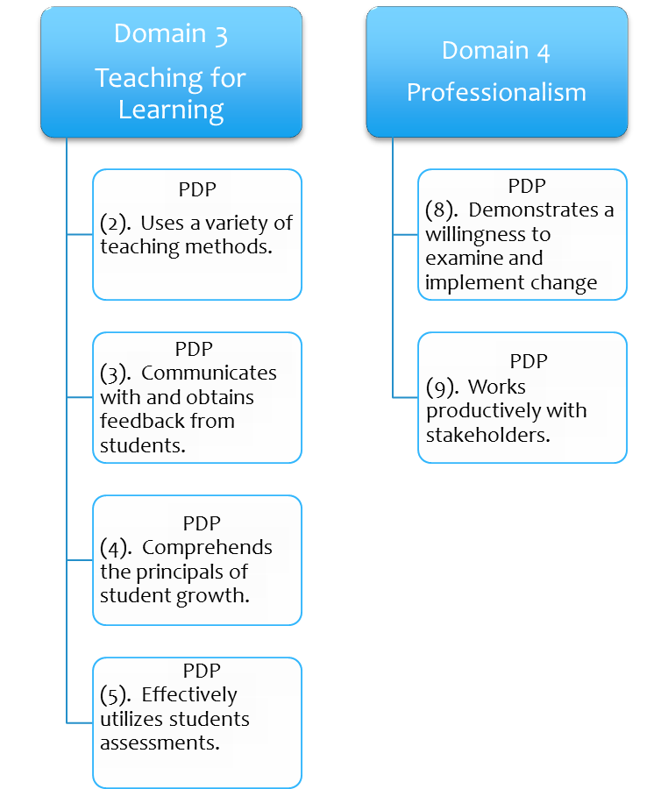
Bridging Teacher
Competencies and Domains
Notes:
We are still waiting for direction from PED regarding the PDP format. As of this date, the current PDP process is still in place. This visual will help teachers to make connections between old and new expectations. It’s important to note that competencies may fall into more than one (1) domain.

Slide 4
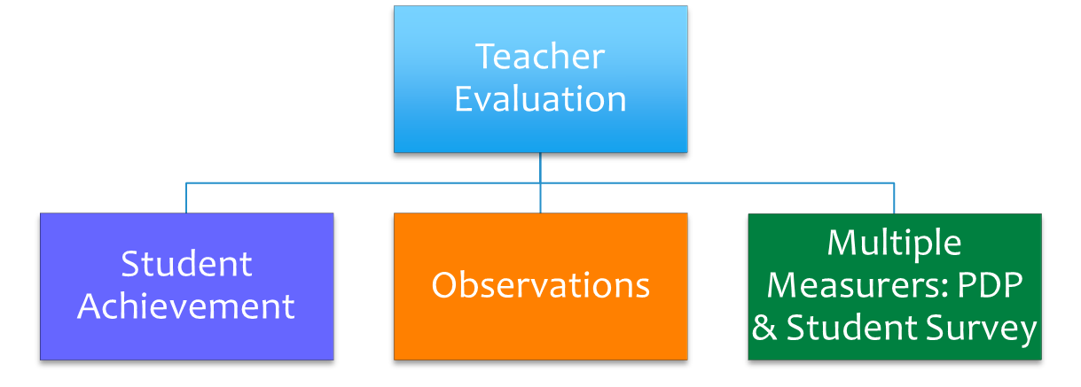
3 -Part System
3 -Part System
Notes:
The percentage weights of the system may change over time depending on what PED determines as their course for the future. Right now the question is whether or not the Multiple Measures portion will incorporate the PDP or not and to what extent the student survey will weigh in to this measure. For now, this is the weighting balance for which we should prepare.

Slide 5
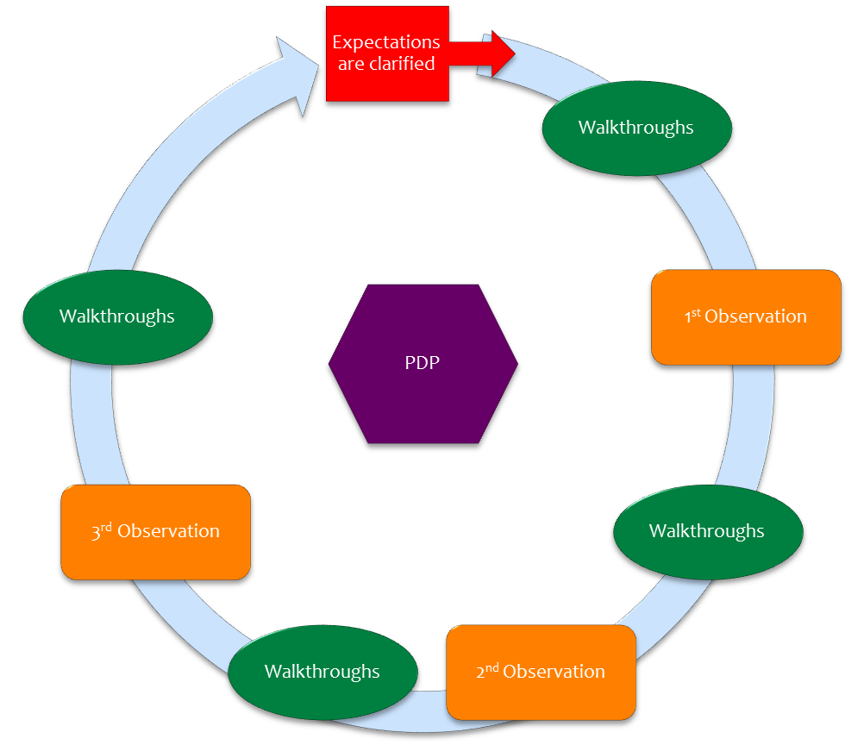
Teacher Observation Cycle
Domain 2 & 3 scored three times per year.
Domain 1 & 4 scored once per semester.
Notes:
Emphasize that Walk-Through’s are on-going and will happen more than 4 times a year but will be strategized in-between formal observations, as in the past.

Slide 6
SAMPLE PDP Aligned to NMTEACH/Danielson Domains
Notes:
Point out: The format continues to remain the same. What changes are the focus areas: Competencies vs. Domains & Elements. The action steps will be focused on the specific Domain & Element(s) the teacher chooses to develop.

Slide 7

DOMAINS 1—4
Everyone needs some support from time to time….
PLANNING AND PREPARATION
CREATING AN ENVIRONMENT FOR LEARNING
TEACHING FOR LEARNING
PROFESSIONALISM
http://ped.state.nm.us/ped/NMTeachIndex.html
Notes:
Use any of the “4 Domains 8 Ways” strategies that follow to present and facilitate discussion around a Domain, or use your own strategy as needed. Encourage teachers to be VERY familiar with the Domains and to work together and support each other as they learn this new process. Remind them that even the best can still grow and that asking for assistance is not a sign of weakness. The imbeded link will take you to the PED NMTEACH site where the current version of the Domains are housed.

Slide 8
Unwrap the Domains…
4 Domains 8 Ways……
Assignment to teachers to pre-read the Domains
Appointment Clock Strategy
Teacher Reflection Tip Sheet
Key Words Stategy
Close Reading
AVID Critical Reading Strategies
Artifact→Domain Matching
Table Talks with Jigsaw report out
Table Talks with Gallery Walk report out
Notes:
Select any number of tasks that will support the focus you wish to take in rolling out the Evaluation process to staff. The slides following the Domains are only samples of this list. Keep or delete as needed.

Slide 9

APPOINTMENT CLOCK
Create an appointment for each of the four times provided. Make sure you have a different name on each line.
Notes:
Give your staff a few minutes to find individuals for each of the 4 appointments on the clock. Encourage them to step out of their comfort zone and make appointments with people they may not know as well or who are in different grades, roles or departments. This should take about 3-4 minutes.

Slide 10
APPOINTMENT CLOCK QUESTIONS/TASKS…..
For ACE:
With your 12:00 appointment, briefly share your plans for addressing the three-part evaluation process with your staff.
Examples for your site:
With your 3:00 appointment, share one strategy you will use to ‘up’ your performance on Domain Ia.
With your 6:00 appointment, share one question you have about Domain 2d that you will take to your PLC for discussion.
With your 9:00 appointment, share one way you will fulfill Domain 4f, regarding record-keeping.
Notes:
Change questions/tasks to fulfill your own needs/expectations for PD at your site. Allow discussions to continue for about 4-5 minutes, enough time for both persons at the appointment to have a chance to speak to the question. Use the other appointments throughout the session at separate intervals. This will get the group up and moving, break up table talk and help them to refocus.

Slide 11
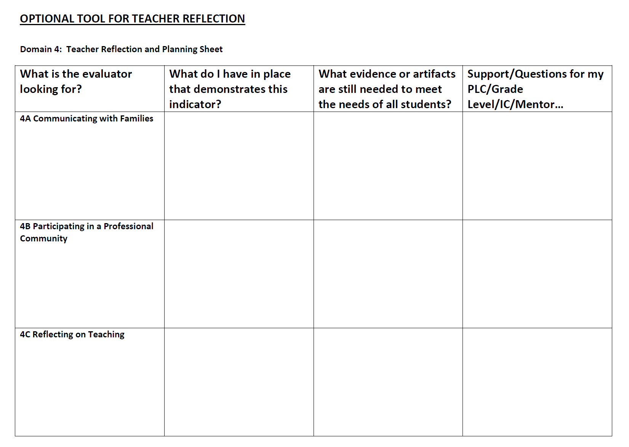

Slide 12
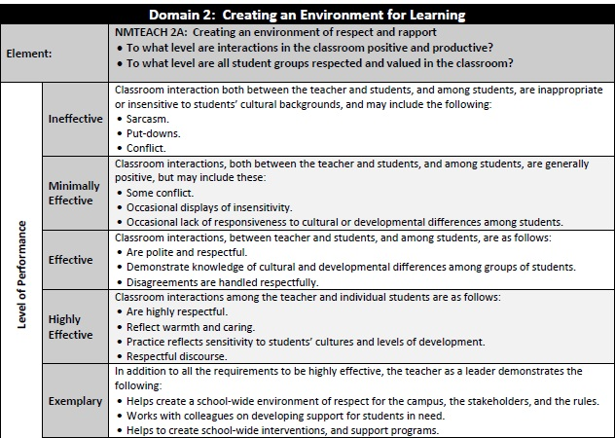
Teaching is a performance. Performances are measured using rubrics.
Notes:
12

Slide 13
Performance Levels: Key Words
Scan the language used in Domain 2 to describe each level of performance.
What “key words” would you use to characterize or describe each level?
Synthesize your thinking as a discussion pair and choose two key words that represent each level.
Notes:
Blank sheets of paper – four per group. Have them put two words on a page for each LevelOfPerf Hold up during discussion.

Slide 15
Performance Levels: Key Words
Ineffective | Minimally Effective | Effective | Highly Effective
Unsafe Negative Inappropriate Insensitive Unclear Poor Low Unsuitable None

Slide 16
Performance Levels: Key Words
Ineffective | Minimally Effective | Effective | Highly Effective
Unsafe Negative Inappropriate Insensitive Unclear Poor Low Unsuitable None | Partial Generally Attempts Awareness Effort Inconsistent Some
Levels of cognition and constructivist learning increase
Notes:
Each of the 22 standards or components have levels of performance that describe the quality of teaching.

Slide 17
Performance Levels: Key Words
Ineffective | Minimally Effective | Effective | Highly Effective
Unsafe Negative Inappropriate Insensitive Unclear Poor Low Unsuitable None | Partial Generally Attempts Awareness Effort Inconsistent Some | Safe Consistent Respectful Effective Clear High Expectations Most
Levels of cognition and constructivist learning increase

Slide 18
Performance Levels: Key Words
Teacher-directed success!
Student-directed success!
Ineffective | Minimally Effective | Effective | Highly Effective
Unsafe Negative Inappropriate Insensitive Unclear Poor Low Unsuitable None | Partial Generally Attempts Awareness Effort Inconsistent Some | Safe Consistent Respectful Effective Clear High Expectations Most | Respectful High Standards Seamless Student Lead Teacher Monitoring STUDENTS Always
Levels of cognition and constructivist learning increase

Slide 19
WHAT IS CLOSE READING?
Close Reading: Read closely to determine what the text says explicitly and to make logical inferences from it; cite specific textual evidence when writing or speaking to support conclusions drawn from the text. Thus, what “close reading” really means in practice is disciplined re-reading of inherently complex and worthy texts. The close = re-read + worthy assumption here is critical: we assume that a rich text simply cannot be understood and appreciated by a single read, no matter how skilled and motivated the reader.
The goal: Closely analyze the material and explain why details are significant. Therefore, close reading does not try to summarize the author’s main points, rather, it focuses on “picking apart” and closely looking at the what the author makes his/her argument, why is it interesting, etc. That emphasis is clear from the anchor standards in the Common Core, as noted above: the goal is to understand what the author is doing and accomplishing, and what it means; the goal is not to respond personally to what the author is doing. This does not mean, however, that we should ignore or try to bypass the reader’s responses, prior knowledge, or interests. On the contrary, reading cannot help but involve an inter-mingling of our experience and what the author says and perhaps means. But it does not follow from this fact that instruction should give equal weight to personal reactions to a text when the goal is close reading. On the contrary: we must constantly be alert to how and where our own prejudices (literally, pre-judging) may be interfering with meaning-making of the text.
Read Domain 3-- Teaching for Learning. Read the Danielson description and paraphrase each of the components (3a, 3b, 3c, 3d, and 3e) on the back of this page.
Reread 3A--Communicating with Students. Explain the teacher’s responsibility in detail to effectively communicate from the beginning of a lesson through the conclusion of the lesson. Cite specific evidence.
Notes:
All materials needed for CLOSE READING model are in your ACE DROPBOX.

Slide 20
CLOSE READING
Materials needed:
• Danielson’s 2013 Teacher Evaluation Information (can be downloaded from site— copy description, not the rubrics)
• NM Teach rubrics
• Close Reading description
• Close Reading Tool
Activity:
1. Read Domain 3 – Communicating with Students thoroughly.
2. Distribute the “tool” and review what Close Reading is and how it is important to the ELA CCSS.
3. Use the tool. (one suggestion – use all groupings to finish up – individual, small groups and whole group)
a. Have teachers individually go through the entire tool. (Important for each teacher to read all areas in detail.)
b. Using at minimum 5 groups (or 10 or 15) and assign each group one of the components/elements.
i. Have each group review the responses to thoroughly answer the question. Have each group prepare a detailed reponse to the question.
ii. Jigsaw or report out to the whole group.
Notes:
Materials for this activity are in your ACE DROPBOX.

Slide 21
CORNELL NOTES TEMPLATE
Notes:
Using the Cornell Notes template and modeling it as part of your CCSS orientation can encourage all staff at your site to use this format with students.

Slide 22
Notes:
Samples of all of the Domains using Cornell Notes, are in your ACE DROPBOX. Instructions for using this tool are also included.

Slide 23
Artifact→Domain Matching
Purpose: To begin to develop familiarity with artifacts and behaviors that will demonstrate competencies in each domain.
Preparation: Print an observation rubric summary for each table group. Print out observables and cut into strips and put strips in an envelope for each group.
Notes:
This activity helps staff to become familiar with DOMAINS and test their knowledge of each Domain and its components.

Slide 25
Artifact→Domain Matching
Activity: Divide teachers into groups. Give each group a copy of the observation rubric summary and the envelope you have prepared. Ask the groups to match each observable with the correct domain.
Extension: Ask each table group to develop one additional observable for each domain.
Notes:
This activity helps staff to become familiar with DOMAINS and test their knowledge of each Domain and its components.

Slide 26
Jigsaw
How do I do it?
In its simplest form, the Jigsaw instructional strategy is when:
1. Each participant receives a portion of the materials to be introduced;
2. Participants leave their "home" groups and meet in "expert" groups;
3. Expert groups discuss the material and brainstorm ways in which to present their understandings to the other members of their “home” group;
4. The experts return to their “home” groups to teach their portion of the materials and to learn from the other members of their “home” group
Notes:
The Jigsaw can be used with adults and students of all ages on a variety of topics. Key to the success of this strategy is to give adequate time during which participants become experts on the topic. The facilitator should maintain good proximity during discussions to assist and keep the groups on task/topic.

Slide 27
Gallery Walk
--a discussion technique for active engagement
The Gallery Walk gets participants out of their chairs and actively involves them in synthesizing important concepts, in consensus building, in writing, and in public speaking.
In Gallery Walk teams rotate around the room, composing answers to pre-determined questions as well as reflecting upon the answers given by other groups.
Questions are posted on charts or just pieces of paper located in different parts of the classroom. Each chart or "station" has its own question that relates to an important discussion concept.
The technique closes with an oral presentation or "report out" in which each group synthesizes comments to a particular question. Be sure to give the group time to independently look at all of the charts/questions and their responses.
Notes:
The Gallery Walk is one of the most familiar strategies we suggest in this presentation. Be sure to have questions written on chart paper (1 question per chart paper) prior to the start of the activity. Giving time after the ‘report out’ session for participants to view all of the charts posted in the room is critical. You will find that particpants take notes, pull out iPhones and iPads to take photo notes and share with others.

Slide 28
Tying it all together in 2013-14
Here’s What….
So What?
Now What?
Common Core Instruction
Effective Teaching
New Evaluation
Tie the new system to CCSS Instruction
PLC/Grade Level discussion on Effective Teaching
Long-term goal-setting
Reflection on progress
On-going collaboration
What does the data say?
Continues review of system, expectations and outcomes.
Staff Meetings
IC Meetings
PLC Time
Principal Forums
Grade Level Meetings
Personal planning time
Conferencing Time
Inst. Coach visits
PTA/PTO Meetings
Notes:
With your staff/leadership team/IC, determine a delivery system through which you will keep the “Here’s What” items alive and in front of your staff throughout the school year. How will you schedule time to review, revise and reflect on this issues from August through May and beyond. How might they be reflected in your EPSS?

Slide 29
CCSS Resources at SYMBALOO.COM
http://www.symbaloo.com/mix/ccssresources2

Slide 30
APS CCSS
Walk-Through Form Indicators
What will my site administrator
look for in my classroom?

