Slide 1
CCSS for Parents
An
Albuquerque Public Schools
Presentation
2013-14

Slide 2
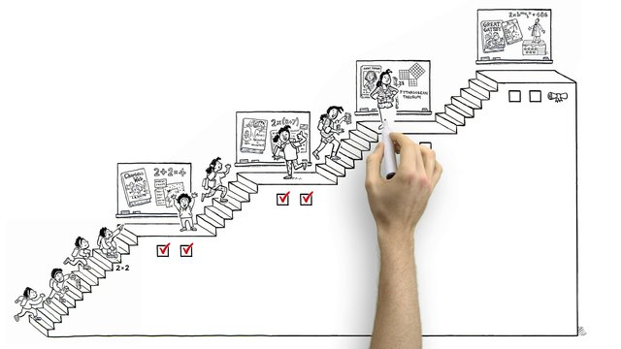
Common Core Basics
http://vimeo.com/51933492
Click on the link above
Notes:
Show the video. After the video, ask participants some or all of the following questions:
What did you learn from this video? What questions do you have about the Common Core? What excites you about the Common Core?
How do you think the Common Core might address some of your child’s needs in school?
Imagine your family has to move from one state or district to another in the middle of the school year. What challenges might this have posed for your child before the Common Core? How does the Common Core make this easier?

Slide 3
Why is this important?
In the past, standards varied from state to state
Student Mobility
Global Competition
Today’s jobs require different sets of skills

Slide 4
Why is this important?
Prepares students with the knowledge and skills they need to succeed in college and work
Ensures consistent expectations regardless of a student’s zip code
Provides educators, parents, and students with clear, focused guideposts.

Slide 5
Common Core Across The USA
Green states have adopted Common Core State Standards
Blue states have adopted only the Common Core State Standards for English Language Arts
Grey states have not adopted Common Core State Standards
Notes:
Whereas each state previously had its own set of expectations, which resulted in potentially significant differences in student learning from state to state, 46 states and DC have now adopted the Common Core State Standards. In addition, Guam, the U.S. Virgin Islands, the American Samoa Islands, and the Mariana Islands have also freely adopted the Standards.
This is not a political initiative. Each state has the authority to adopt standards. To have 46 states come together, regardless of their political affiliation, and agree on what’s best for education in America is no small feat.

Slide 6
What are the Common Core State Standards?
The Common Core State Standards set grade-by-grade learning expectations for students in grades K-12 for Mathematics and for English Language Arts and Literacy.
While states have had standards for more than 15 years, this set of standards is more focused on preparing students for success in college and career. They set clear, consistent and high learning goals.
Notes:
The Common Core State Standards set clear goals, rather than broad and vague: they are specific about what students should know and be able to do at each grade level, in each content area. Before the Common Core, it was estimated that some states’ standards could take almost 30 years to adequately teach– now, students are given the time they need to learn what’s most important for college and careers.
The Common Core State Standards are consistent: what one student learns in the 5th grade in one state is the same thing that a student learns in the 5th grade in another state. This is also true from school to school. If your child were to transfer from one school to another, the expectations and learning standards would now be the same. This does not mean how they learn will be the same, or that classroom activities will be the same – teachers and local communities will still decide on their own curriculum. But it does means that we have agreed upon learning outcomes for each grade.
The Common Core State Standards set high learning goals: they require students to go beyond the surface of a long list of topics and support in-depth study and understanding of key concepts and skills. The learning goals are intended to help students make real-world applications and to adequately prepare them for higher education and career pathways. The Standards are informed by standards in the top-performing states in the nation and from around the world. They seek to make our children global competitors.

Slide 7
It takes all of us!
Parents
Community members
Colleges and universities
Technical training programs

Slide 8
What should I expect?
More of a focus on preparing students for college and career readiness.
Notes:
The Standards allow more time to focus on what matters most! Focusing on what matters most means teachers and students are able to slow down and go in depth with their learning. Prior to the Common Core, the structure of learning concepts stretched a mile wide and an inch deep, so while students covered a lot of material, the level of knowledge about the material they covered was typically shallow. This shallow level of understanding will not prepare students for the level of success we want them to have in college or in their careers. The Standards offer an opportunity to take time for authentic learning instead of rushing through concepts.
What will this look like? In mathematics, certain topics may no longer be included. Instead, students will have time to really develop understanding and fluency with key mathematics skills and concepts. In literacy, more time to focus means students may spend a lot of time with a particular text, reading and rereading it closely to gain meaning.

Slide 9
Instructional Shifts: English Language Arts
Building knowledge through content-rich nonfiction
Reading, writing and speaking grounded in evidence from text, both literary and informational
Regular practice with complex text and its academic language
Notes:
As we think about what it takes to help students become ready for college and careers, there are major changes, or “shifts,” in the way teachers will teach. The shifts represent what the standards now expect students to learn and teachers to teach. They are the headlines that describe some of what will change.
The shifts in ELA/Literacy are as follows:
Shift 1 – The first shift focuses on the need to incorporate more nonfiction text into the curriculum. This expectation is different from what is typically taking place in classrooms, where students mostly read stories. Reading nonfiction prepares your children for reading text that can support their learning about the world around them. Nonfiction reading has historically been the type of reading that students struggle with the most, but the only way students can get better at it is to practice more, with support from their teachers. As we talk about building knowledge and incorporating more nonfiction into the curriculum, parents can expect students to see more emphasis on literacy in science, social studies, and history.
Shift 2 - As in careers and education beyond high school, students need to be able to respond to, write, and speak about information they read. This seems like a common thing to expect, but many assessments or assignments prior to CCSS did not make this a requirement. Students are often asked to write about their personal experiences and opinions without being required to ground their thoughts in evidence. Such use of evidence in reading, writing, and speaking is essential to success in nearly all pathways following K-12 education.
Shift 3 – In the research about college and career readiness that informed the development of the Common Core State Standards, it was determined that standards in literacy need to address not only the skills of literacy, but also the level of text students read. In other words, not just how students read, but what they read. Many of the students who graduate high school struggle with reading the types of texts required either in the workplace or college and training classes. To address this issue, the Standards include expectations for the complexity of texts students read in each grade; it is a staircase that reaches college and career readiness by graduation. The features of a text that make it complex include vocabulary, sentence structure, and the subject and theme of the text.

Slide 10
Key Features of the CCSS for ELA
Reading: Text complexity and growth of comprehension
Writing: Text types, responding to reading, and research
Speaking and listening: Flexible communication and collaboration
Language: Conventions (grammar), effective use, and vocabulary
Notes:
The CCSS for ELA include standards for use in ELA courses as well as literacy standards in history/social studies, science and technical subjects. The standards for ELA describe expertise that sutdnets will develop in the areas of reading, writing, speaking and listening, an language. The standards also describe how students use and strengthen these skills, particularly reading and writing, in other subjects at their grade level.

Slide 11
How can you help your child in literacy?
Ask your child specific questions about what they read.
Encourage children to read, then write and speak about, nonfiction text such as newspapers, magazines, and biographies.
Encourage children to research topics of interest and read books, stories, and/or articles that relate to a central topic.
Have your child follow step by step instructions or a set of directions in order to accomplish a task, such as building a sandcastle or operating a game.
Notes:
These are ideas for supporting students with the Common Core shifts in ELA/Literacy at home.
As students read, parents can read the same material and have conversations with their children that are focused on the text.
Give children multiple opportunities to engage in reading about things that interest them – especially informational texts (biographies, historical non-fiction, hobbies, sports, science topics, etc.) If your children are interested in games, have them read information about who invented the game, when it was invented, or have them explain step by step procedures to make their games operate in a certain manner. If they are interested in different historical figures, athletes, or science topics, encourage them to read books or articles that relate to those people.
As children inquire about different concepts or become curious about certain topics, encourage them to research their own questions by doing a web search and reading news articles or books that help them to find out new information.

Slide 12
Instructional Shifts: Mathematics
Focus: Zero in on mathematical practices and specific content within standards
Coherence: Think across grades, and link to major topics
Rigor: In major topics, pursue conceptual understanding, procedural skill and fluency, and application with equal intensity
Notes:
Focus means making room in the curriculum so that students have time to develop a foundation in the important math concepts and skills that they need to continue learning more advanced math concepts and skills. Year after year international studies demonstrate that the US is behind other high performing countries in math achievement. In those countries students focus on doing fewer things well, which supports the development of deeper understanding and greater confidence in math. This approach was integrated into the design of the CCSS. Rather than a list of topics appearing year after year, over and over again, each year the standards provide a more focused list of concepts that students experience in depth. In the past students and teachers were expected to merely cover many topics in one year, rather than spend time on really teaching and learning to mastery.
Coherence is about math making sense. In the past, students would learn one concept one week, say place value, then a totally different concept the following week, like geometry. In this process, students often got lost in their learning and were not able to make connections from one week to another, let alone from one year to the next year. When standards were not focused, teachers did not have the time to make these connections to build understanding. The CCSS are connected in a purposeful way so that students have a learning experience that bridges the concepts they learn within and across grades.
Rigor: In building mathematics proficiency there are three elements-- students need to understand the math concepts (vs. just how to get the answer), perform the procedures with fluency (speed and accuracy), and apply math to real world situations. All three elements are important in developing deep understanding, and each requires specific classroom experiences.

Slide 13
Key Features of the CCSS for Math
Standards for Mathematical Practice
Make sense of problems and persevere in solving them.
Reason abstractly and quantitatively.
Construct viable arguments and critique the reasoning of others.
Model with mathematics.
Use appropriate tools strategically.
Attend to precision.
Look for and make use of structure.
Look for and express regularity in repeated reasoning.
Notes:
The Common Core State Standards (CCSS) for mathematics include two types of standards: one for mathematical practice (how students are able to apply and extend math principles) and one for mathematical content (what students know about math). The two are linked together while students are learning.

Slide 14
How can you help your child in math?
Help children practice their addition, subtraction, multiplication and division facts.
Encourage children not to give up while solving problems, to build stamina and develop their critical thinking skills. Don’t give them the answers - ask them to think of different ways they can solve problems.
Have children illustrate the math they were thinking in their head and discuss it out loud.
Have children apply their math knowledge to a real-world scenario at home, such as doubling a recipe or calculating the area of a room.
Notes:
These are some ideas to support children at home with the Common Core shifts in math.
Working with your child on basic math facts such as addition, subtraction, multiplication, and division will help to improve student’s speed and accuracy in math. This could involve a variety of opportunities from flash cards to games including dice and cards.
Encourage your child not to give up on math problems, but finish them to completion. This will help build their stamina for solving multi-step problems that they will be required to engage in at school. Encourage children to engage in math games or test their skills with online math challenges that are timed.
Many student can get the answers to their math problems, but have a difficult time explaining their thinking behind the answer. Encouraging your child to talk the math out and show their work or thinking helps them to demonstrate their conceptual understanding of math.
Helping children to see math in action at home creates a real-world experience and application for math skills. Try measuring ingredients, measuring objects around the house, calculating the area of a room to input furniture, analyzing sports statistics, etc.

Slide 15
What does this mean for students with special needs?
Opportunity to improve access to rigorous academic content
Continued emphasis on research-based practices and effective implementation

Slide 16
How do we help students with disabilities achieve success?
Incorporate supports and accommodations designed to meet unique needs
Develop goals aligned with CCSS and chosen to facilitate learning
Deliver high quality, evidence based individualized instruction and supports
Promote culture of high expectations
Supports for learning based on principles of Universal Design for Learning

Slide 17
What does this mean for English Language Learners?
Common questions and concerns:
Q: Can ELL and bilingual students handle higher language and literacy expectations?
A: Absolutely! They can and will succeed with additional support from teachers to ensure comprehension and academic language development.
Q: For much too long, the needs of ELL and bilingual students have not been met, despite the best intentions and efforts of educators. What will be different?
A: Teachers will build upon language, cultural and experiential differences to support students in meeting the Common Core State Standard demands. Focus will be on enrichment versus remediation.
Q: What about dual language and bilingual programs?
A: Bilingual and dual language programs will follow the rigor of Common Core State Standards but the instructional shifts will take place in Spanish and English.

Slide 18
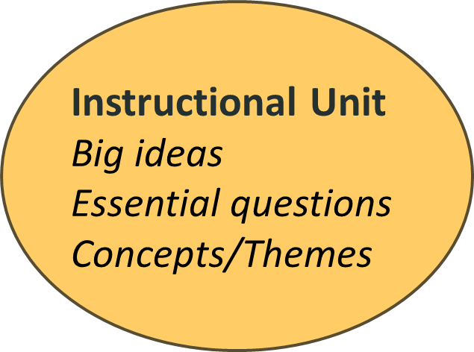
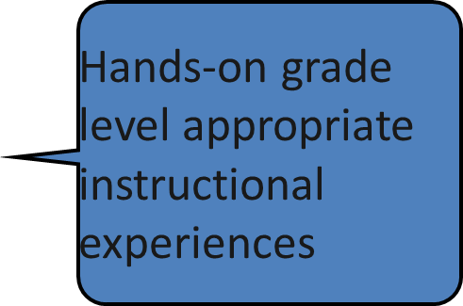
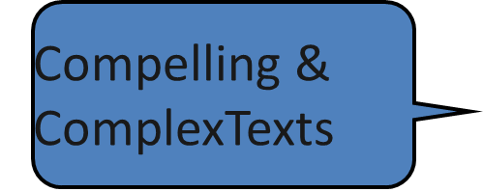
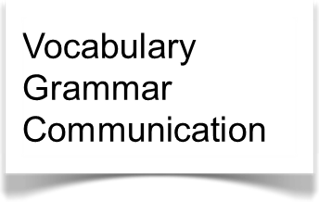
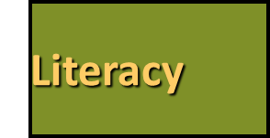
WHAT WILL THIS LOOK LIKE FOR ALL LEARNERS?

Slide 19
How will CCSS effect testing?
Partnership for Assessment of Readiness of College and Careers (PARCC) will replace the SBA by 2014.
PARCC is Common Core aligned.
PARCC will be administered totally online.
PARCC’s next-generation assessment system will provide the tools needed to identify whether students — from grade 3 through high school — are on track for postsecondary success, where gaps may exist and how they can be addressed well before students enter college or the workforce

Slide 20
Key points to talk about with teachers during conferences.
Keep the conversation focused on your child’s needs. Don’t worry about how the rest of the class is doing.
What are his/her strength and growth areas?
Ask to see your child’s data. Ask for an explanation of anything that is not clear.
Ask for one math and one reading strategy that you can use with your child at home to help your child meet instructional goals. Follow through with this at home!
Ask about upcoming tests. How does your child react during testing and how can you help them be less stressed and successful?
Notes:
Teachers should be able to show work sample, data folders, testing results that will help a parent understand how their child is doing academically. Have an idea of what that child should be doing at home to help improve performance in reading and math. If you think you will need more than your standard conference appointment time to cover these issues, plan ahead and create that time in your schedule or make a separate appointment so that all necessary topics are covered and everyone understands what needs to be done to help this child succeed.

Slide 21
RUMORS and MYTHS
To get to the truth about Common Core go to:
http://www.ascd.org/publications/educational-leadership/dec12/vol70/num04/The-Common-Core-Ate-My-Baby-and-Other-Urban-Legends.aspx
http://www.corestandards.org/resources/myths-vs-facts
Notes:
There are many myths and rumors flying in the media about the Common Core. In recent days, Common Core State Standards have been blamed for everything from promoting Communism in schools to using iris scans to track children to hurting teachers by dictating curriculum and teaching methods.
Is any of that true? No. Common Core State Standards define what students need to know at each grade level. They are simple, clear and rigorous academic expectations and do not dictate curriculum – meaning how teachers teach, how students learn and the materials used for instruction. Research shows that for decades, the education establishment has lowered academic standards in our schools. The result has been generations of Americans students not adequately prepared for college or the workforce, which has ultimately led to a decline in American competitiveness. Common Core standards challenge students to read critically, write extensively, and solve real-world math problems at greater capacity, raising the bar for all students and resulting in a more valuable education. The standards are benchmarked to high international standards to guarantee that American students are prepared to succeed in the 21st century global economy. Don’t believe everything you hear in the media. Research a bit for yourself with these resources. Additional Resources are on the next slide.

Slide 22
Additional Resources
Council of the Great City Schools Parent Roadmaps:
Math
http://www.cgcs.org//site/Default.aspx?PageID=244
ELA / Literacy
http://www.cgcs.org/Page/328
National Parent Teachers Association (PTA)
http://pta.org/parents/content.cfm?ItemNumber=2583
Achieve the Core
http://www.achievethecore.org/
Colorín Colorado: a bilingual site for families and educators of English language Learners.
http://www.colorincolorado.org
Univisión and Common Core
Especial: Estándares educativos esenciales- Univisión Vida y Familia
http://vidayfamilia.univision.com/es-el-momento/article/2012-06-20/estandares-comunes-common-core-standards
Notes:
Alert parents to the websites for math and literacy parent guides, created by the Council of the Great City Schools. These guides should be printed out and distributed to parents at the end of the meeting. Calling their attention to the website will serve as a resource for them if they need to refer back to the Roadmaps over the course of the year.
Show parents the major emphases chart for math, for their child’s specific grade level, on www.achievethecore.org.
Show parents the Common Core text exemplar site for appendix B. This might be of interest for parents who support book fairs at school and want suggestions on the types of books they might choose for their child.

